Slide 1

Chief Administrative Officer
Virtual Workshop
Shane Paul
Training Director

Slide 2

Learning Objectives
Identify your duties in code
Prepare to meet the Dec 31 deadline by initiating your privacy program report
Locate available resources and support tools
The information in this presentation is provided as a resource to assist governmental entities and does not constitute legal advice. Governmental entities should consult with their legal counsel regarding this information.

Slide 3
Authority
Chief Administrative Officer (CAO)
Requirement: Each governmental entity shall designate a chief administrative officer
Definition: The individual designated by a governmental entity to perform duties described in §63A-12-103.
Notes:
Other Definition
Records Officer
Appointed by the CAO to care, maintain, use, schedule, dispose, classify, designate, manage access to, and preserve records in accordance w/ applicable laws.

Slide 4

Accountability
Data Governance: The framework & practices that ensure personal data is collected, used, stored, & shared responsibly, legally, & securely.
It helps organizations protect individuals’ privacy & comply with data protection laws.

Slide 5
Duties 1-3
Records Program: Establish & maintain an active, continuing program for the economical & efficient management of their records;
Records Officers: Appoint one or more records officers who will be trained to work with the state archives in the care, maintenance, scheduling, disposal, classification, designation, access, & preservation of records;
Training: Ensure employees that receive or process records requests receive required training on GRAMA procedures & requirements;
Notes:
establish and maintain an active, continuing program for the economical and efficient management of the governmental entity's records as provided by this chapter and Title 63G, Chapter 2, Government Records Access and Management Act;
appoint one or more records officers who will be trained to work with the state archives in the care, maintenance, scheduling, disposal, classification, designation, access, and preservation of records;
ensure that officers and employees of the governmental entity that receive or process records requests receive required training on the procedures and requirements of this chapter and Title 63G, Chapter 2, Government Records Access and Management Act;
make and maintain adequate and proper documentation of the organization, functions, policies, decisions, procedures, and essential transactions of the governmental entity designed to furnish information to protect the privacy, transparency, legal, and financial rights of persons directly affected by the entity's activities;
submit to the state archivist proposed schedules of records for final approval by the Records Management Committee created in Section 63A-12-112;

Slide 6
Duties 4-7
4. Documentation: Make & maintain adequate & proper documentation of the organization, functions, policies, decisions, procedures, & essential transactions designed to furnish information to protect the privacy, transparency, legal & financial rights of persons directly affected by the entity’s activities;
5. Schedules: Submit to the state archivist proposed schedules for final approval;
6. Surveys: Cooperate with the state archivist in conducting surveys;
7. Compliance: Comply with rules issued by DGO (i.e. DARS procedures for collection, storage, designation, classification, access, mediation for records access, & management of records);
Notes:
establish and maintain an active, continuing program for the economical and efficient management of the governmental entity's records as provided by this chapter and Title 63G, Chapter 2, Government Records Access and Management Act;
appoint one or more records officers who will be trained to work with the state archives in the care, maintenance, scheduling, disposal, classification, designation, access, and preservation of records;
ensure that officers and employees of the governmental entity that receive or process records requests receive required training on the procedures and requirements of this chapter and Title 63G, Chapter 2, Government Records Access and Management Act;
make and maintain adequate and proper documentation of the organization, functions, policies, decisions, procedures, and essential transactions of the governmental entity designed to furnish information to protect the privacy, transparency, legal, and financial rights of persons directly affected by the entity's activities;
submit to the state archivist proposed schedules of records for final approval by the Records Management Committee created in Section 63A-12-112;

Slide 7
Duties 8-10
8. Reporting: Report to the state archives: the designation & classification of each record series they maintain & the name of their chief administrative officer; & records officers;
9. Legal Compliance: Ensure your entity is compliant with DARS requirements, GRAMA, & GDPA;
10. Non-Record Retention: Establish & report to the state archives retention schedules for objects that the governmental entity determines are not defined as a record but that have historical or evidentiary value.
Notes:
6. cooperate with the state archivist in conducting surveys made by the state archivist;
7. comply with rules issued by the Department of Government Operations as provided by Section 63A-12-104;
8. report to the state archives: (a) the designation of each record series that the governmental entity maintains; (b)the classification of each record series that the governmental entity has classified; and (c)the name of the governmental entity's: (i)chief administrative officer; and (ii)records officers;
9. ensure that the governmental entity complies with the requirements found in: (a)this part; (b)Title 63G, Chapter 2, Government Records Access and Management Act; and (c)Chapter 19, Part 4, Duties of Governmental Entities; and
10. establish and report to the state archives retention schedules for objects that the governmental entity determines are not defined as a record under Section 63G-2-103, but that has historical or evidentiary value.

Slide 8

Records Program: Maintain records management program
Records Officers: Appoint records officers
Training: Train records officers on GRAMA procedures
Documentation: Document key functions and decisions
Schedules: Submit records schedules for approval
Surveys: Cooperate in state archivist surveys
Compliance: Follow DGO/DARS records rules
Reporting: Report records data and officers to archives
Legal Compliance: Meet GRAMA, GDPA, & DARS standards
Non-Records: Schedule retention of non-record items

Slide 9
Your Responsibility
Initiate a data privacy program before December 31, 2025;
Obtain & process only the minimum amount of personal data reasonably necessary to efficiently achieve a specified purpose;
Complete a privacy program report by Dec 31, 2025 and annually thereafter
Meet the following requirements for all new processing activities implemented before May 7, 2025, as soon as is reasonably practicable, but no later than July 1, 2027:
Identify non-compliant processing
Document the issues
Prepare a strategy to fix them
Include this in the privacy report
Utah Code
Notes:
Privacy program report.
On or before December 31 of each year, the chief administrative officer of each governmental entity shall prepare a report that includes:
(a)whether the governmental entity has initiated a privacy program;
(b)a description of:
(i)any privacy practices implemented by the governmental entity;
(ii)strategies for improving the governmental entity's privacy program and practices; and
(iii)the governmental entity's high-risk processing activities;
(c)a list of the types of personal data the governmental entity currently shares, sells, or purchases;
(d)the legal basis for sharing, selling, or purchasing personal data;
(e)the category of individuals or entities:
(i)with whom the governmental entity shares personal data;
(ii)to whom the governmental entity sells personal data; or
(iii)from whom the governmental entity purchases personal data;
(f)the percentage of the governmental entity's employees that have fulfilled the data privacy training requirements described in Section 63A-19-401.2; and
(g)a description of any non-compliant processing activities identified under Subsection 63A-19-401(2)(a)(iv) and the governmental entity's strategy for bringing those activities into compliance with this part.
(2)The report described in Subsection (1):
(a)shall be considered a protected record under Section 63G-2-305; and
(b)may be made available at the request of the office.

Slide 10
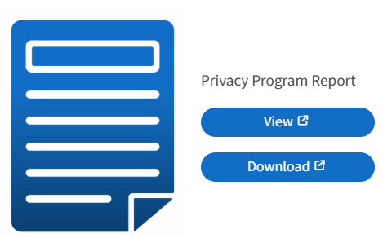
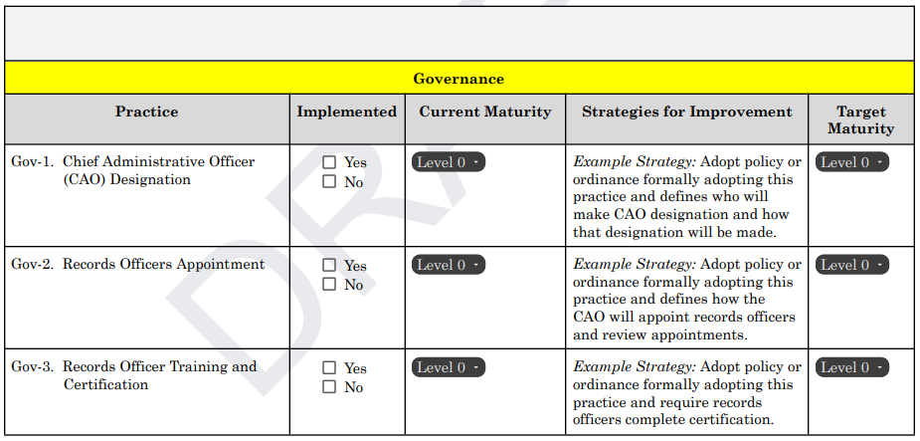
Privacy Report
Notes:
Addresses 3 of the reporting responsibilities:
Whether the governmental entity has initiated a privacy program
Description of privacy practices implemented
Strategies for improving privacy programs and practices

Slide 11
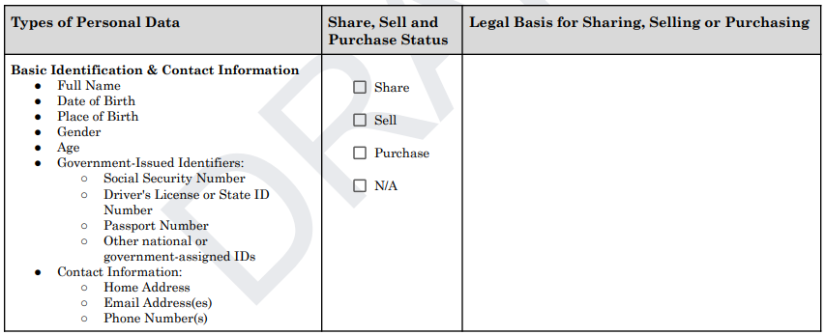
Record Status

Slide 12
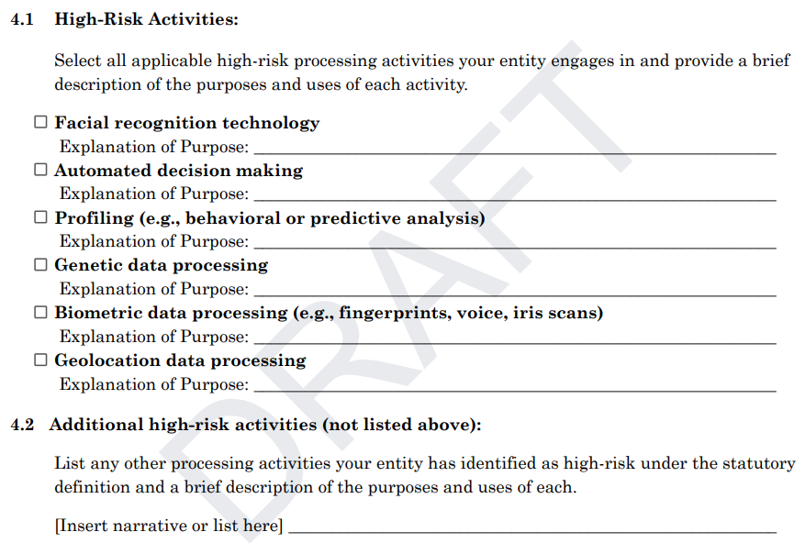
High-Risk Activities

Slide 13
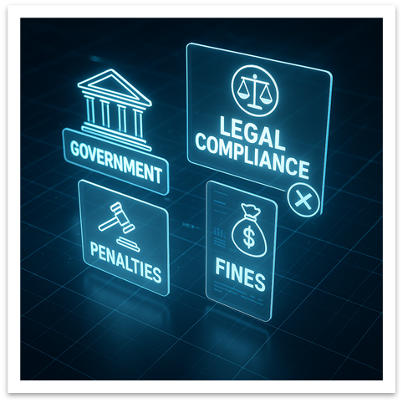
High-Risk Processing Activities
“High-risk processing activities" means a governmental entity's processing of personal data that may have a significant impact on an individual's privacy interests, based on factors that include:
the sensitivity of the personal data processed;
the amount of personal data being processed;
the individual's ability to consent to the processing of personal data; and
risks of unauthorized access or use.

Slide 14
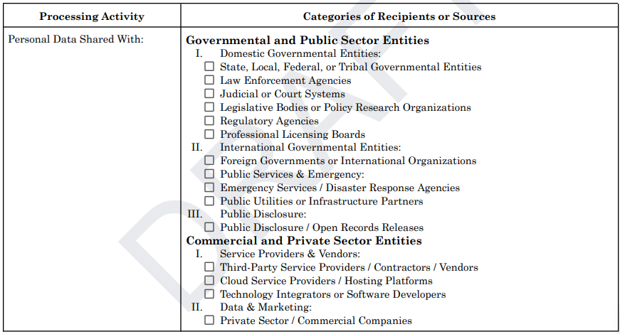
Source Categories

Slide 15
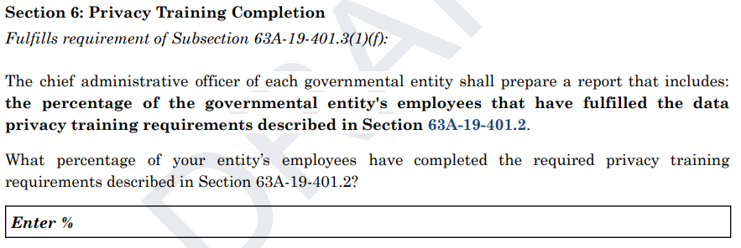
Training

Slide 16
Privacy Report Protection
Report is a protected record under §63G-2-305
Prepared within your entity
May be shared upon request by the Utah Office of Data Privacy
📌 Maintain careful documentation and control access appropriately.

Slide 17
Create and maintain a data privacy framework designed to assist governmental entities to identify and implement effective and efficient data privacy practices, tools, and systems
📌 Find a full list of our mandates here.

Slide 18
What is a privacy Framework?
A comprehensive plan for managing personal data.
Covers collection, use, storage, sharing, and protection of data.
Built on laws: GDPA, GRAMA, DARS, SPDP, HIPAA, FERPA, Others
Providing minimum compliance
Focus on incremental development and resource-based growth.
📌 Link to ODP Privacy Framework.
Notes:
Program does not mean mature.

Slide 19
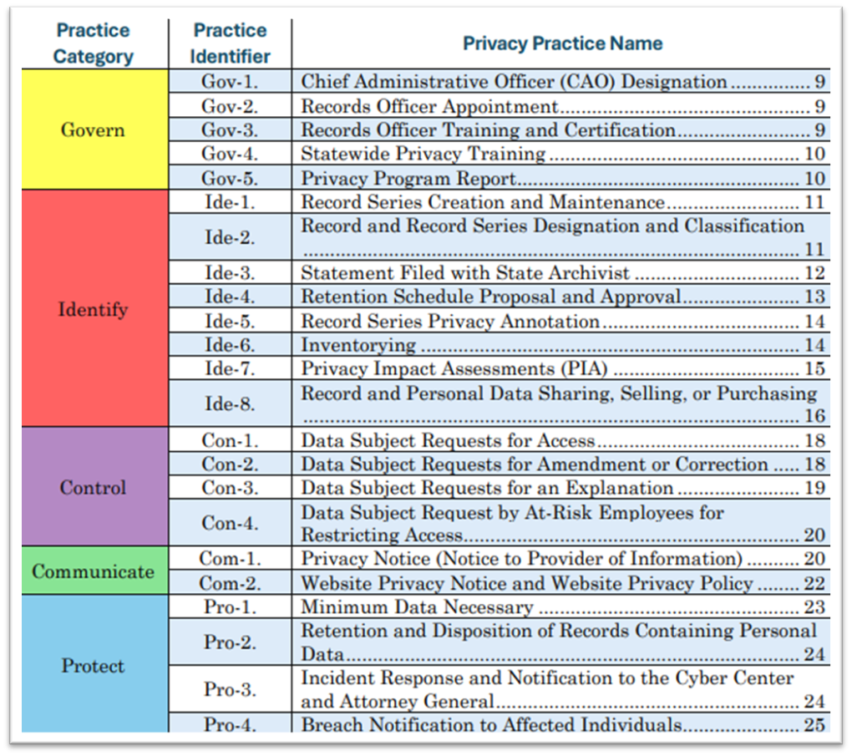
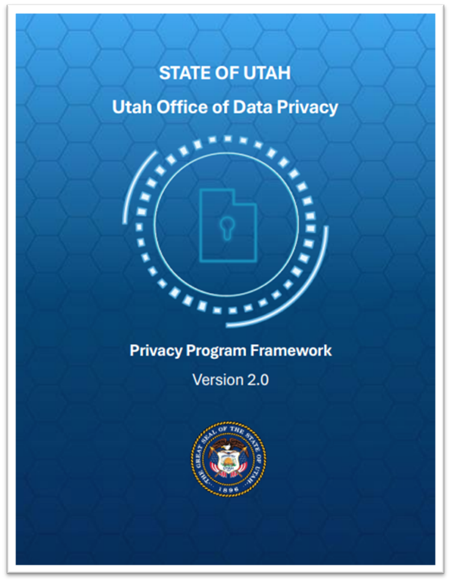
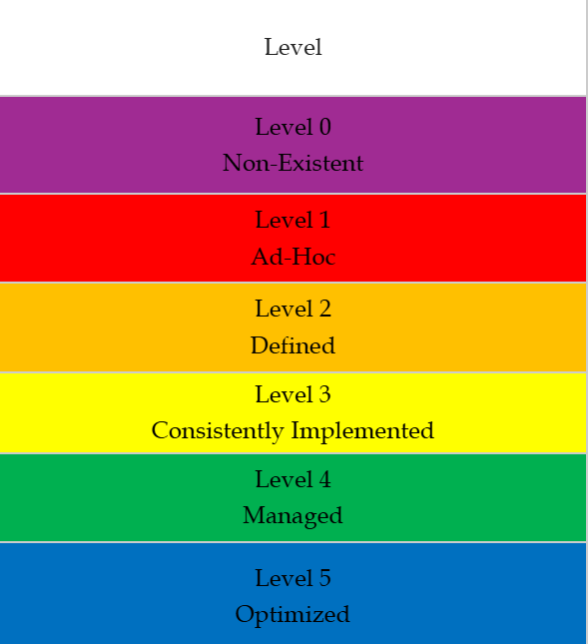

Slide 20
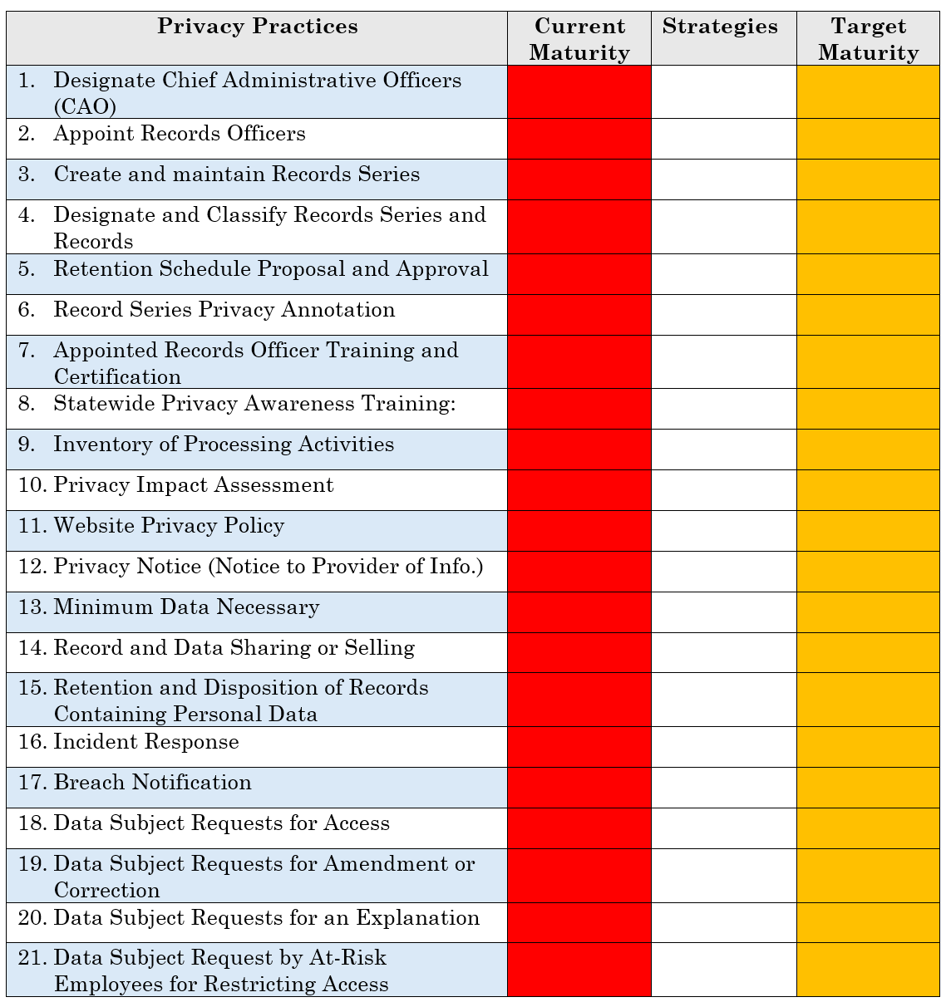
Notes:
Addresses 3 of the reporting responsibilities:
Whether the governmental entity has initiated a privacy program
Description of privacy practices implemented
Strategies for improving privacy programs and practices

Slide 21
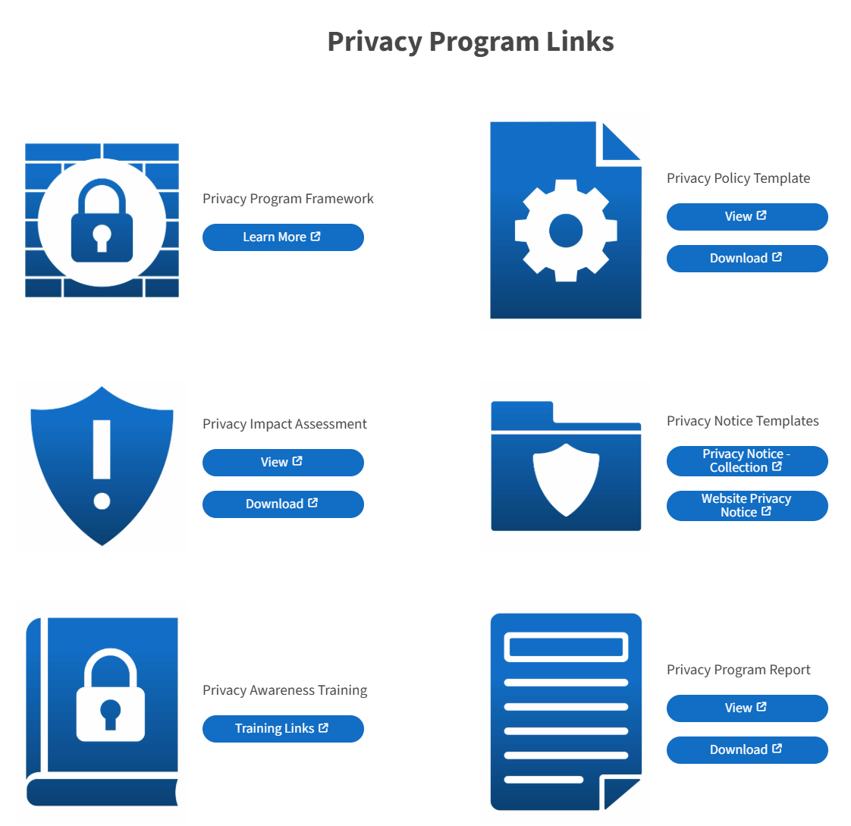
Privacy Program Tools

Slide 22
Training & Certification
GRAMA/RIM Certification
Certification Instructions
Supplemental Training - DARS YouTube
Statewide Privacy Awareness Training
CIPM Training - DM if interested
Virtual Workshops – PIA, Data Sharing, Privacy Notice/Site Scanning, GDPA Requirements
Coming Soon: Privacy Report, Incident Response
Data Governance Summit - 2025

Slide 23
Resources
Assigning & Reporting CAO
DARS CAO Resources
ODP CAO Resources
Templates: Framework, Privacy Policy, Notice of Collection, Website Notice, Breach Notification, Data Sharing Agreement, Contract T&C, PIA, Privacy Program Report - Access on privacy.utah.gov
Identify CAO with DARS
CAO Duties in Code §63A-12-103

Slide 24
Visit us at: privacy.utah.gov
Or email us at officeofdataprivacy@utah.gov

