Slide 1

RECORDS/DATA SHARING
The information in this presentation is provided as a resource to assist governmental entities and does not constitute legal advice. Governmental entities should consult with their legal counsel regarding this information.

Slide 2
GRAMA Definition
A record includes:
electronic data or other documentary material regardless of physical form or characteristics prepared, owned, received, or retained by a governmental entity
63G-2-103 (25)

Slide 3
SHARING RECORDS/DATA
This section describes how and with whom a governmental entity’s records/data may be shared.
A governmental entity may share a private, controlled, or protected records/data with:
another governmental entity
a government-managed corporation
the federal government; or
another state
63G-2-206

Slide 4
LEGAL BASIS FOR SHARING
A governmental entity may share records/data if the requesting entity:
archives records/data
enforces, litigates, or investigates the law
conducts audits
collects info for probationary or parole purposes; and
is the Legislature

Slide 5
WRITTEN ASSURANCE
A governmental entity may share records/data if the receiving entity gives written assurance the:
records/data is necessary for the receiving entity to perform their duties and functions
records/data will be used for a similar purpose to the purpose for which the information in the records/data was collected; and
use of the records/data will produce a public benefit that is greater than or equal to the privacy rights that protect the records/data

Slide 6
CONTRACTORS & PRIVATE PROVIDERS
A contractor or private provider may receive records/data from a governmental entity if the records/data:
are required to perform the contract;
will only be used for the performance of the contract;
will not be disclosed to any other person; and
will not be used for advertising or solicitation purposes.
📌 The contractor or private provider must give written assurance that it will adhere to these restrictions.

Slide 7
REQUIRED SHARING
Records/data must be shared if the requesting entity:
is entitled to inspect the records/data by law; or
is required to inspect the records/data as a condition of participating in a state or federal program or for receiving state or federal funds.

Slide 8
PREEMPTION
If a more specific court rule or order, statute, or regulation prohibits or requires sharing of records/data; that rule, order, statute, or regulation controls.
Records/data that is “exempt” may be subject to specific sharing requirements or limits on use.

Slide 9
NOTICE TO RECEIVING ENTITY
Before disclosing records/data, the originating entity must inform the receiving entity of:
the classification of the records/data; and
any restrictions on access.
A receiving entity may not disclose records/data it received under the sharing provisions in response to a GRAMA request made under Utah Code § 63G-2-204.

Slide 10
TERMS AND CONDITIONS
When sharing records/data the parties should enter into a written agreement that describes:
with whom the records/data may shared;
how the records/data may be used;
how the records/data must be secured; and
the responsibilities of each party.
The agreement should generally be signed by the head of an agency but should be shared with anyone who has access to the records/data.

Slide 11
HOW THIS RELATES TO PRIVACY
According to the NIST Privacy Framework entities should ensure:
access to data and devices is managed (PR.AC-P2 & P3);
procedures for sharing, disclosing, or transferring data are established and in place (CM.PO-P);
records of data sharing are maintained (CM.AW-P4);
third-parties, including service providers, understand their privacy roles and responsibilities (GV.PO-P & GV.MT-P); and
legal, regulatory, and contractual requirements regarding privacy are understood and managed (GV.PO-P5).

Slide 12
DATA SHARING AGREEMENTS
A DSA is an agreement between two governmental entities that outlines the terms and conditions under which records/data may be provided by the originating entity to the receiving entity.

Slide 13
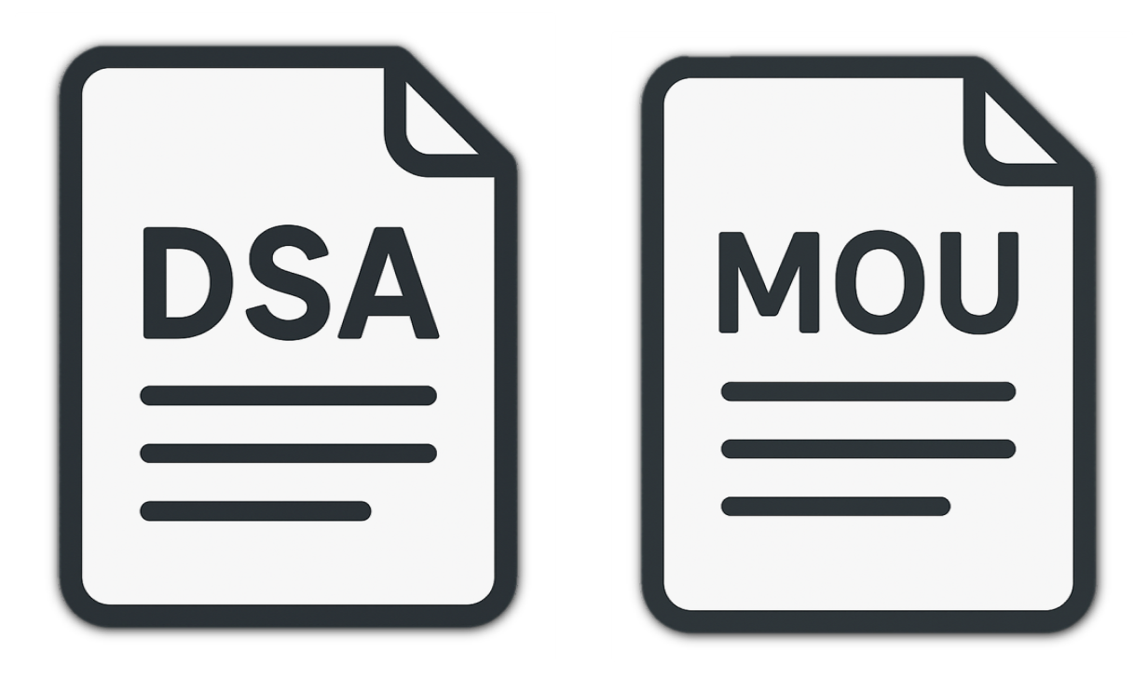
VS
A MOU is an agreement that describes how two governmental entities will work together to perform their duties and functions.
A DSA relates to sharing and managing records/data.

Slide 14
CONTRACTS
A contract is an agreement to purchase goods, services, or technology in exchange for public funds.
A contract is required any time a governmental entity expends money for goods or services.
State agencies who enter into a contract involving technology or the sharing of electronic records/data may rely on the terms and conditions included in Division of Technology Services’ Attachment B.

Slide 15
REQUIREMENTS FOR CONTRACTORS
A contractor that processes or has access to personal data must comply with the same requirements as the governmental entity.
A contract entered into or renewed between a governmental entity and a contractor after 7/1/26 must include specific language that requires the contractor to comply with the requirements of the GDPA.
63A-19-401.4

Slide 16
WHO IS A CONTRACTOR UNDER THE GDPA?
Any person who:
has entered into a contract or an agreement with a governmental entity; and
processes personal data under the contractor.
A contractor includes a contractor's employees, agents, or subcontractors.

Slide 17
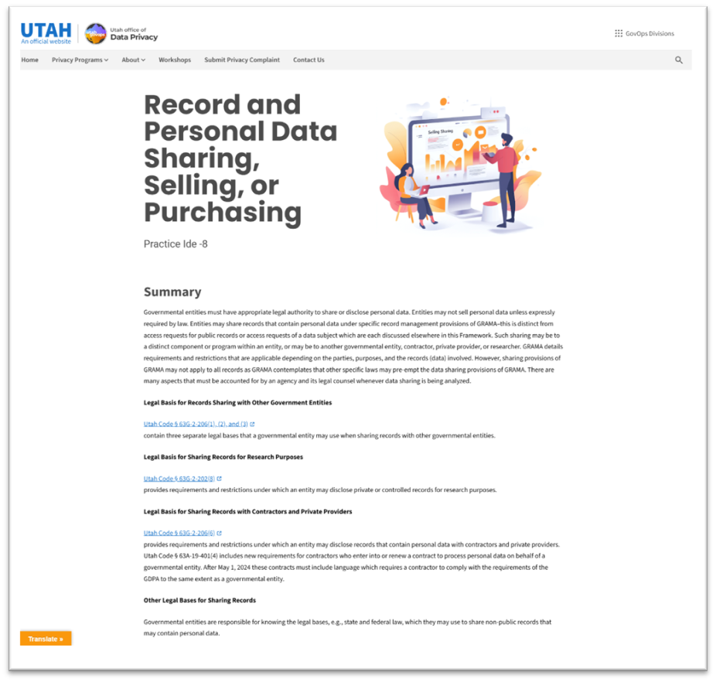
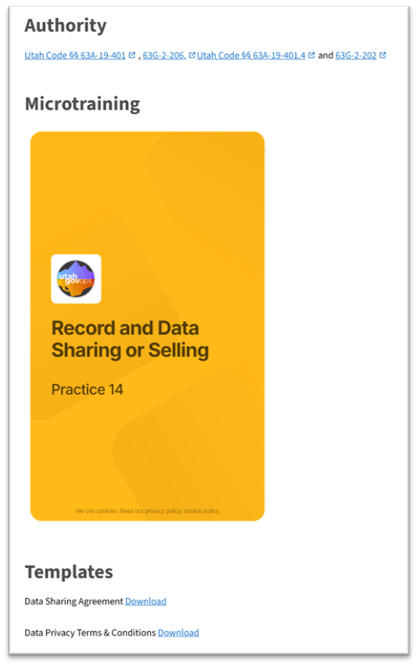
Resources
privacy.utah.gov

Slide 18
Visit us at: privacy.utah.gov
Or email us at officeofdataprivacy@utah.gov

