Slide 1

Incident Response
And Breach Notification
Office of Data Privacy
The information in this presentation is provided as a resource to assist governmental entities and does not constitute legal advice. Governmental entities should consult with their legal counsel regarding this information.

Slide 2
Learning Objectives
Definitions
Building a program
Cyber Center responsibilities
Notices
Templates

Slide 3
Definitions
How is this different from a security incident?
GDPA
"Data breach" means the unauthorized access, acquisition, disclosure, loss of access, or destruction of personal data held by a governmental entity, unless the governmental entity concludes, according to standards established by the Cyber Center, that there is a low probability that personal data has been compromised.
"Personal data" means information that is linked or can be reasonably linked to an identified individual or an identifiable individual.
GDPA
Cyber Center
Notes:
GRAMA
"Individual" means a human being
“Person” means: an individual, a nonprofit or profit corporation, a partnership, a sole proprietorship, other type of business org, or any combination acting in concert with another.
This is the current language in the bill:
"Security incident" means an event that compromises or potentially compromises the security, confidentiality, availability, or integrity of personal data or the computer systems used by a governmental entity, regardless of whether the event rises to the level
of a data breach.
Also being considered is the definition from HIPAA:
“Security incident” means the attempted or successful unauthorized access, use, disclosure, modification, or destruction of information or interference with system operations in an information system. 45 C.F.R. § 164.304

Slide 4
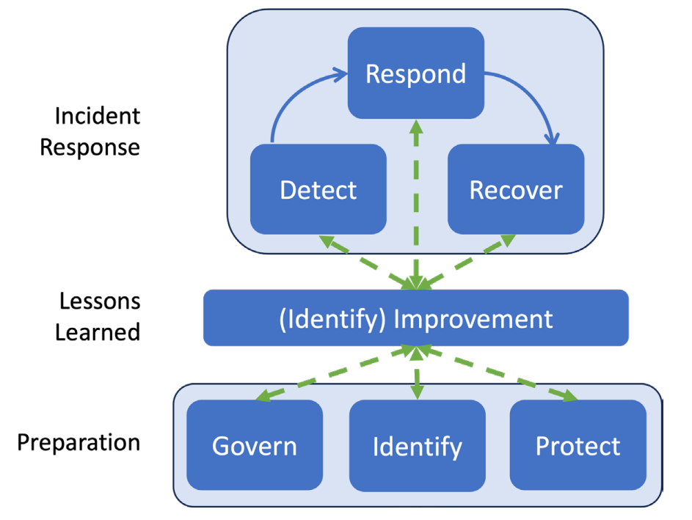
Incident Response Life Cycle Model
Notes:
The lessons learned during incident response should often be shared as soon as they are identified, not delayed until after recovery concludes. Continuous improvement is increasingly necessary for all facets of cybersecurity risk management in order to keep up with modern threats.

Slide 5
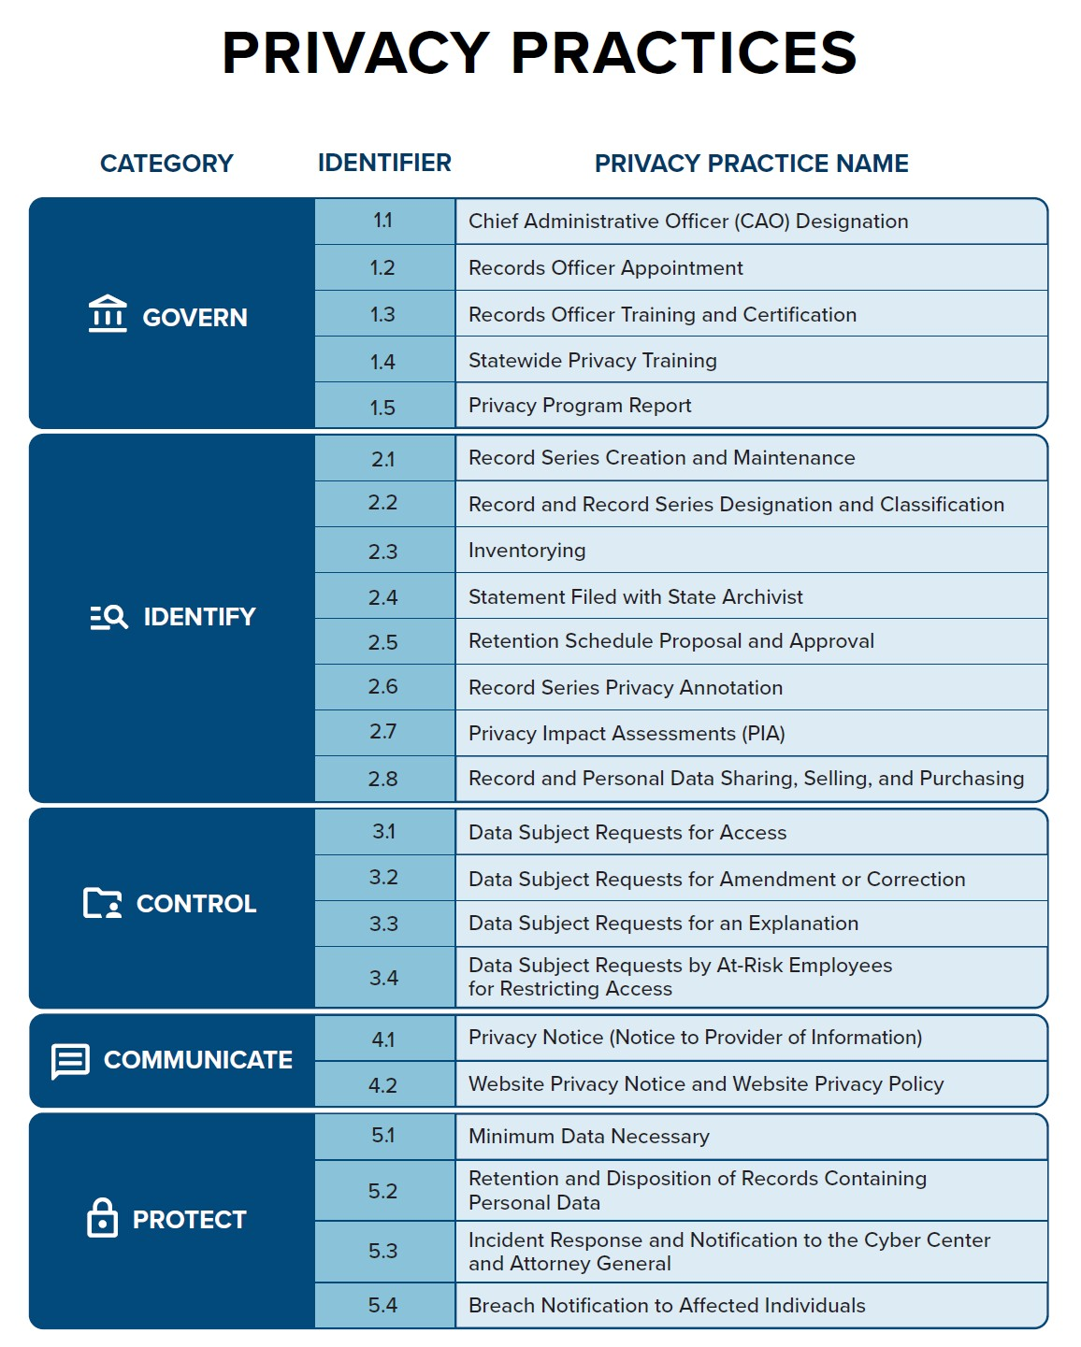

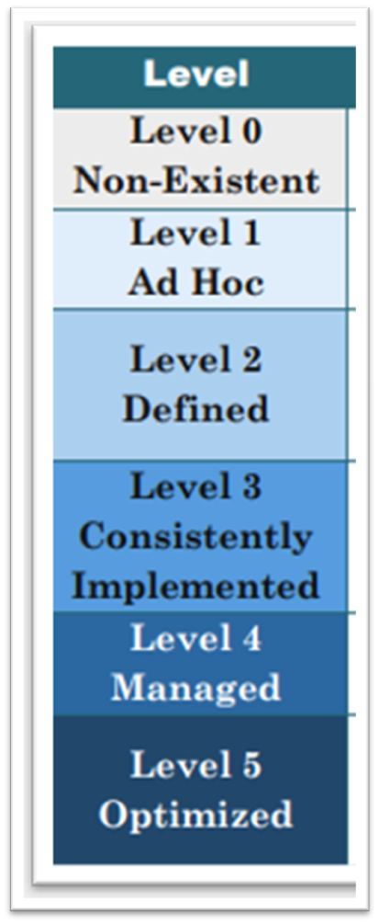

Slide 6
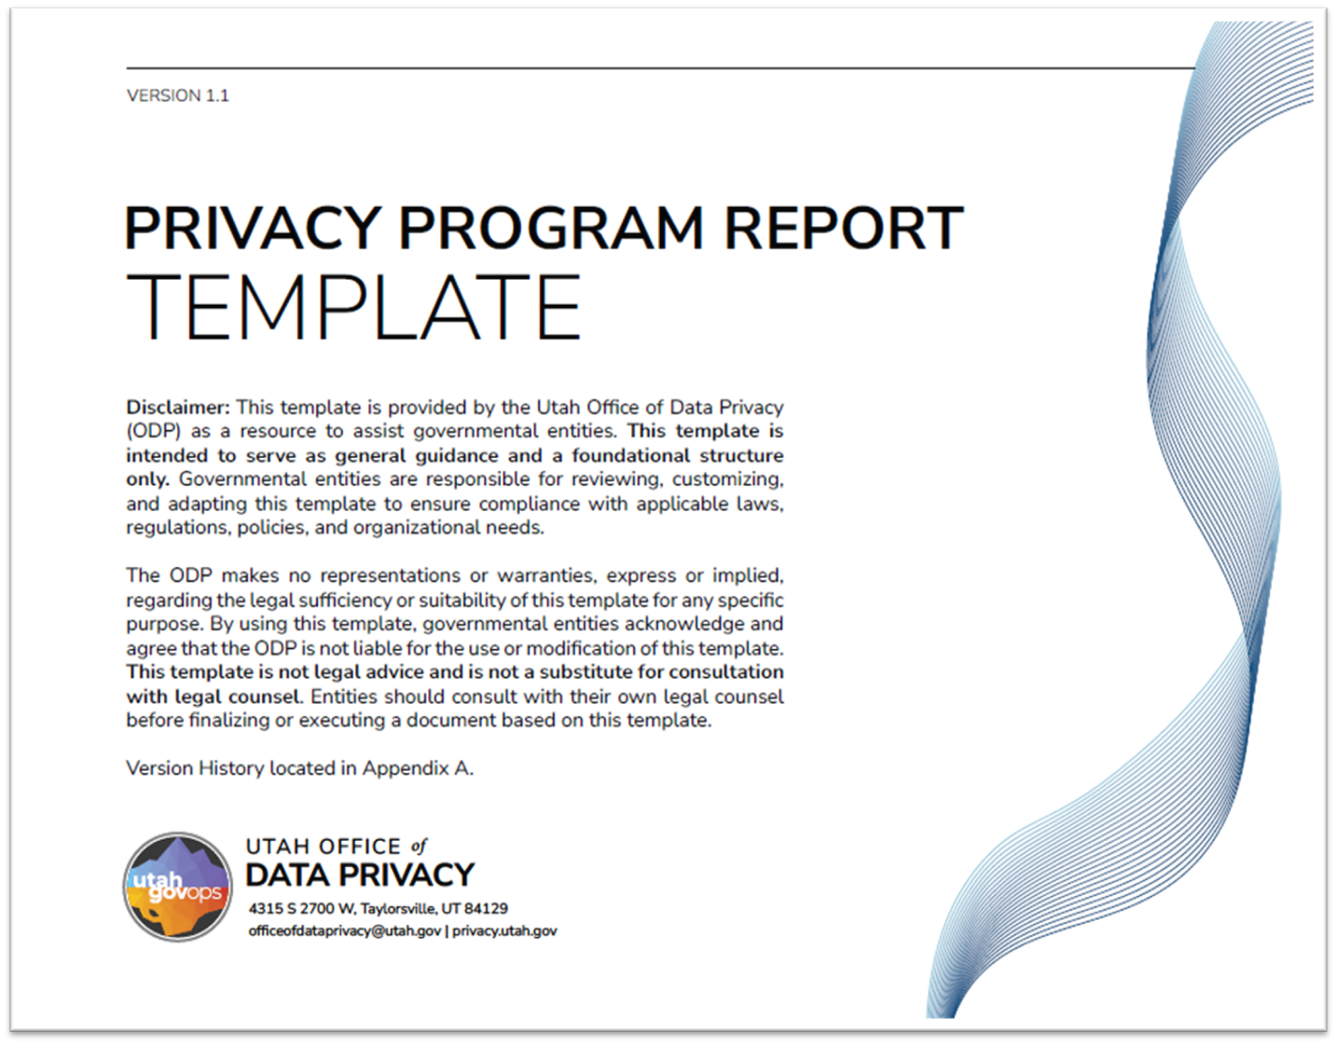
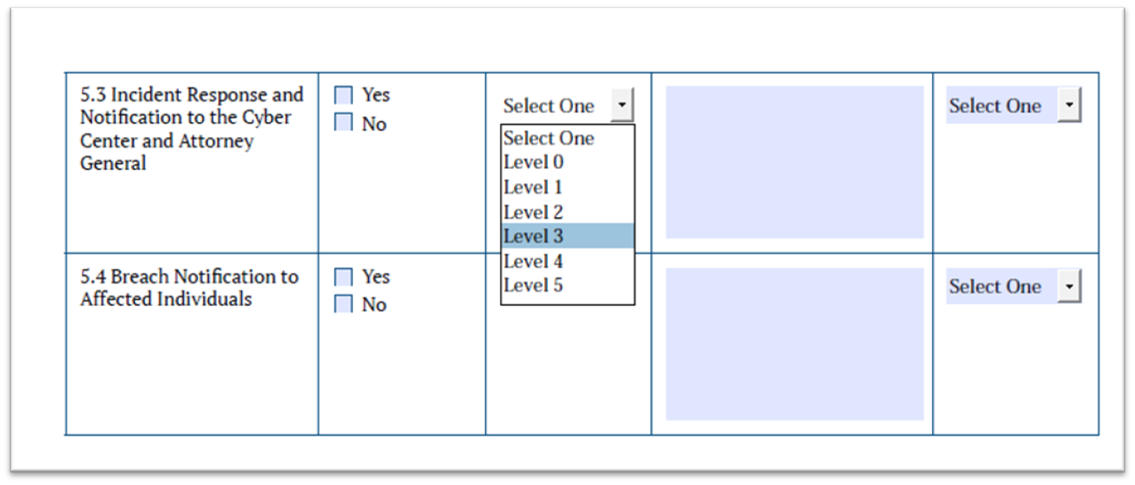
Annual Report
What level of maturity do you believe your entity has with this practice?

Slide 7

Strategies for Improvement
Formal Governance Document
Policy, rule, ordinance, or resolution that formally establishes the program.
Incident Response Team (IRT) - Defined team of personnel responsible for responding to incidents.
Roles and Responsibilities
Clear assignment of duties for team members, IT, legal, communications, management, IRT, etc.
Incident Response Templates and Forms
Standardized reporting forms, investigation templates, and documentation guides.
Secure Storage of Incident Data
Methods for safeguarding evidence, logs, and reports.
Notes:
The lessons learned during incident response should often be shared as soon as they are identified, not delayed until after recovery concludes. Continuous improvement is increasingly necessary for all facets of cybersecurity risk management in order to keep up with modern threats.

Slide 8
Strategies for Improvement
Incident Response Procedures / Playbooks
Step-by-step guides for different types of incidents (e.g. compromised system integrity, IT assets, physical data, verbal).
Detection and Monitoring Capabilities
Tools and processes to detect anomalies, intrusions, and potential breaches.
Communication Plan
Internal and external communication protocols, including notifying leadership, staff, affected parties, and the Cyber Center.
Training and Awareness
Regular staff training, simulations, and tabletop exercises to ensure readiness.
Reporting and Escalation Procedures
Defined triggers for escalation and required reporting steps.
Notes:
The lessons learned during incident response should often be shared as soon as they are identified, not delayed until after recovery concludes. Continuous improvement is increasingly necessary for all facets of cybersecurity risk management in order to keep up with modern threats.

Slide 9
Strategies for Improvement
Legal and Regulatory Compliance
Alignment with state, federal, and industry requirements for breach notification, privacy, and data security.
Post-Incident Review / Lessons Learned
Conducting root cause analysis, documenting findings, and updating processes based on lessons learned.
Metrics and Continuous Improvement
Tracking KPIs (e.g., time to detect, time to contain) and regularly updating the program.
Third-Party Coordination
Processes for involving external vendors, incident response partners, or law enforcement if needed (Check your contract T&C).

Slide 10

Reporting Obligations
Data breach notification to the Cyber Center and the Office of the Attorney General.
A governmental entity that identifies a data breach affecting 500 or more individuals shall notify the Cyber Center and the attorney general of the data breach.
In addition to the notification required by Subsection (1)(a), a governmental entity that identifies the unauthorized access, acquisition, disclosure, loss of access, or destruction of data that compromises the security, confidentiality, availability, or integrity of the computer systems used or information maintained by the governmental entity shall notify the Cyber Center.
63A-19-405

Slide 11
What’s in the notification?
the date and time the data breach occurred;
the date the data breach was discovered;
a short description of the data breach that occurred;
the means by which access was gained to the system, computer, or network;
the person who perpetrated the data breach;
steps the governmental entity is or has taken to mitigate the impact of the data breach; and
any other details requested by the Cyber Center.
If the breach affects 500 or more, also include:
the total number of individuals affected by the data breach, including the total number of Utah residents affected; and
the type of personal data involved in the data breach.

Slide 12

Timeline
made without unreasonable delay, but no later than five days from the discovery of the data breach;
If the information required by Subsections (2)(b) and (3) is not available within five days of discovering the breach, the governmental entity shall provide as much of the information required under Subsections (2)(b) and (3) as is available and supplement the notification with additional information as soon as the information becomes available.

Slide 13
Internal Report
A governmental entity that experiences a data breach affecting fewer than 500 individuals shall create an internal incident report containing the information in Subsection (2)(b) as soon as practicable and shall provide additional information as the information becomes available.
A governmental entity shall provide to the Cyber Center:
an internal incident report described in Subsection (5)(a) upon request of the Cyber Center; and
an annual report logging all of the governmental entity's data breach incidents affecting fewer than 500 individuals.
📌 Information provided to, or produced by the Utah Cyber Center is deemed confidential

Slide 14
Additional Reporting Requirements
Depending on the type of data involved in the breach, you may be subject to additional reporting requirements. Please use the links below to find out more information about the different types of data.
• Personal Health Information (HIPAA) • Federal Tax Information (FTI) • Criminal Justice Information (CJIS) • Payment Card Information (PCI-DSS)

Slide 15
Cyber Center Support
conducting all or part of an internal investigation into the data breach;
assisting law enforcement with the law enforcement investigation if needed;
determining the scope of the data breach;
assisting the governmental entity in restoring the reasonable integrity of the system; or
providing any other assistance in response to the reported data breach.
63A-16-1103

Slide 16
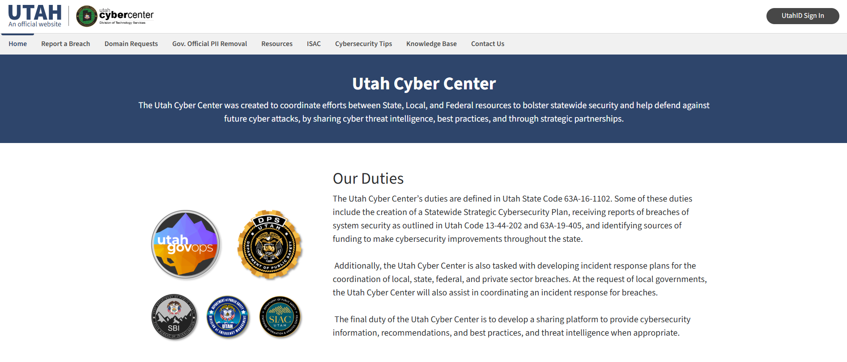

How to Report
📌 An organization which completes this form automatically provides notification to these two entities.

Slide 17
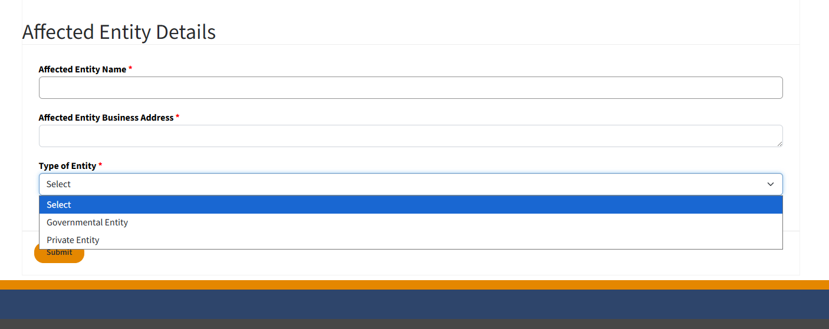

Slide 18
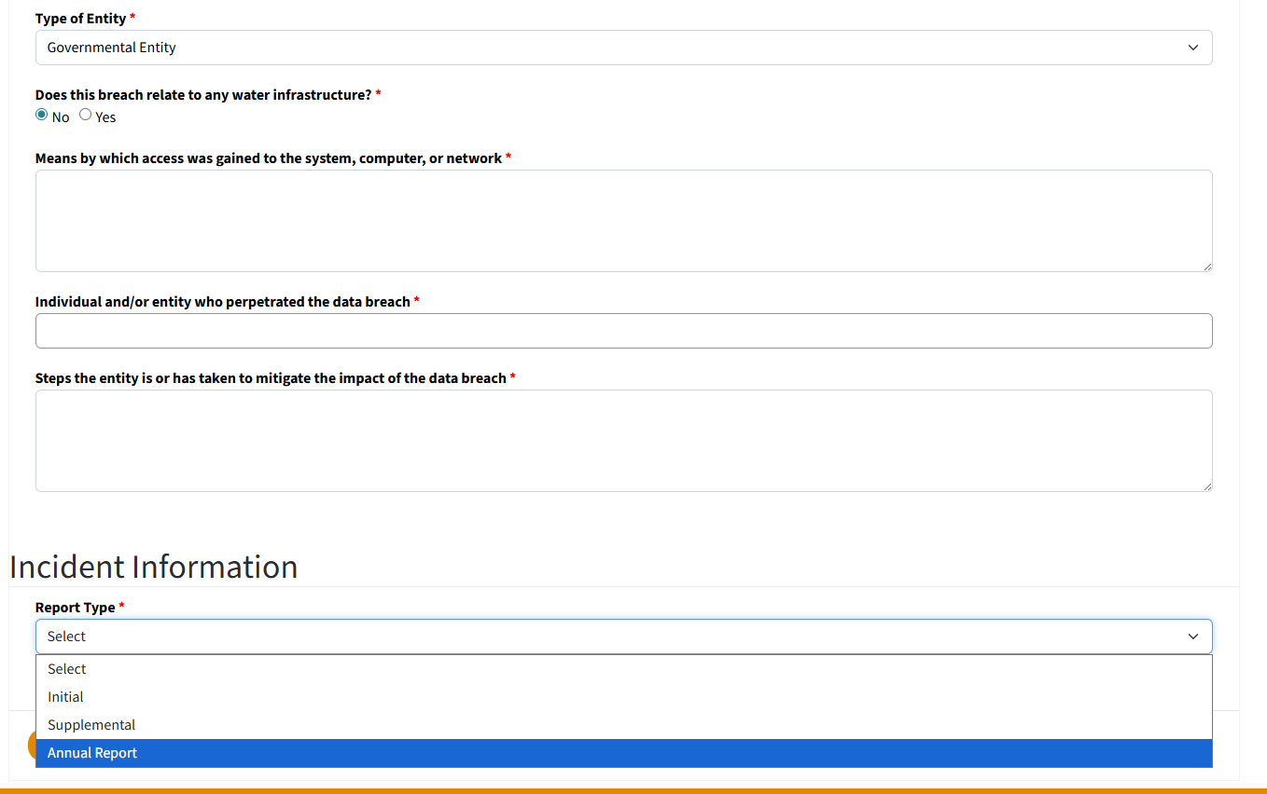
Notification sent to DEQ

Slide 19
Notice Requirement
Agencies are required to provide notice to an individual or the legal guardian of an individual, if the individual’s personal data is affected by a data breach in accordance with Utah Code § 63A-19-406.
State agencies that are currently subject to breach notification requirements, such as those required for compliance with federal regulations, laws or other governing requirements (HIPAA, 42 CFR Part 2, PCI, etc..) are currently required to create and maintain their own agency specific breach notification policies and procedures that meet the requirements of the applicable regulations.
63A-19-406

Slide 20

Notice Exception
A governmental entity is not required to provide a data breach notice to an affected individual as described in Subsection (1)(a) if the:
(i) personal data involved in the data breach would be classified as a public record under Section 63G-2-301; and
(ii) the governmental entity prominently posts notice of the data breach on the homepage of the governmental entity's government website.
63A-19-406

Slide 21
What’s in the notice?
(3) The data breach notice to an affected individual shall include:
(a) a description of the data breach;
(b) the individual's personal data that was accessed or may have been accessed;
(c) steps the governmental entity is taking or has taken to mitigate the impact of the data breach;
(d) recommendations to the individual on how to protect themselves from identity theft and other financial losses; and
(e) any other language required by the Cyber Center.
63A-19-406(3)

Slide 22
When is the notice sent?
(1) A governmental entity shall provide a data breach notice to an individual or legal guardian of an individual affected by the data breach:
(a) after determining the scope of the data breach;
(b) after restoring the reasonable integrity of the affected system, if necessary; and
(c) without unreasonable delay except as provided in Subsection (1)(b).
(2) A governmental entity shall delay providing notification under Subsection (1) at the request of a law enforcement agency that determines that notification may impede a criminal investigation, until such time as the law enforcement agency informs the governmental entity that notification will no longer impede the criminal investigation.
63A-19-406(1)&(2)

Slide 23
How is the notice sent?
(4) Unless the governmental entity reasonably believes that providing notification would pose a threat to the safety of an individual, or unless an individual has designated to the governmental entity a preferred method of communication, a governmental entity shall provide notice by:
(a)(i) email, if reasonably available and allowed by law; or
(ii) mail; and
(b) one of the following methods, if the individual's contact information is reasonably available and the method is allowed by law:
(i) text message with a summary of the data breach notice and instructions for accessing the full notice; or
(ii) telephone message with a summary of the data breach notice and instructions for accessing the full data breach notice.
(5) A governmental entity shall also provide a data breach notice in a manner that is reasonably calculated to have the best chance of being received by the affected individual or the legal guardian of an individual, such as through a press release, posting on appropriate social media accounts, or publishing notice in a newspaper of general circulation when:
(a) a data breach affects more than 500 individuals; and
(b) a governmental entity is unable to obtain an individual's contact information to provide notice for any method listed in Subsection (4).
63A-19-406(4)&(5)

Slide 24
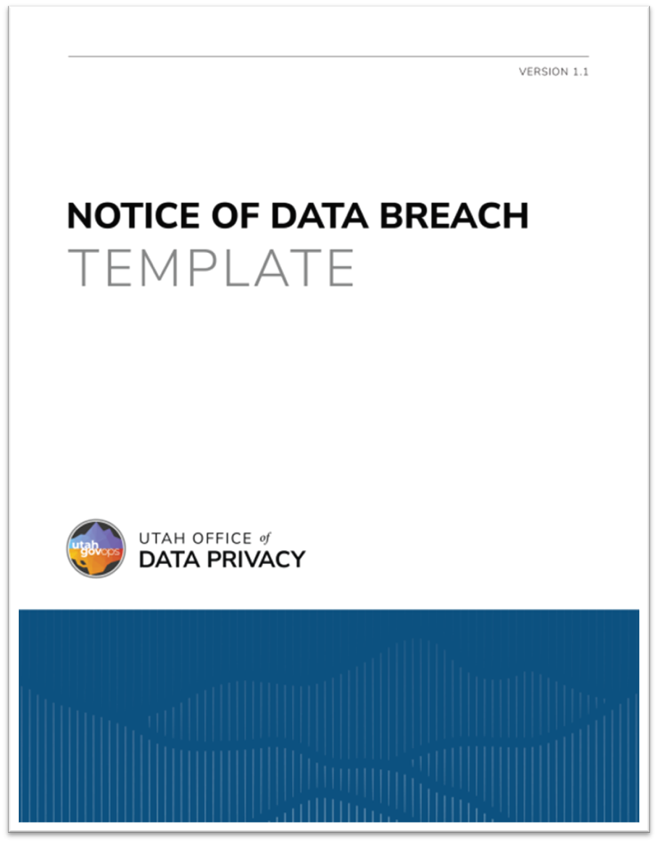
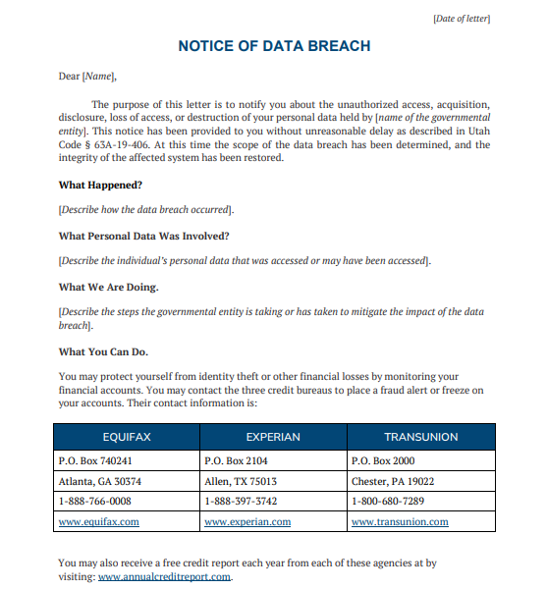
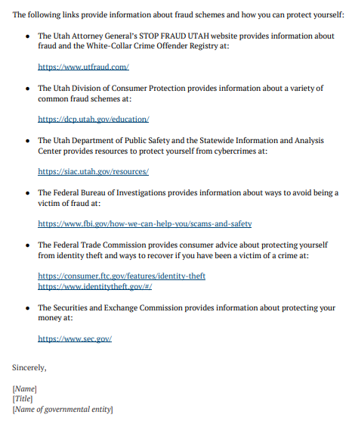
Notice Template

Slide 25
Templates
Incident Report (coming soon)
Attestation of Destroyed Data (coming soon)
Incident Response Team Report (coming soon)
Incident Response Policy (located in Privacy Policy Template)
Cyber Security Incident Response Plan Procedure
Notes:
A governmental entity must provide conclusive
evidence, backed by data such as a forensic review or
report and a packet capture of network traffic, to
prove that data was not accessed or exfiltrated.

Slide 26
Scenarios
Personal data is emailed to an unintended recipient.
A file containing personal information is left in a public or unsecured location.
Following an individual’s death, relatives discover a box of old work files containing personal information and deliver it to an office.
During a website review, you discover a third-party cookie has been collecting data for an unknown period of time.
An incorrect file containing personal information is shared with another governmental entity.
Notes:
A governmental entity must provide conclusive
evidence, backed by data such as a forensic review or
report and a packet capture of network traffic, to
prove that data was not accessed or exfiltrated.

Slide 27
Visit us at: privacy.utah.gov
Or email us at officeofdataprivacy@utah.gov

