Slide 1

Privacy Impact Assessments
Proactively Managing Privacy Risk

Slide 2

Learning Objectives
Define what a PIA is and articulate its purpose
Recognize the requirements mandating PIAs for state IT systems and applications
Outline the PIA process
Apply key retention, roles and mitigation requirements
Locate resources for ongoing support
The information in this presentation is provided as a resource to assist governmental entities and does not constitute legal advice. Governmental entities should consult with their legal counsel regarding this information.

Slide 3
Legal Authority
Definition: An analysis of how personally identifiable information is processed… helps identify, evaluate, and mitigate privacy risks
Utah Code 63A-12-103
Legal Authority: 63A-12-103 are general duties requiring privacy risk assessments and R895-8 requires a PIA (or privacy risk assessment) for systems processing personal data
Utah Admin R895-8
Policy Mandate: DTS Info Security Policy 5000-0002 makes PIA a mandatory document for all IT systems processing personal data, across all Utah State agencies
Notes:
Privacy program report.
On or before December 31 of each year, the chief administrative officer of each governmental entity shall prepare a report that includes:
(a)whether the governmental entity has initiated a privacy program;
(b)a description of:
(i)any privacy practices implemented by the governmental entity;
(ii)strategies for improving the governmental entity's privacy program and practices; and
(iii)the governmental entity's high-risk processing activities;
(c)a list of the types of personal data the governmental entity currently shares, sells, or purchases;
(d)the legal basis for sharing, selling, or purchasing personal data;
(e)the category of individuals or entities:
(i)with whom the governmental entity shares personal data;
(ii)to whom the governmental entity sells personal data; or
(iii)from whom the governmental entity purchases personal data;
(f)the percentage of the governmental entity's employees that have fulfilled the data privacy training requirements described in Section 63A-19-401.2; and
(g)a description of any non-compliant processing activities identified under Subsection 63A-19-401(2)(a)(iv) and the governmental entity's strategy for bringing those activities into compliance with this part.
(2)The report described in Subsection (1):
(a)shall be considered a protected record under Section 63G-2-305; and
(b)may be made available at the request of the office.

Slide 4
Purpose & Template
Why conduct a PIA To ensure legal compliance (GDPA and rules), purpose specification, risk anticipation, and mitigation before system deployment.
Template Version 1.1 Official and required version, incorporating updated legal and best-practices alignment

Slide 5
Key Sections
General Information
Entity, CAO, data/system inventories, legal authority
Screening Questions
Is it new or modified? Does it process personal data?
Risk Identification & Safeguards
Privacy risks < mitigation actions
Operationalization & Approval
Dates and roles for approval and safeguards
Documentation Artifacts
Flow diagrams, data schemas to support analysis

Slide 6
Scenario Application
Scenario 1: Launching an AI-enabled citizen portal collecting sensitive personal data.
Determine if PIA is required (yes)
Identify risks: sensitive data misuse, bias, data retention
Propose safeguards: limited data collection, encryption, access controls, bias audits
Scenario 2: Modifying a legacy system for email notifications
Does it process personal data? If yes < PIA or modification relative to existing one.
Identify minimal risk, propose minor safeguards (email opt-in, retention controls).

Slide 7
Retention & Accountability
Retention: Completed PIA’s must be retained for at least 4 years or as long as processing continues, whichever is longer
Roles:
CAO: Responsible for accuracy and attestation
Records Officer (ARO): Supports records aspects, appointed by CAO
CIO & CPO: CIO approves template, CPO offers guidance and oversight
Documentation: PIA’s, plus artifacts, help demonstrate compliance during audits and reviews

Slide 8
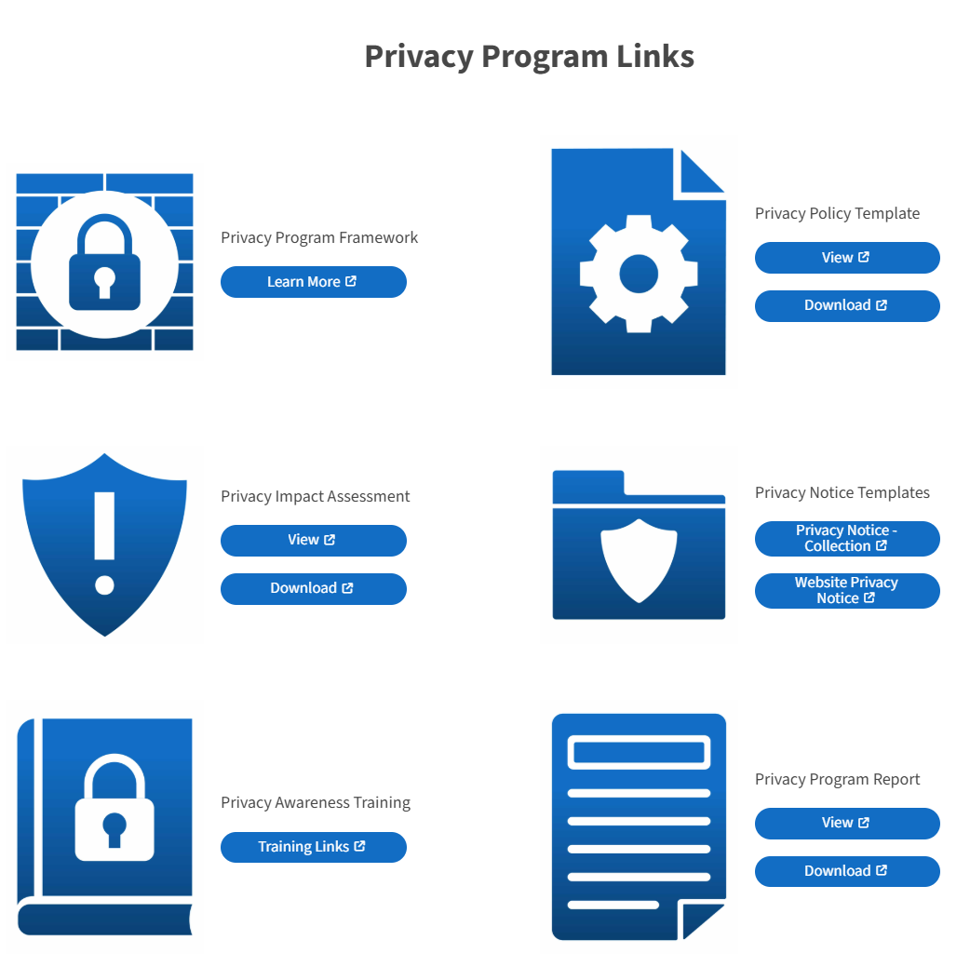

Tools & Resources
Template
Version 1.1 available now.
What to expect out of next version…

Slide 9
Additional Support
Monthly Live Training
Subcommittee for Expansion
A Privacy Commission subcommittee is actively refining the PIA to address additional use scenarios not covered in Version 1.1, including emerging technologies, interagency data sharing, and high-risk processing activities.
Scenario-Specific Guidance
Development of supplemental modules for unique system types (e.g., AI-enabled applications, large-scale public-facing platforms, sensitive data handling environments) is an ongoing effort driven from needs communicated to the Office of Data Privacy.
Integrated Security Alignment
The revised DTS Security Policy 5000-0002 now explicitly links system security reviews with the PIA process, ensuring a single, coordinated compliance workflow.
Q&A (DM for consultation)

Slide 10
Visit us at: privacy.utah.gov
Or email us at officeofdataprivacy@utah.gov

