Slide 1

Privacy Notices
For Collection & Website
The information in this presentation is provided as a resource to assist governmental entities and does not constitute legal advice. Governmental entities should consult with their legal counsel regarding this information.

Slide 2

Learning Objectives
Create and properly use a Website Privacy Notice
Develop Personal Data Collection Privacy Notice(s)
Obtain a free website scanning report
📌 Tip: This slideshow can be found here.

Slide 3
What is a Website Privacy Notice?
A website privacy notice is a statement on a website that explains how the site collects, uses, shares, and protects personal (user) information.
In simple terms, it tells people:
What data you collect (like names, emails, cookies, or IP addresses)
Why you collect it (such as improving services or marketing)
Who you sell/share it with (if anyone)
How you protect it
What rights users have over their data (like access, correction, or deletion)

Slide 4

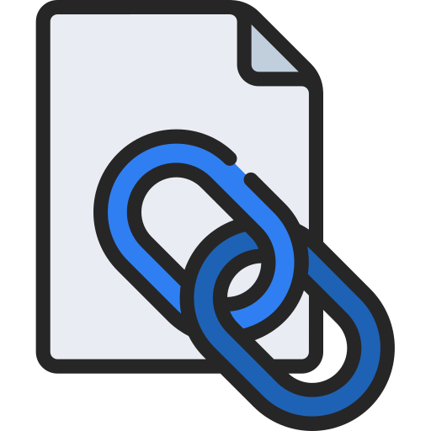
Required Language
A governmental entity's website shall include notice to a user:
WHO is the owner/operator of the government website;
HOW to contact the governmental entity responsible for the website;
the method by which a user may:
seek access to the user's personal data or user data;
request to correct or amend the user's personal data or user data; and
file a complaint with the data privacy ombudsperson;
How an at-risk employee may request that their information be classified private.
Note: Entities may not collect user data on a government website unless the entity has complied with the requirements in this section.
63A-19-402.5

Slide 5
If you collect user data
The website privacy notice must also include:
Any website tracking technology that is used to collect user data on the government website;
What user data is collected;
All intended purposes and uses of the user data
Classes of persons and governmental entities:
With whom the data is shared or sold
The record series in which the user data is included
63A-19-402.5
Notes:
Link to Privacy notice (ODP’s website or somewhere else?)

Slide 6
What is a Personal Data Collection Privacy Notice
A personal data collection privacy notice is a statement on a website that explains how the site collects, uses, shares, and protects personal information from its visitors or users.
In simple terms, it tells people:
What data you collect (like names, emails, addresses, phone#, etc.)
Why you collect it (such as in order to provide services)
Who you share it with / sell it to (if anyone)
How you protect it
What rights users have over their data (like access, correction, or deletion)

Slide 7
Required Language
Personal Data notice – required if you are collecting personal data
If the personal data collected by a governmental entity is:
classified as a public record under GRAMA, the privacy notice shall be limited to a statement indicating that the individual's personal data may be available to the public, & (iv – the record series)
not classified as a public record under GRAMA, the privacy notice shall describe:
all intended purposes & uses of the personal data;
the consequences for refusing to provide the personal data;
the classes of persons & governmental entities:
with whom the governmental entity shares personal data; or
to whom the governmental entity sells personal data; &
the record series in which the personal data is included.
63A-19-402

Slide 8

Two Distinct Notices
Personal Data Collection Privacy Notice
GDPA section 402
Website Privacy Notice
GDPA section 402.5
1 document
*Prominently* Posted on your website
1+ document(s)
Made available wherever personal data is collected

Slide 9
What are Tracking Technologies?
Cookies / Tags: Small pieces of data that a website stores on your device to remember information about you
Purpose:
Performance (analytics)
Targeted advertising (personalized/behavioral advertising)
Service required (such as authentication (login), security, user preferences, functionality)
📌 Only use what’s strictly necessary to provide the service
Notes:
Why is this important? Is there a need for targeted ads on a government website?

Slide 10

Cookie Examples
Cookies - strings of text sent to your browser from a visited site
First-party cookies - are set by the site you visited
Third-party cookies - are set by service providers/partners
Session cookies - deleted once you close your browser
Persistent cookies are stored in the session for a period of time
Tags – small pieces of code used on websites to collect and share data. 90% of 3rd-party Cookies are set by Tags (i.e. Pixels, Beacons, keyloggers)
Notes:
Why is this important? Is there a need for targeted ads on a government website?

Slide 11

Website Scanning Report
What is it? A report that identifies tracking technologies on entity websites, such as cookies & tags.
Instructions: Complete the Website Assessment Request
or request by email: officeofdataprivacy@utah.gov

Slide 12
Understanding the Report

Slide 13
Privacy Notice Examples
Utah Dept. of Government Operations:
https://govops.utah.gov/website-privacy-notice/
Davis County:
https://www.daviscountyutah.gov/privacy-policy
Bear River Health Department:
https://brhdut.gov/about-us/privacy-policy/
Utah Dept. of Health & Human Services:
https://dhhs.utah.gov/website-privacy/#webtracking

Slide 14
Conclusion
1. Request the Scan
2. Download the templates
Website Privacy Notice
Privacy Notice for
Collection of Personal Data
3. Receive your scanning report
Analyze the report with your team
Confirm legal authority for collection
Correct any issues with your technical team

Slide 15

Reference Help
https://cookie-script.com/web-cookie-types
A deeper dive into cookies and tags
Observe Point is working on a Data Dictionary reference tool for cookies and tags (Pending deployment)

Slide 16
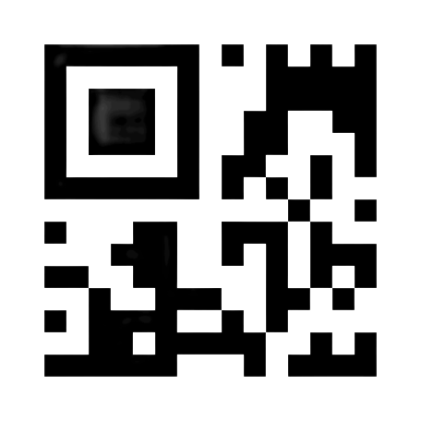
Next Steps
4. Update privacy notice & personal data collection notices
Where do you post?
Website privacy notice should be prominently displayed on your website
Personal data collection notice must be Included as part of any document or form collecting personal data (this includes electronic forms downloaded)
Tip: Use a conspicuous link (see next slide) or a QR code
(refer site visitor to the appropriate personal data collect notice)
IMPORTANT: The governmental entity may only use personal data furnished by an individual for the purposes identified in the privacy notice provided to that individual.
63A-19-402

Slide 17
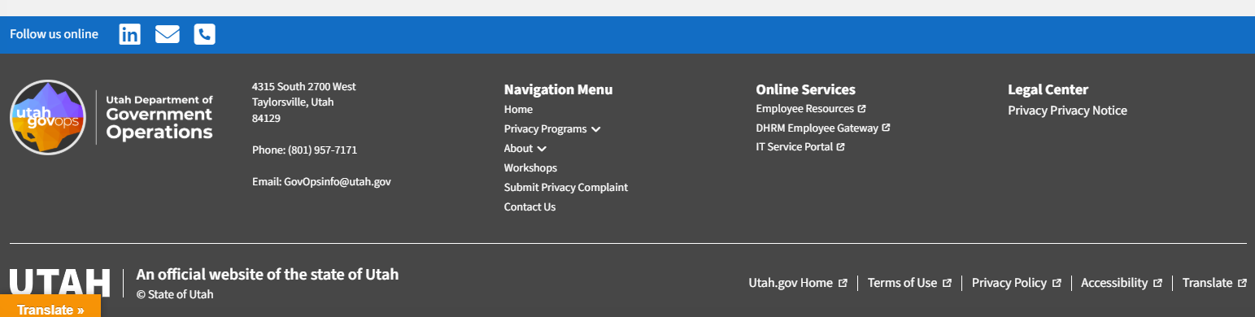
Example Location

Slide 18
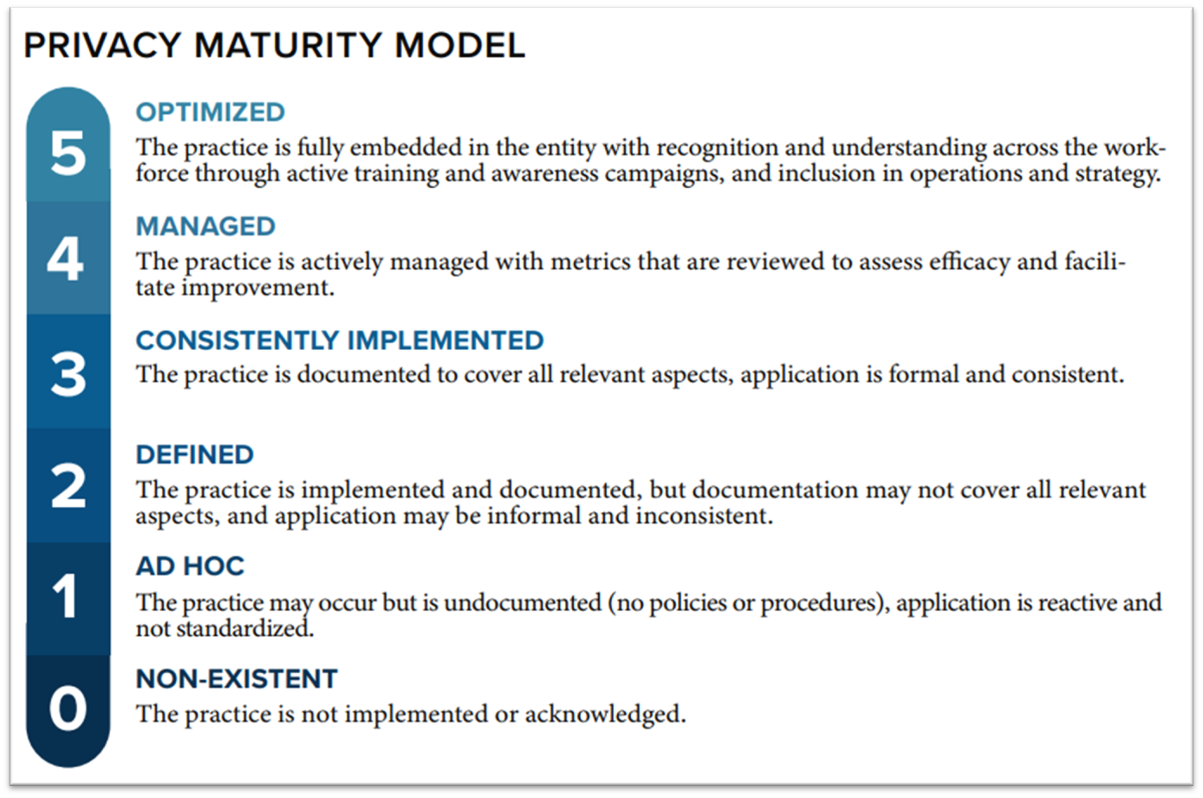
Next Steps
6. CONGRATS!
You now have a level 3 privacy practice
- Time to update your annual privacy report

Slide 19
Visit us at: privacy.utah.gov
Or email us at officeofdataprivacy@utah.gov

