Slide 1

Privacy Program Overview
Virtual Workshop
Shane Paul
Training Director

Slide 2

Learning Objectives
Explain key requirements of GDPA
Prepare to meet the Dec 31 deadline by initiating your privacy program report
Locate supplemental training and support
The information in this presentation is provided as a resource to assist governmental entities and does not constitute legal advice. Governmental entities should consult with their legal counsel regarding this information.

Slide 3
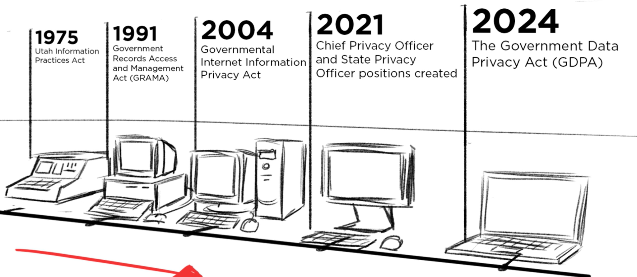

Slide 4
Why Entities Struggle w/ Privacy
Complex Laws: Privacy laws are often duplicative, conflicting, outdated, or have regulatory gaps.
Digitalization without Compliance: Agencies digitize services without privacy programs.
Limited Resources: Many lack staffing, funding, or tools.
Unclear Roles: Ambiguity in roles like Chief Administrative Officer (CAO), Agency Records Officer (ARO), etc.
Lack of Planning: Absence of strategic, master, improvement, or long-term privacy plans.

Slide 5
Create and maintain a data privacy framework designed to assist governmental entities to identify and implement effective and efficient data privacy practices, tools, and systems
📌 Find a full list of our mandates here.

Slide 6
What is a privacy framework?
A comprehensive plan for managing personal data.
Covers collection, use, storage, sharing, and protection of data.
Built on laws: GDPA, GRAMA, DARS, SPDP, HIPAA, FERPA, Others
Providing minimum compliance
Focus on incremental development and resource-based growth.
📌 Link to ODP Privacy Framework.
Notes:
Program does not mean mature.

Slide 7
Your Responsibility
Initiate a data privacy program before December 31, 2025
Complete a privacy program report that includes the information required under 63A-19-401.3 by Dec 31, 2025 and annually thereafter.
For any processing activity implemented before May 7, 2025, as soon as is reasonably practicable, but no later than July 1, 2027:
Identify non-compliant processing
Document the issues
Prepare a strategy to fix them
Include this in the privacy report
Utah Code

Slide 8
Good News!
There is no requirement for a fully mature program.
Your focus should be on laying out a clear roadmap for incremental and increasing maturity of the program over time
Utah Office of Data Privacy has a legislative responsibility to support you
Utah Code

Slide 9
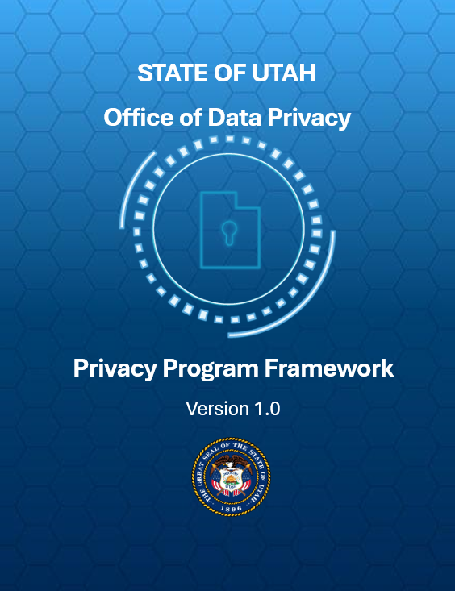
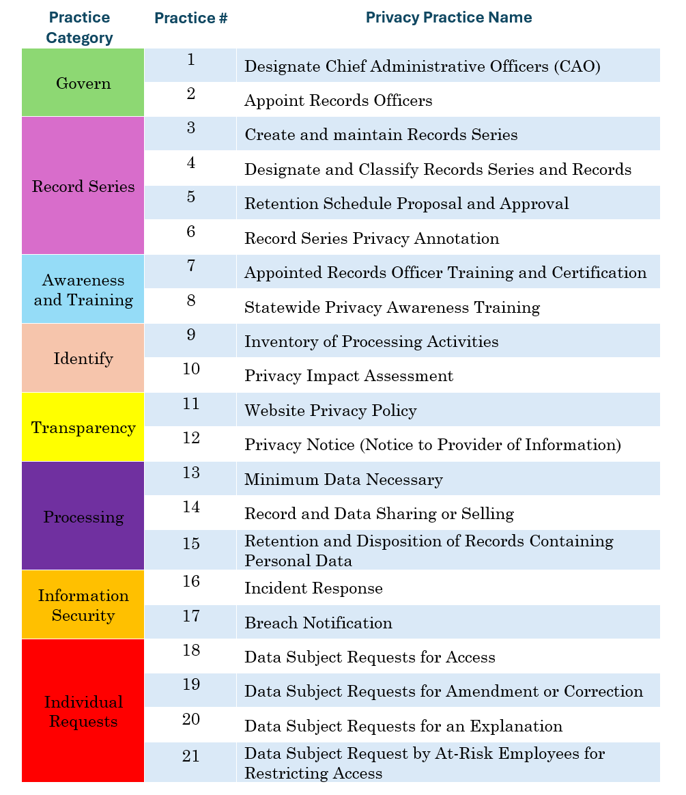
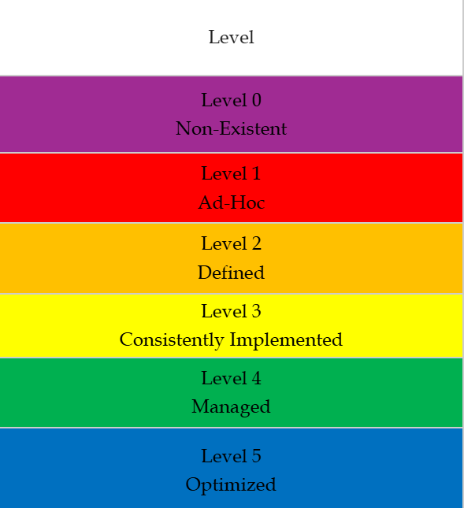

Slide 10

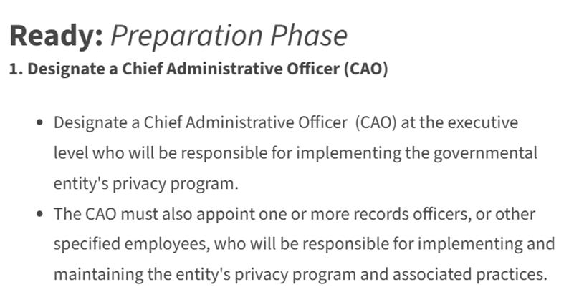
Ready, Set, Go!

Slide 11
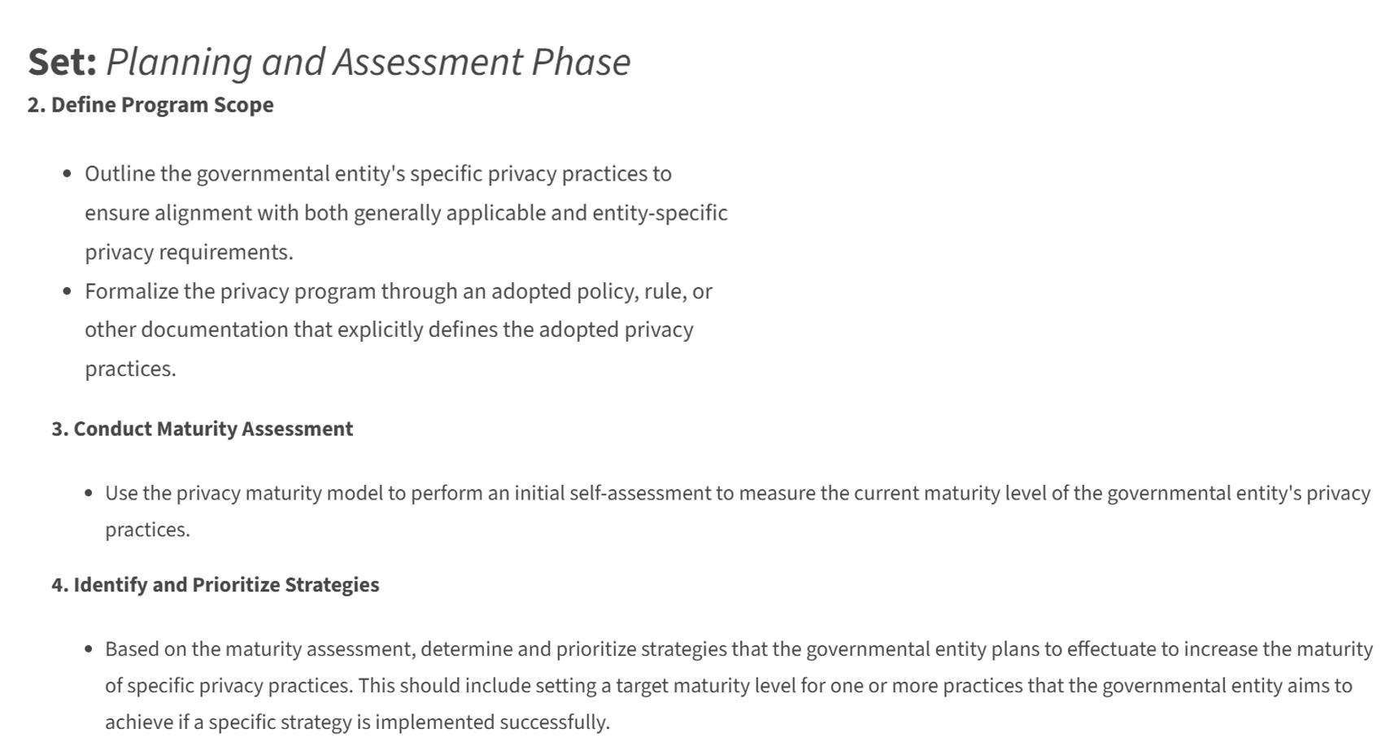

Ready, Set, Go!

Slide 12
Notes:
Our plan rationalizes the many laws and define “practices.” These are the things you are required to do, or strongly recommended to do, as part of your privacy program. What is Privacy? From a government entity perspective, privacy is these practices, which we do in order to reasonably protect individuals privacy interests.

Slide 13
Ready, Set, Go!

Slide 14
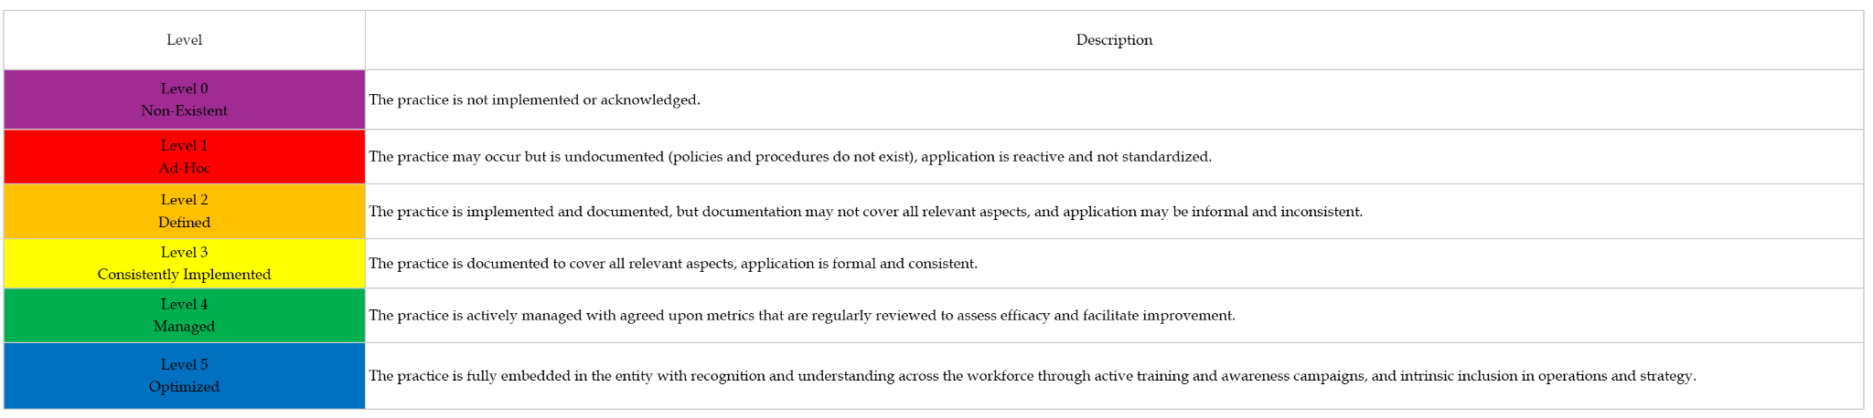
Maturity Model
Notes:
This is how we measure privacy.

Slide 15
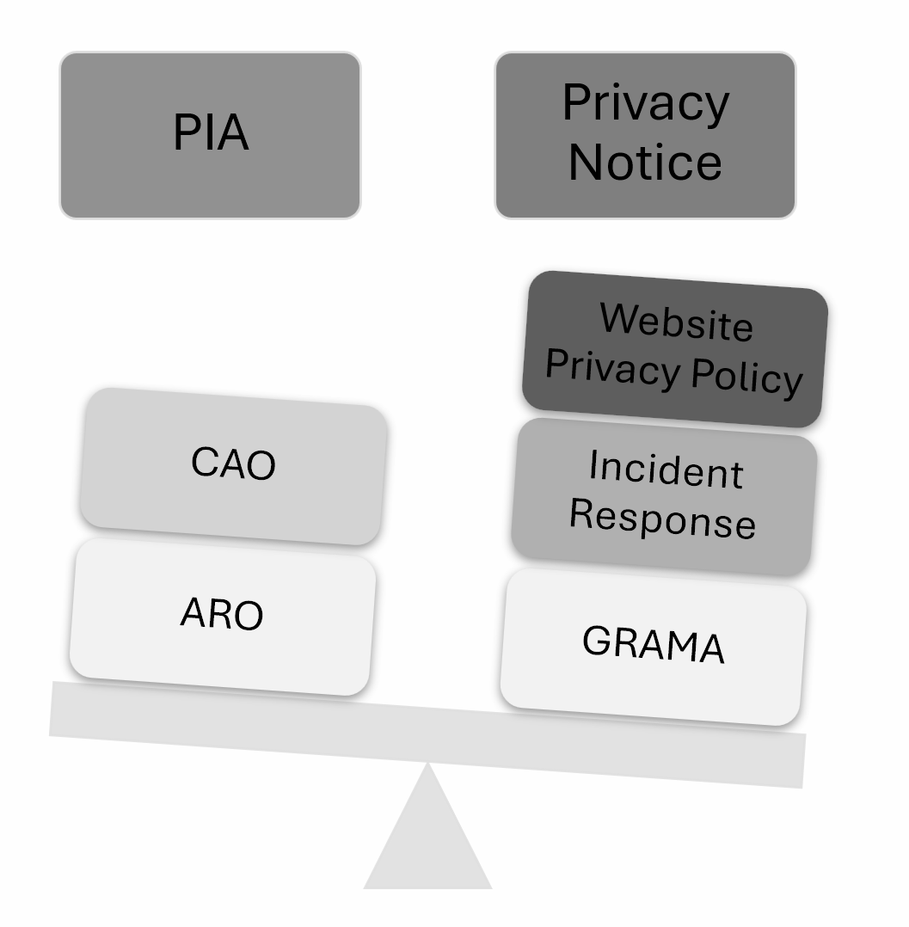
Factors to consider
Records Series
Retention
Data selling
Purpose & Use limitation
Data sharing
Artificial Intelligence
Disposition
Biometric data
Facial recognition
3rd Party Vendors
Notes:
There are many factors to consider. You are already doing many of these. Some are ad hoc, some are in policy, some are established processes that have been run for years. In general, Utah is doing very well when compared to other States.

Slide 16
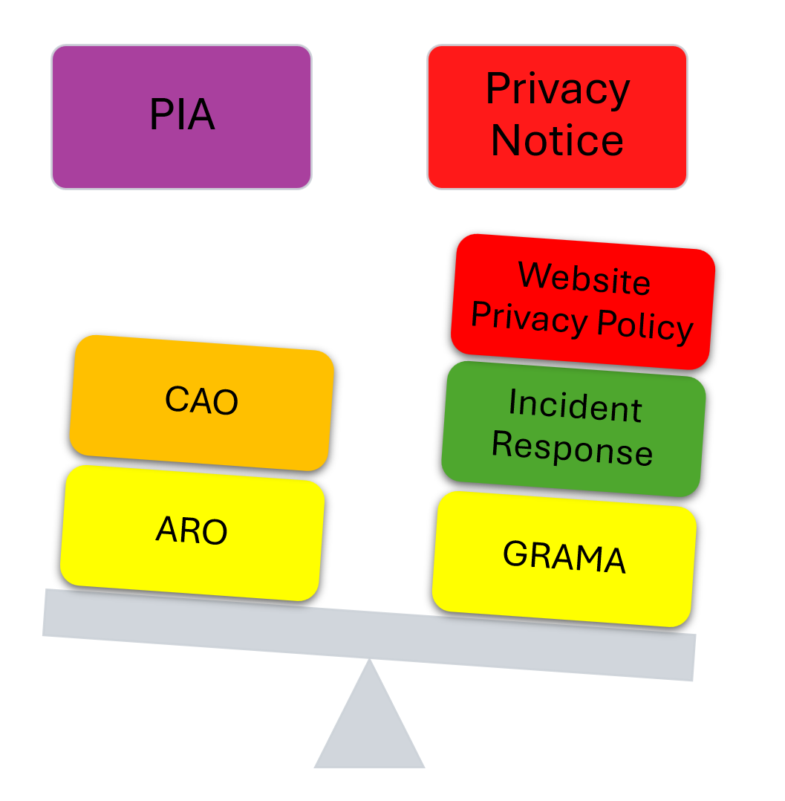

Slide 17
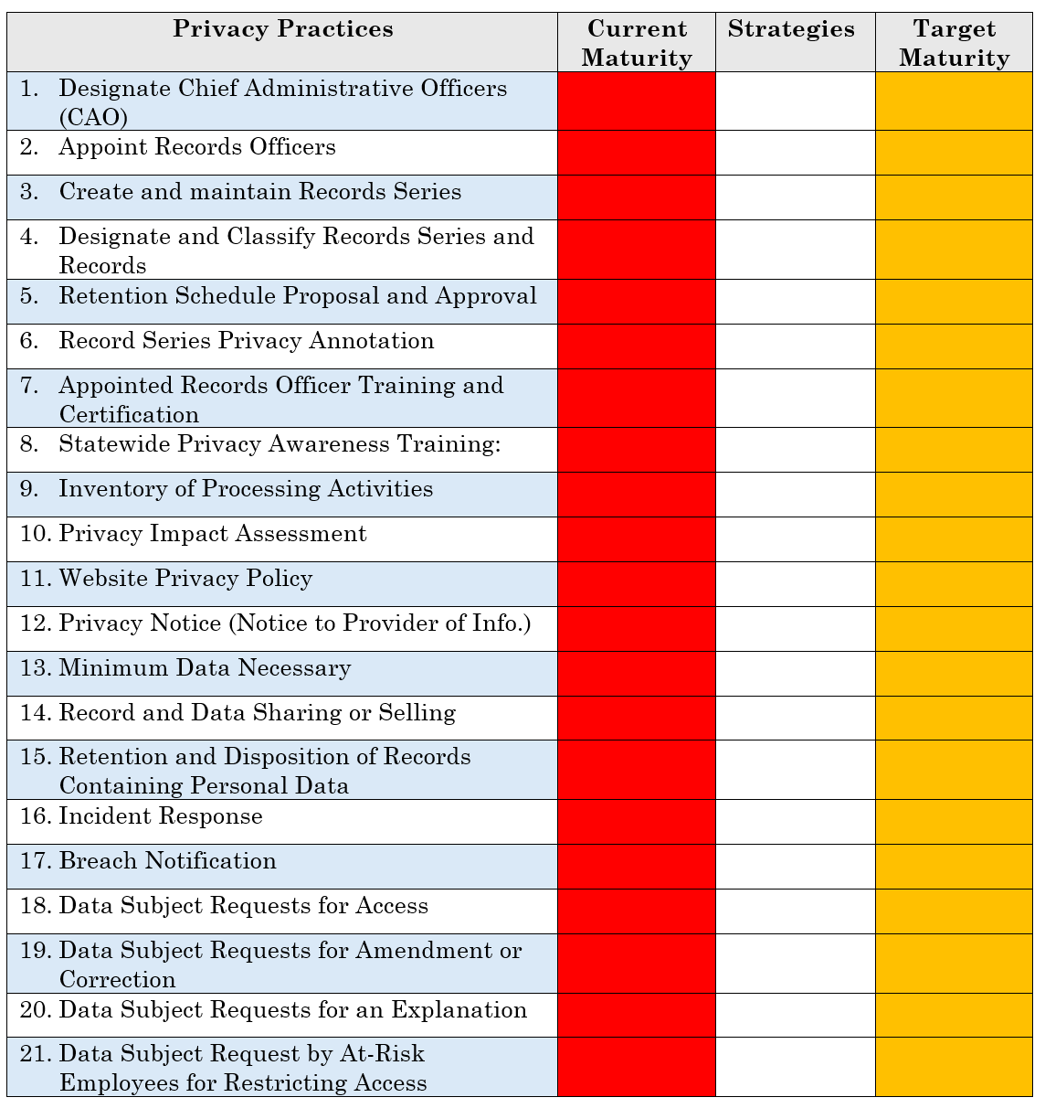
Notes:
Addresses 3 of the reporting responsibilities:
Whether the governmental entity has initiated a privacy program
Description of privacy practices implemented
Strategies for improving privacy programs and practices

Slide 18

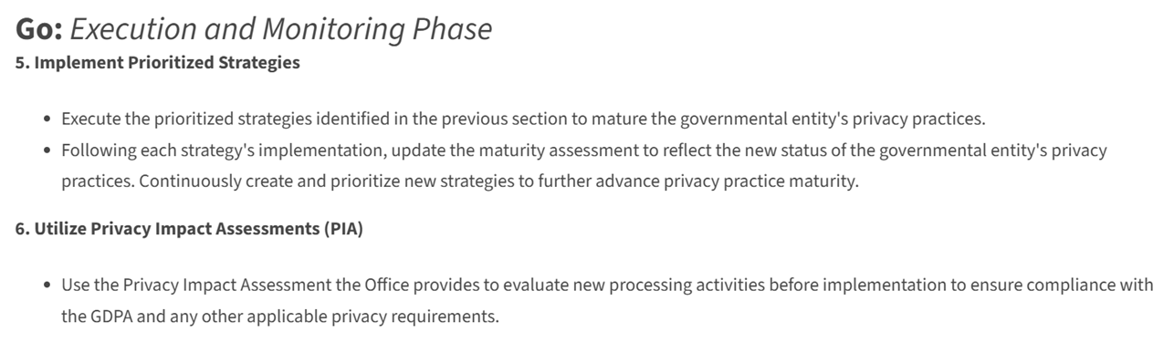
Ready, Set, Go!

Slide 19
Recap - Keep it simple
Ready
Set
Go
Define Roles
Measure your privacy program
Implement prioritized strategies

Slide 20
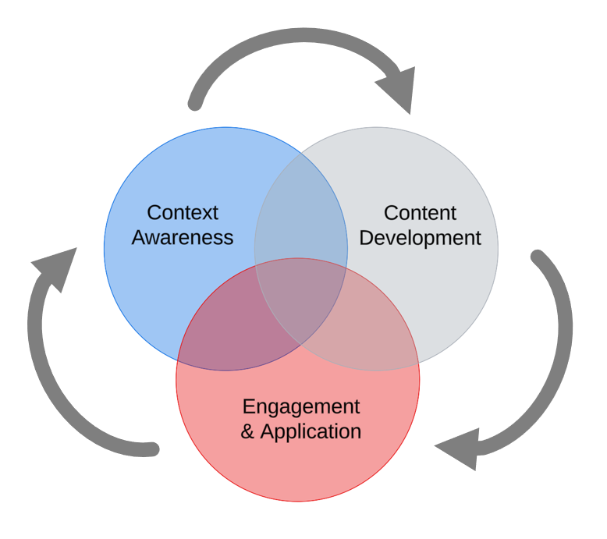
Training Program - Where context, resources & engagement form a learning continuum
Notes:
There are 3 phases of this continuum. In the first blue bubble, we create context for the learner. This is where our mandatory training lives. This is where we explain the purpose of having a privacy program. By starting with building context, we increase the learners understanding which creates incentive within them to participate.
In phase 2, we have content development. This is where all of our supplemental training lives. This is where we get into the weeds of how to do it.
And in the 3rd bubble, we have Engagement. This is where we close the loop. We’ve now built a group of advocates that have institutional knowledge and actively assist in pushing their entity through the privacy program framework’s maturity model

Slide 21
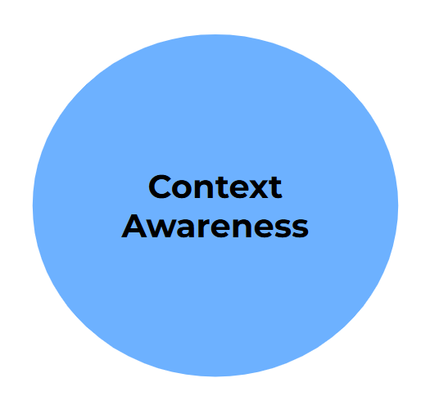
Why
Statewide Privacy Awareness Training
Virtual Workshops
Overview
CAO
PIA
Privacy Notice/Website Scanning
GDPA Req/Personal Interests
Privacy Program Report
Data Sharing/Selling
Conference Participation (DM if interested)

Slide 22
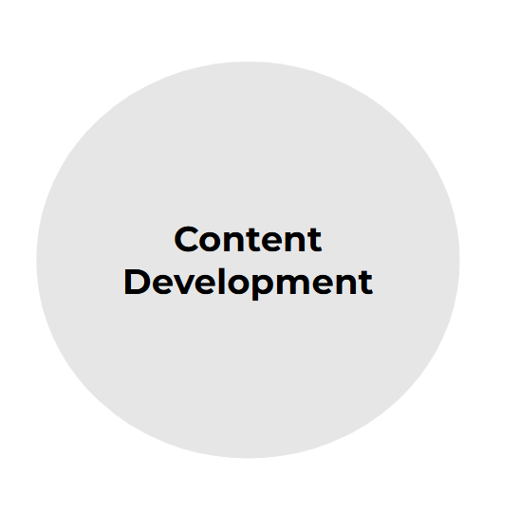
How
Learning Materials
Privacy Program Framework
Privacy Policy Template
Notice of Collection Templates
Micro-training (7Taps)
Handouts/Infographics
Inventory Template
Handbook (In Development)

Slide 23
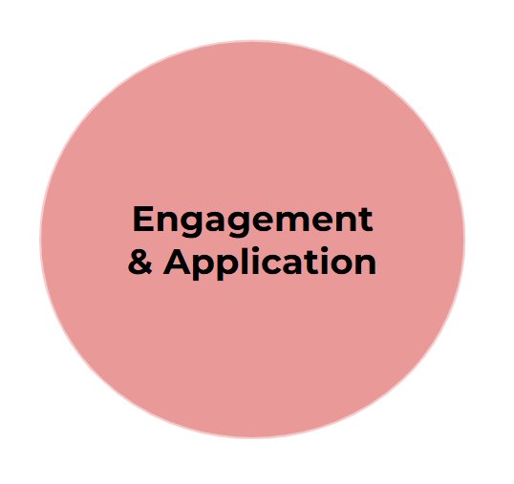
Plan For The Future
Privacy Council (State Agencies)
Data Governance Summit
Privacy.Utah.gov mailing list
CIPM Training

Slide 24
Visit us at: privacy.utah.gov
Or email us at officeofdataprivacy@utah.gov

