Slide 1



Records Management
Overview
*Division of Archives and Records Service = DARS = State Archives
Notes:
Welcome to Records Management and Privacy workshop! I’m so excited to collaborate with the Office of Data Privacy for this training.
This session is designed for beginners and focuses on practical foundations, not legal deep dives.
Before we get started, I’d like you each to tell us in the chat box what agency you are from. This will help me to understand your situations a little better.
Also, if you have a question at any time, please put that in the chat box. Shane will be monitoring the chats and will make sure we address each question at the best possible time.

Slide 2
Why Privacy & Records Matter
?
The information in this presentation is provided as a resource to assist governmental entities and does not constitute legal advice. Governmental entities should consult with their legal counsel regarding this information.
Notes:
Why do privacy and government records matter?
Government agencies collect personal information every day
People trust government to protect their data
Laws require careful handling of records
Privacy controls depend on record structure
Records management operationalizes privacy law
GRAMA tries to provide transparency while also protecting individual privacy and some specific processes
Trust and accountability. Privacy failures impact real people, not just your reputation or compliance scores.

Slide 3

Learning Objectives
Explain basic privacy and records terms
Describe the records or data lifecycle
Understand your record series obligations
Locate helpful resources
📌 Tip: This slideshow can be found here.
Notes:
Learning Objectives
Explain basic privacy and records terms
Describe the records or data lifecycle and role that retention schedules play
Understand your record series obligations
Locate helpful resources

Slide 4
What is Privacy in Government?
GRAMA does not allow blanket confidentiality.
Privacy protections must be grounded in statute and implemented through records practices.
Public access is the default
Access restrictions must be justified by statute
  Private
  Protected
  Controlled
  Exempt (access governed by another statute, such as FERPA or HIPAA)
Personal data requires structured protection
63G-2-201
Notes:
Privacy does not mean secrecy. Government must balance openness with protection of individuals.
GRAMA does not allow blanket confidentiality. Privacy protections must be grounded in statute and implemented through records practices.
Public access is the default
Access restrictions must be justified by statute
Private
Protected
Controlled
Exempt (access governed by another statute, such as FERPA or HIPAA)
Personal data requires structured protection

Slide 5
What is a Government Record?
Documentary material created or kept by government
Prepared, owned, received, or retained by government
Regardless of format
Reproducible by electronic or mechanical means
A record can be:
Paper or electronic (ex PDF)
Emails
Data within databases
Forms
Video or audio recordings
Definition
Notes:
Documentary material created or kept by government
Prepared, owned, received, or retained by government
Regardless of format
Reproducible by electronic or mechanical means
Format does not matter—content and purpose do.

Slide 6
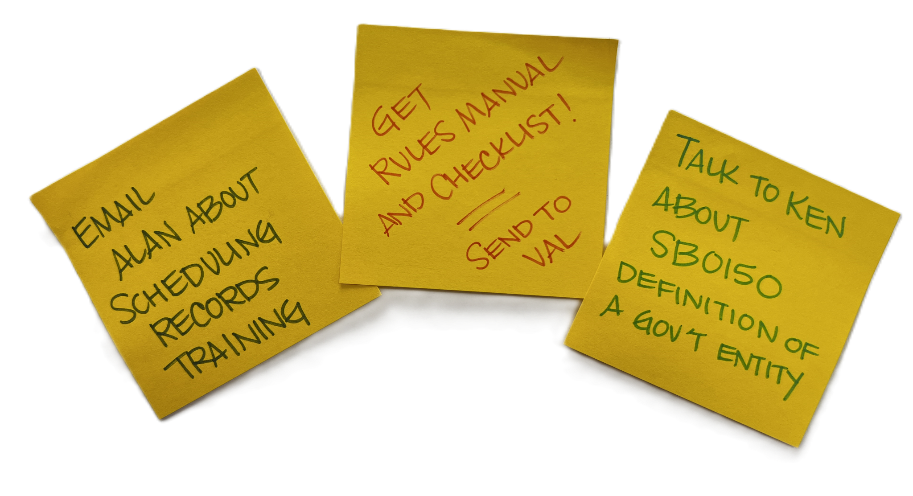
What is not a government record?
Personal emails and documents*
Temporary drafts*
Calendars
Books contained in a library
Junk mail or spam
Computer programs
Etcetera
Definition
*created for personal use
Notes:
Knowing what is and isn’t a government record will help you make determinations about how long things need to be kept and rules about what can and cannot be accessed.
GRAMA does also list many items that are not considered government records according to the law (even if they sometimes meet the definition of one) Familiarizing yourself with Utah Code 63G-2-103 will help you know if any of the exceptions apply to your records. You should make note of any citations in the code that apply to you, so you can quickly reference them. Some common examples of non-records according to Utah Code include:
personal emails,
temporary drafts created for personal use,
calendars
copyrighted books, and
computer programs.
This is not an exhaustive list. So take the time to know what might apply to your unique situation.

Slide 7
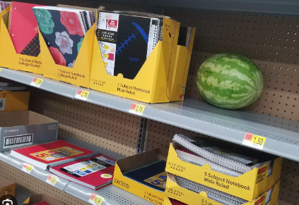
Record Series = Group of Records
Like aisles in a grocery store - arranging records in groups can help us provide better care and access.
Related in a logical way
Document a business process
  Transaction
  Function
  Subject
Share a relationship
Every record within a series is retained for the same amount of time
Access designation & collection purpose statement at the record series level
63G-2-601
63G-2-307
63G-2-103
Notes:
Record series = group of records related in a logical way: they may document a particular transaction, function, or subject; and should share a relationship based on how or why they are created or how they get used and maintained over time. Any records kept together in an identified records series should be retained for the same amount of time, and destroyed together when that time expires. GRAMA access designation and collection purpose statements are also applied at the record series level.
Like aisles in a grocery store, arranging records in groups can help us provide better care and access.

Slide 8

Identifying Record Series
Bread = 1 series
OR
Wheat bread = 1 series
White bread = 1 series
Rolls = 1 series
Bagels = 1 series
OR
Fresh bread = 1 series
Stale bread = 1 series
Notes:
There are many different ways to identify a records series and to group records. Using an analogy of bread we could categorize bread as one series (bread), or as many series (maybe based on type—wheat, white, rolls, bagels,) OR as two series: one for fresh bread and one for stale bread.

Slide 9

Identifying Record Series
Contracts = 1 record series
OR
Simple contracts = 1 record series
Fixed-price contracts = 1 record series
Incentive contracts = 1 record series
OR
Expired contracts = 1 record series
Active contracts = 1 record series
Notes:
Let’s apply that concept to a real-world record example of contracts: we might organize contracts as one record series—as long as they all could be deleted or destroyed according to the same rules -- OR you may choose to create multiple series for different kinds of contracts (simple, fixed-price, incentive) OR one for active contracts and one for expired contracts.
Your decision to group records might be based on the volume and variety of contracts that you manage, and the care that they need.
For example: if you don’t have a large variety of contracts you might only want to distinguish between expired and active. Or if you have a large volume of contracts to manage annually you might want to divide them by contract type for ease of use.

Slide 10
Why Record Series Matter
All Governmental Entities must:
Identify and evaluate record series
Designate classification of each record series
Report designations to DARS
Without identified record series:
Lack of oversight and organization
Data may be kept too long or too short
Personal data may be misused
Inaccurate privacy notices
Unauthorized secondary use
Increased breach impact
63G-2-307
63A-12-103
Notes:
Why do record series matter?
All Governmental Entities must:
Identify and evaluate record series
Designate classification of each record series
Report designations to DARS
Without identified record series:
Lack of oversight and organization
Data may be kept too long or too short
Personal data may be misused
Inaccurate privacy notices
Unauthorized secondary use
Increased breach impact

Slide 11
Working with DARS
Do you need to create a record series with DARS for every record you create?
Required to:
  Identify, evaluate, and classify/designate every record series and report them to DARS, per 63A-12-103(8); and
  File a statement with DARS explaining the purpose for which each private or controlled record is collected, maintained or used , per 63G-2-601(1).
No automated way to report these things to DARS, and
DARS staff members don’t have the capacity to enter each and every record series for each and every governmental entity in Utah into DARS’ system.
  Multiple options for agencies
Notes:
Do you need to create a record series with DARS for every record you create?
Each governmental entity is required to:
identify and classify/designate every record series and report them to DARS, per 63A-12-103(8); and
file a statement with DARS explaining the purpose for which each private or controlled record is collected, maintained or used , per 63G-2-601(1).
There’s no automated way to report these things to DARS, and DARS staff members don’t have the capacity to enter each and every record series for each and every governmental entity in Utah into DARS’ system. Therefore, DARS has provided multiple options for agencies to meet the requirements to report their record series, along with the required information about classification and designation, purpose and use, to DARS.

Slide 12
Options
Agencies may choose from the following methods:
Working with a DARS RIM specialist, create a data file in DARS' system for every record series, with the required elements specified; or
Create an in-house inventory spreadsheet that lists every record series and share the spreadsheet with DARS.
  AND all record series with private or controlled information or personal data are added/documented in DARS' system; or
Create an in-house inventory spreadsheet that lists every record series, along with the required elements, and share the spreadsheet with DARS.
Inventory Spreadsheet Template
Email recordsmanagement@utah.gov to share the spreadsheet with DARS
Notes:
Options:
Working with a DARS RIM specialist, create a data file in DARS' system for every record series, with the required elements specified; or
Create an in-house inventory spreadsheet that lists every record series and share the spreadsheet with DARS. AND all record series with private or controlled information or personal data are also added/documented in DARS' system in order to meet the requirement to file a purpose or collection statement, per 63G-2-604(1); or
Create an in-house inventory spreadsheet that lists every record series, along with the required elements, and share the spreadsheet with DARS.

Slide 13
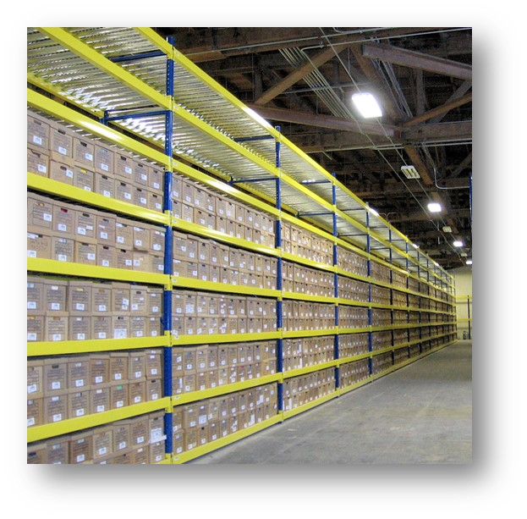
Please note
Record series must be added/documented in DARS’ system if the records:
Retention needs to be approved by the Records Management Committee (RMC),
Are stored at the State Records Center, or
Are being transferred to State Archives
The option you choose must be applied consistently across your entire organization and documented centrally.
Notes:
Record series must be added/documented in DARS’ system if the records:
Retention needs to be approved by the Records Management Committee (RMC),
Are stored at the State Records Center, or
Are being transferred to State Archives
We recommend that your agency choose wisely. The option you choose must be applied consistently across your entire organization and documented centrally.
If you have questions or would like to discuss options, talk to your RIM Specialist.

Slide 14

Record Series Profile
Unique ID | Unique ID
Name | Title
Parents | Creating agency
Age | Dates
Photo & Intro | Description
Address | Media formats
Modes of Transportation | Arrangement
Life Expectancy & Goals | Retention & Disposition
Availability | Designation & Classification
Contact Details | Privacy Annotation
Notes:
Sometimes people think that if they don’t have record series in the State Archives’ system, then they don’t have record series. But that isn’t the case.
Every agency creates records, all records are part of a record series, even if it hasn’t been identified or documented officially.
Documenting a record series is like creating a profile for a person.
Required fields for a record series, whether it’s in the DARS system or not, include:
Unique ID
Title
Creating agency
Dates
Description
Media formats
Arrangement
Retention and Disposition
Designation & Classification
Privacy Annotation

Slide 15
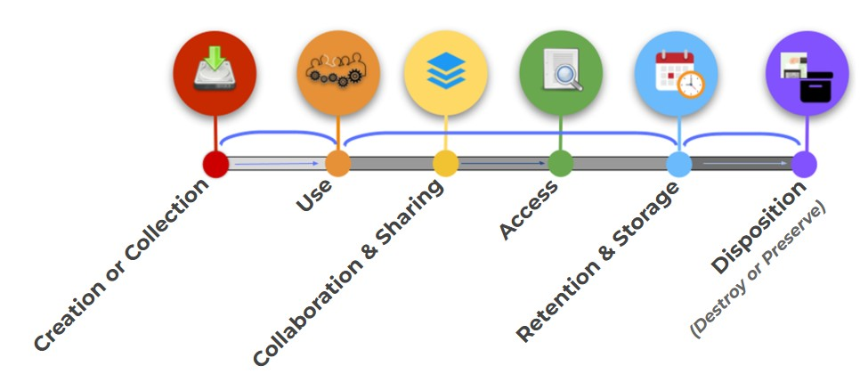
Data & Records Lifecycle
📌 Privacy requirements attach at each lifecycle stage, but retention and disposal are the most common failure points.
Notes:
This is the data and records lifecycle, which data governance professionals use to break down the stages of records management.
First we create or collect records
Second: we use the records for various business processes
Third: We use the records to collaborate, or we share the records with others who have legitimate use for the records, making considerations for the various versions that now might exist
Forth: We organize the data and records in order to provide access—whether that is for business purposes, legal discovery, or GRAMA requests!
Fifth: We plan and manage the storage of the records by identifying how long they need to be kept based on our various needs for the records
Finally, we dispose of the records we no longer need through destruction OR transferring records that have a permanent or historic value to a place where they can be adequately preserved!
📌 Privacy requirements attach at each lifecycle stage, but retention and disposal are the most common failure points.

Slide 16

Collecting Personal Data
Purpose Matters —Minimize Risk
Collect only what you need
Know why you are collecting it
Document the purpose
  Personal data collection must align to purpose
63G-2-601
Notes:
When collecting personal data, the purpose for collecting it matters because over-collection increases risk and reduces public trust.
Good strategies include:
Collect only what you need -
Know why you are collecting it -
Document the purpose
Personal data collection must align to purpose
63A-19-401.1. Privacy annotations.
(1)
(a) Beginning July 1, 2027, a state agency shall make a complete and accurate privacy annotation for each record series containing personal data that the state agency collects, maintains, or uses.
(b) After July 1, 2027, a state agency that has not created a privacy annotation for a record series containing personal data, may not collect, maintain, or use the personal data.
(2) If a state agency determines that a record series:
(a) does not contain personal data, the privacy annotation shall be limited to a statement indicating that the record series does not include personal data; or
(b) contains personal data, the privacy annotation shall include:
(i) an inventory of all types of personal data included in the record series;
(ii) a description of all purposes for which the state agency collects, keeps, or uses the personal data;
(iii) a citation to the state agency's legal authority for collecting, keeping, or using the personal data; and
(iv) any other information required by the rules created by the office under Section 63A-19-301.

Slide 17
Using & Sharing Data
Using and Sharing Records
Sharing includes vendors, contractors and other government agencies
Secondary use increases privacy risk
  Use must align with stated purpose
Processor vs Sub-processor
Tip: Inventory your contracts. Ensure you have MOU’s or DSA’s in place that specify all aspects of ownership and management of the records.
ODP Template
DARS Guideline for Managing Data When Using a Third-Party Vendor
Notes:
Using and Sharing Records
Sharing includes vendors, contractors and other government agencies
Secondary use increases privacy risk
Use must align with stated purpose
Processor vs Sub-processor
Tip: Inventory your contracts. Ensure you have MOU’s or DSA’s in place that specify all aspects of ownership and management of the records.
ODP Template
DARS Guideline for Managing Data When Using a Third-Party Vendor

Slide 18
Providing Access:
Classification Basics
Classification Under GRAMA
Classification governs access
Protects some personal information
Applied when access is requested
May redesignate a record series or reclassify a record, record series, or information within a record at any time.
GRAMA Classification Types
Public
Private
Protected
Controlled
Exempt
63G-2-302-305
63G-2-307
Notes:
Classification, as used in GRAMA, is all about determining whether or not to disclose a record to someone.
Protects some personal information and some processes
Applied when access is requested
May redesignate a record series or reclassify a record, record series, or information within a record at any time.
Records can be classified as
Public
Private
Protected
Controlled
Exempt

Slide 19
Designation vs. Classification
Series Designation applies to record series
Designation predicts typical classification
Record Classification applies to records or data
Classification applies to specific records
Example of each for record series 28572, Record request files
Notes:
Designation vs. Classification
Series Designation applies to record series
Designation predicts typical classification
Record Classification applies to records or data
Classification applies to specific records
When does Classification go wrong?
Over-restriction reduces transparency
Under-restriction exposes personal data

Slide 20
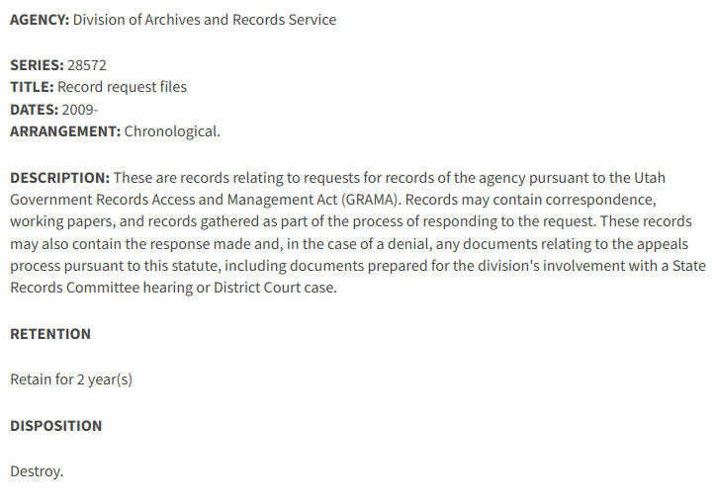
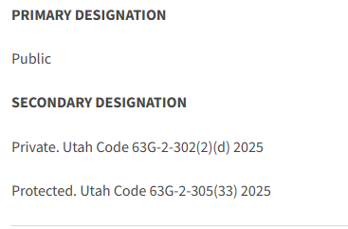
Record Series 28572, Record request files
Designation: Primary = Public; Secondary = Private, Protected

Slide 21
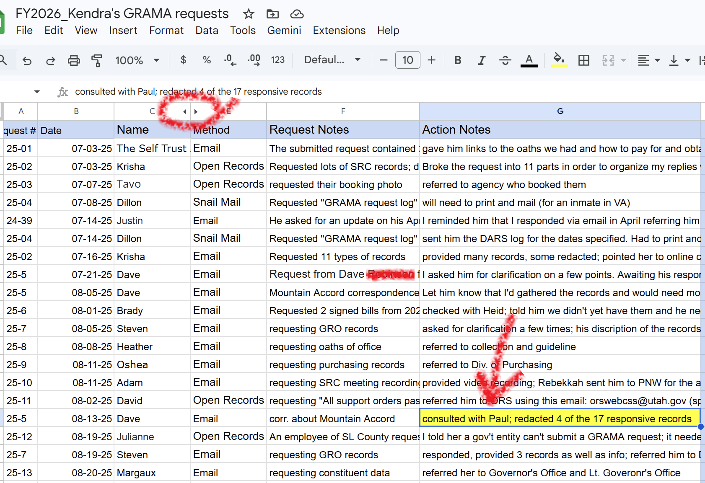
I receive a request for my GRAMA request log, which is part of Record Series 28572, Record request files
Look at the record to classify
Identify what isn’t public
Private per 63G-2-302(2)(d)
Protected per 63G-2-305(17)
Note: it’s different than was designated
Redact it and provide record
Notes:
I review the designation, then look at the record
I see that my log sometimes discloses personal information, particularly if the requester included it in their request (sometimes I copy and paste the wording directly into my log). For instance, someone requested the DCFS file of her son (by name), who was sexually assaulted. Not only is the name of her son personal data, but her name is as well. And in combination with the content of the request, as logged by me, was definitely too much information to share publicly.
I therefore classified some of the information in the record as private, per 63G-2-305(2)(d) (“contains data on individuals the disclosure of which constitutes a clearly unwarranted invasion of personal privacy”)
You can see that I hid the column of last names from my log, to anonymize the requests a bit. But I also had to make sure I didn’t leave last names in there anywhere.
I had to read through all of my notes before I could release the record, to classify the data. In addition to personal data that I felt shouldn’t be public, I also classified some data as protected, as it revealed the content of legal counsel I’d received, which was protected by attorney-client privilege. Now that specific classification subsection had not been included in my designation, but it doesn’t matter for the purposes of classification. I can classify a record or reclassify a record at any time. Maybe I’ll add that subsection to the designation at a later date; for now, I just cite it in my response and redact the offending note.

Slide 22

Retention and Storage
How long you need to keep something based on your use and/or statutory compliance
The environment or system you need to retain it in for the period of time you designated
Notes:
Okay, let’s switch gears and talk about the ‘Retention and Storage” phase - to explore in more detail the processes for determining how long to keep records. Within the scope of this phase you would make considerations for:
How long you need to keep something based on its use to your agency and statutory regulations
The environment or system you need to retain it in for the period of time designated - to ensure you have access to the records for as long as you are required to have them.

Slide 23
Records Appraisal Values
Administrative
Fiscal
Legal
Historical
Notes:
The process of figuring out the value of records is called appraisal. Appraisal is often associated with a monetary assessment. But in this case a records appraisal is assessing the usefulness value of the information contained in the records to our business practices and/or statutory requirements.
Records can be valuable in different ways:
They can be administratively valuable for as long as they are needed to carry out the functions of a governmental entity.
They can be fiscally valuable if they are needed to document the expenditure of public funds and to fulfill government financial obligations.
They can be legally valuable if they are needed to provide evidence of the legal rights or obligations of the government or its citizens, or to ensure compliance with laws and regulations.
They can be historically valuable if they contain information that documents the history of government or the community.
Records with historical value become part of the historical record of the state after their administrative, fiscal, and/or legal purposes have been served.

Slide 24



Determining Retention
Purchasing Team
Legal Team
Financial Team
Notes:
Using our earlier example of contract records, here is how this one record type might be appraised differently by the various people involved in its use:
Contract example:
Purchasing Team - For the sake of our example let’s say that our Purchasing Team is in charge of negotiating a contract with a vendor. The team draws up a contract for a needed service, this creating our record. The Purchasing Team has a need to use the record only until the service is provided and then they have little administrative need for the record. (Let’s say it takes one year for our vendor to execute our service)
Legal Team - After creating the contract our Purchasing Team passes the record to the legal team to review it for terms and conditions and to ensure it complies with the law. The legal team wants to keep the contract to ensure that they have it to review in case the contracted service isn’t done correctly and they need to negotiate or sue. Let’s say the statute of limitations is 7 years for this service. So our Legal Team wants the contract around for that entire period of time after the contract expires.
Finance Team - Lastly our contract gets passed along to the Finance Team for review, as evidence of how much to pay the service provider. They want to keep the contract around for 4 years in case they are audited and need to provide proof of why they paid the service provider.
Despite its various uses - we keep the records for 7 years after it expires to meet its longest need. In this case a legal need

Slide 25
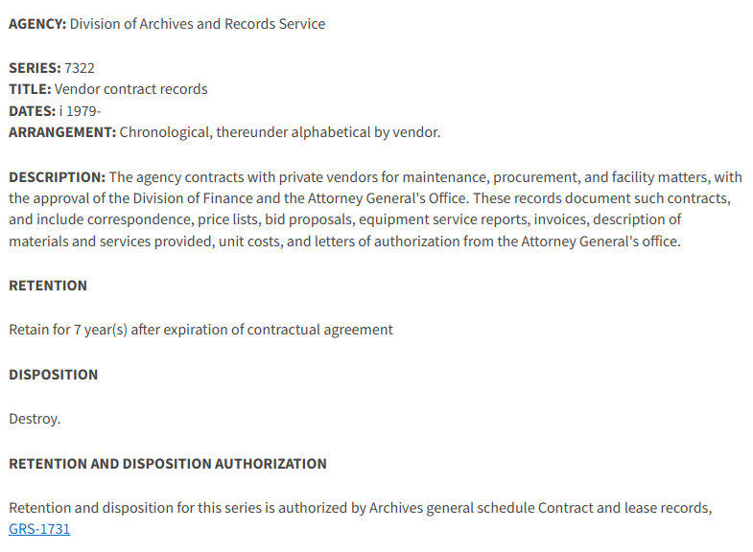
Record series for contracts contains the retention schedule
Notes:
After we determine how long to keep a record, we want to get the retention and disposition authorized and documented in an official way. A collection of these retention rules is called a records retention schedule.
You can see the approved retention and disposition for our vendor contract records is part of the profile for this record series. “Retain for 7 years after expiration of contractual agreement, then a disposition of destroy” represents the records-use appraisal we previously discussed.

Slide 26
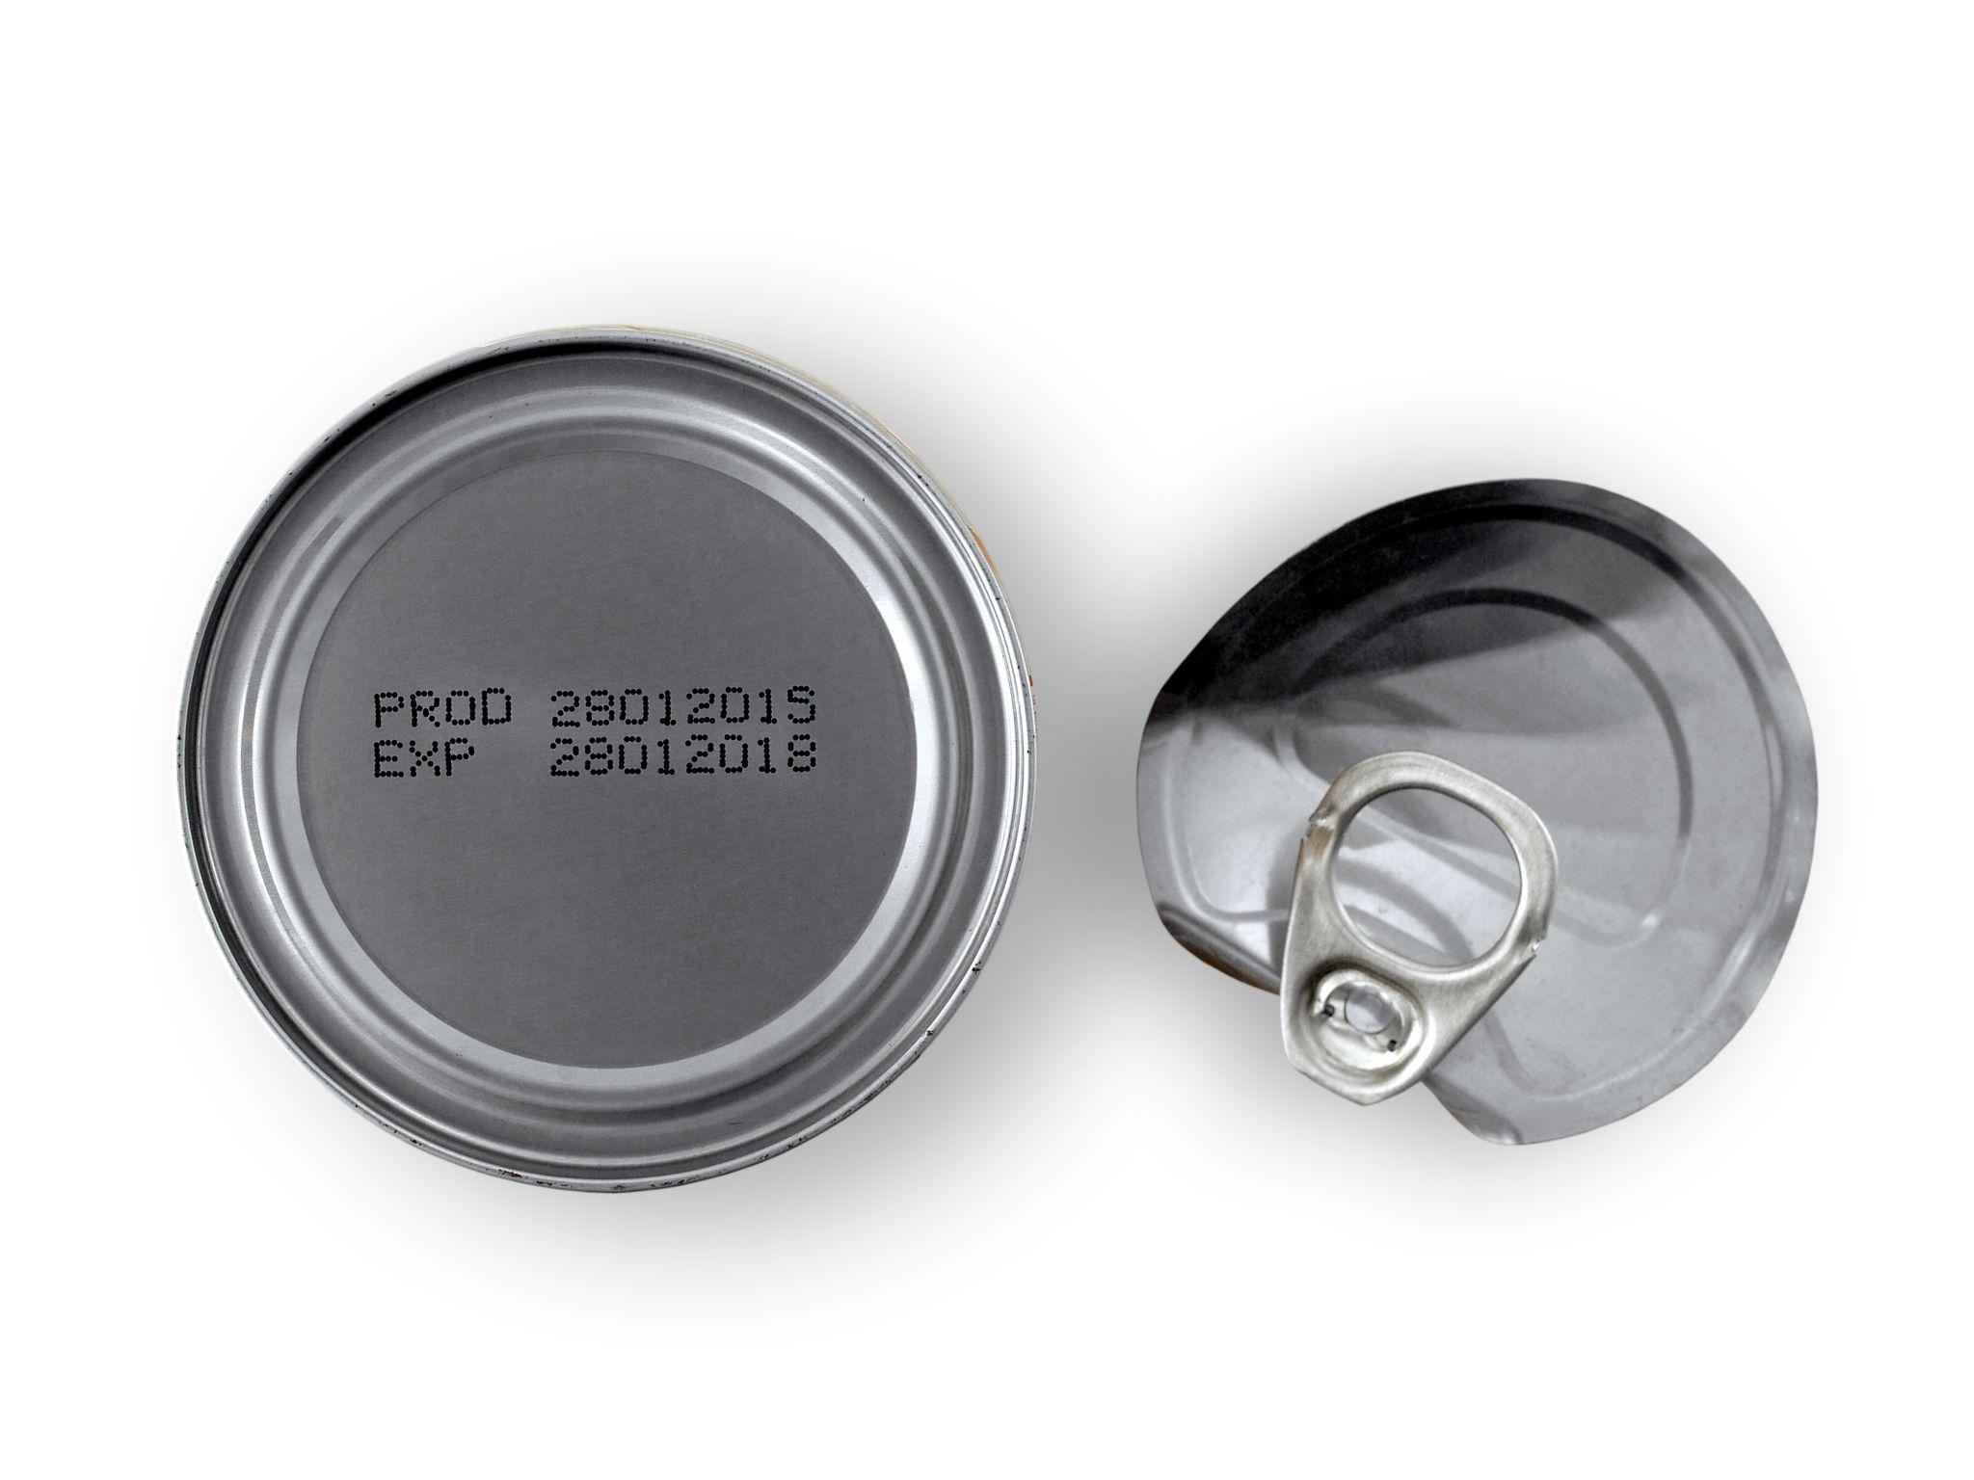
Retention Schedule = Expiration Date
63A-12-112
Notes:
One of the most important tools for taking care of records is the retention schedule—often called disposition authority. Imagine what a grocery store would look and smell like if they rarely got rid of food that hadn’t been purchased or used. Or if there were no “sell by” or “use by” date. In short, retention schedules provide us our legal use-by date.

Slide 27
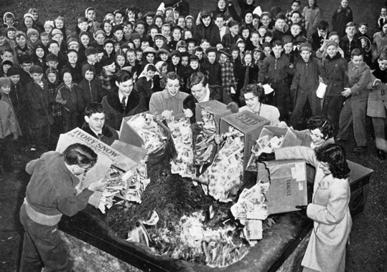
Records are property of the state
Do not intentionally
destroy
mutilate
damage
dispose of
the record copy contrary to a
properly adopted retention schedule!
63A-12-105
Notes:
The law states that records are property of the state, meaning that their maintenance is governed by statute, it’s not just something any government employee can decide.
The law says it's unlawful to destroy, mutilate, damage, or dispose of records contrary to a properly adopted retention schedule. In fact, to do so is a Class B Misdemeanor. (Utah Code 63A-12-105)

Slide 28

Retention & Disposal
Records must follow approved retention schedules. Benefits include:
Increased efficiency
Reduced cost
Increased transparency
Reduced risk to personal data
Provides a safe harbor!
63G-2-604
63A-12-105
Notes:
All records must follow approved retention schedules.
Benefits include:
Increased efficiency
Reduced cost
Increased transparency
Reduced risk to personal data
Implementation of retention schedules provides a safe harbor in times of litigation, audit, or data breach

Slide 29

Approval Authority for Retention Schedules
Records Management Committee (RMC)
Notes:
All government records must have a legally approved retention schedule assigned to them to provide disposition authority. Identifying your governments records series through an inventory process and assigning them an approved retention schedule will ensure you are in compliance with this mandate. The State Archives provides options for finding or getting a legally approved records retention for your records, including:
The Records Management Committee (RMC), which is a public board appointed by the Governor’s office that has the responsibility to “review and approve schedules for the retention and disposal of records” generated by state and local governmental entities.

Slide 30
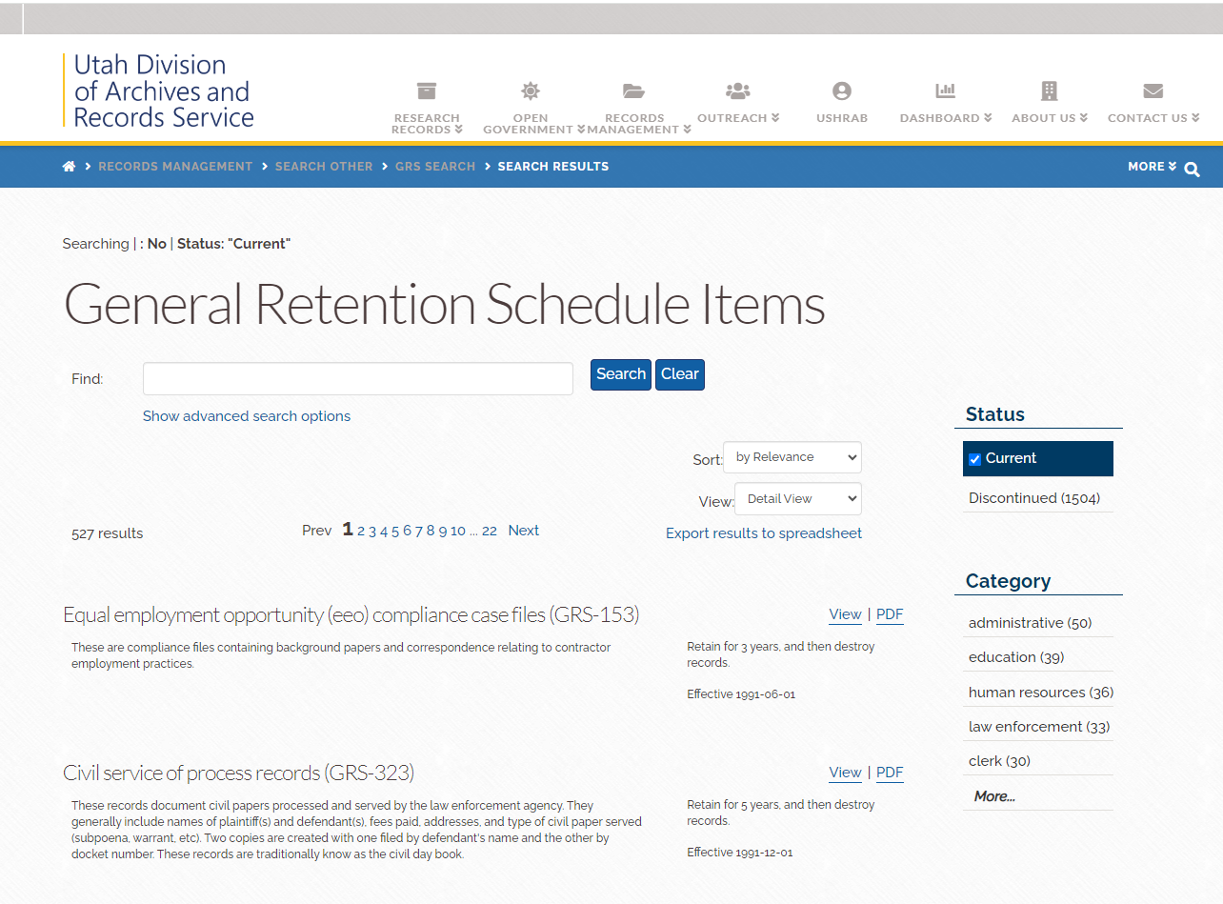
Notes:
The Records Management Committee, or RMC, reviews and approves the general retention schedule the State Archives has the responsibility to keep as outlined in the law. This tool can assist agencies to quickly identify pre-approved disposition authorizations for commonly created government records. If you have not identified the retention schedules your government records are following, it is assumed that they are subject to the general records retention schedule. Once a general records retention is approved, it is considered active and supersedes all previous versions of that schedule. The Archives will send out draft schedules to Appointed Records Officers prior to their review and approval by the RMC. So make sure your ARO contact info is up to date so you are in the know about new and updated schedules.

Slide 31
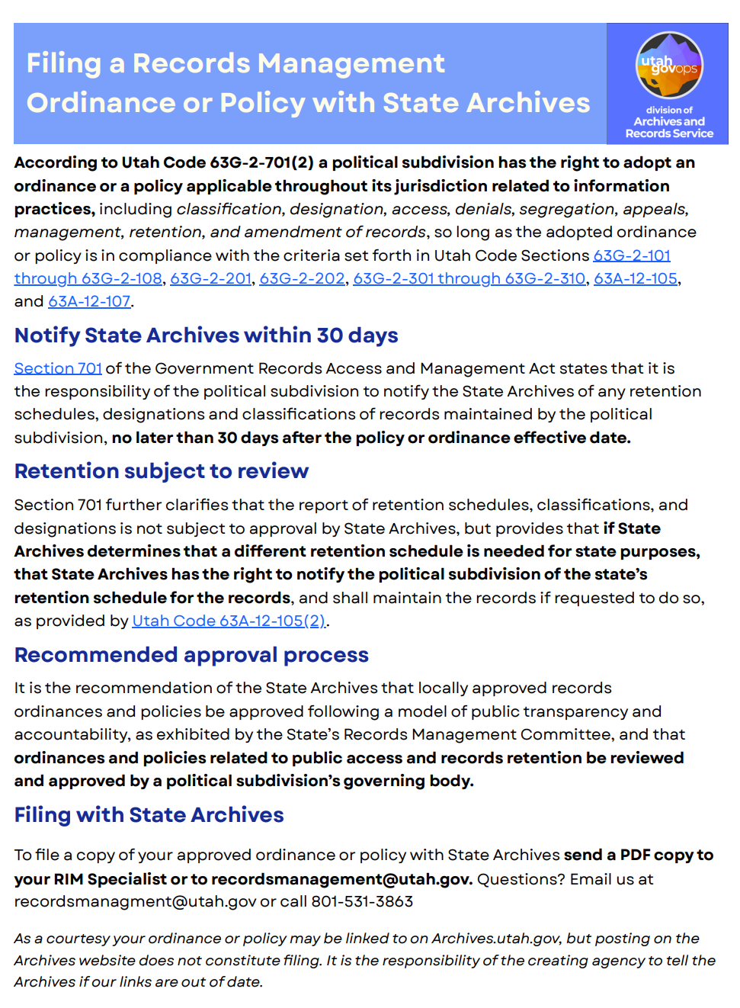
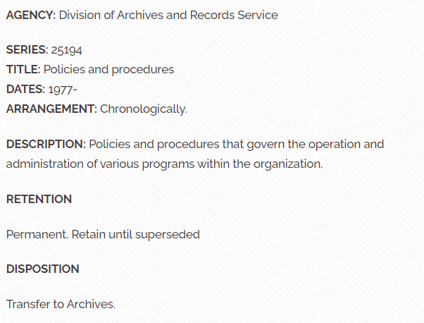
Approval Authority for Retention Schedules
Notes:
If the general records retention schedule doesn’t have a sufficient retention period to suit your disposition needs you have options for creating one that is unique to the records series you have identified. You can create a records-series specific retention schedule approved through the Records Management Committee

Slide 32
Additional Option for Local Government
Political subdivisions may adopt an ordinance or policy relating to information practices including classification, designation, access, denials, segregation, appeals, management, retention and amendment of records, per 63G-2-701.
Any such policy must be filed with DARS no later than 30 days after the policy effective date, per 63G-2-701(2)(e). (See a complete list of policies filed with DARS.)
Notes:
Local government agencies have one additional option:
Political subdivisions may adopt an ordinance or policy relating to information practices including classification, designation, access, denials, segregation, appeals, management, retention and amendment of records, per 63G-2-701.
Any such policy must be filed with DARS no later than 30 days after the policy effective date, per 63G-2-701(2)(e). (See a complete list of policies filed with DARS.)

Slide 33
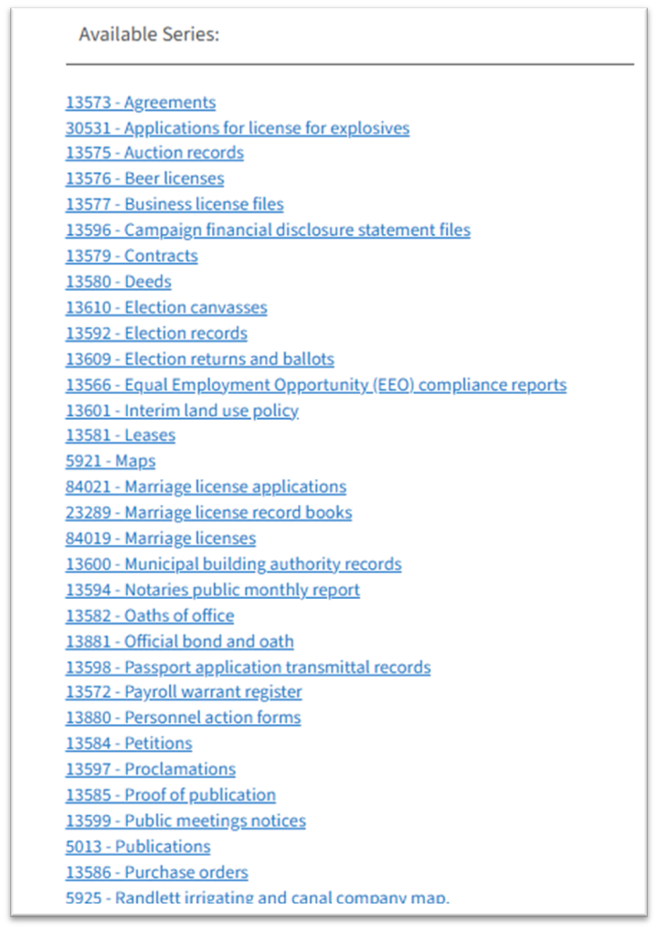
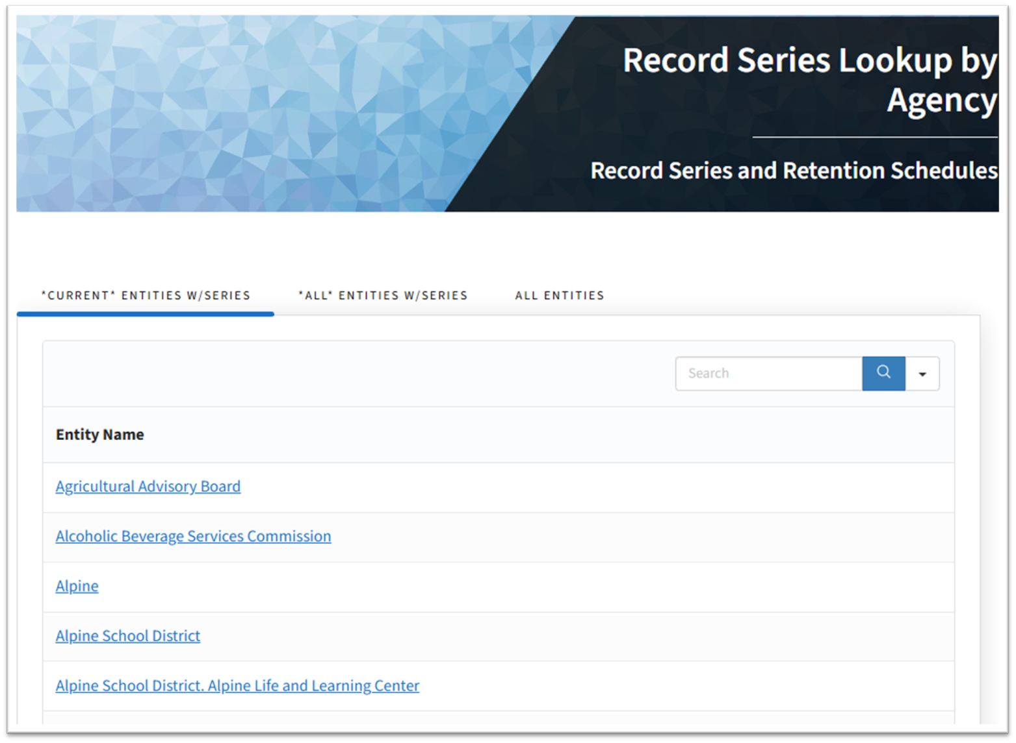
Record series lookup by agency
Notes:
Many record series were entered into the DARS system at some point in the past. You do not need to start from scratch. You can look up what's filed under your entity and do a gap analysis.

Slide 34
Where to find Record Series
Sources
DARS website, if you’ve worked with us
Entity-managed inventory
General Retention Schedules (Reflect common record series)
Links
Record Series Lookup by Agency
General Retention Schedule Items
Special Rules for Local Government
May adopt RIM ordinances or policies
Must report them to DARS
Ordinance/Policy lookup
63G-2-701
Notes:
You can find your record series on the DARS website if they were reported to us and you worked with us to get them entered into our system.
You may find them in an entity-managed inventory
GRS can be useful in helping agencies identify some of the common records they create
Local ordinances reported to us are on our website

Slide 35
Things to consider
Where are your records?
HR records
Licensing & permitting
IT systems
Structured vs unstructured data
Offsite storage
What Goes Wrong Most Often
Shadow systems
Untracked spreadsheets & other unstructured data
Vendor-managed data
Over-retention
Decentralized processes & insufficient standardization create inconsistencies
Notes:
As you get started on records management, consider all the places that your records may be located. Some types of records or formats are trickier than others:
HR records
Licensing & permitting
IT systems
Structured vs unstructured data
Offsite storage
What Goes Wrong Most Often
Shadow systems
Untracked spreadsheets & other unstructured data
Vendor-managed data
Over-retention
Decentralized processes & insufficient standardization create inconsistencies

Slide 36

Getting Started Checklist
Identify who is responsible
  Report AROs and CAOs to DARS
Record series inventory complete
Purpose statements documented
Retention schedules approved
Classifications defensible
Next Steps
Review high-risk record series
Validate retention and purpose
Engage Archives or ODP early
63A-12-103
Notes:
Getting Started
Identify who is responsible and
report appointed records officers (AROs) and Chief Administrative Officer (CAOs) to your RIM specialist at DARS.
Record series inventory complete
Purpose statements documented
Retention schedules approved
Classifications defensible
Next Steps
Review high risk record series
Validate retention and purpose
Engage Archives or ODP early

Slide 37
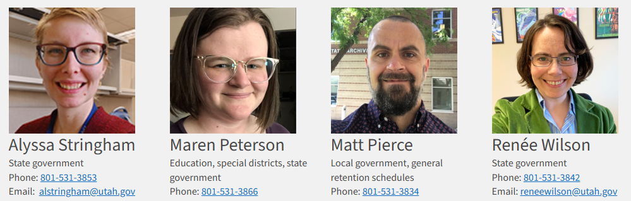
Help & Support
DARS, aka State Archives
Assigned RIM Specialist
ODP Website
Strategic Privacy Plan Guides
Retention Schedules
Inventory Template
RIM 101 recorded training
GRAMA 101 recorded training
Notes:
Help & Support
DARS, aka State Archives
Assigned RIM Specialist
ODP Website
Strategic Privacy Plan Guides
Record Series Templates
Retention Schedules
Inventory Template

Slide 38

Stay Connected
Join the Utah Office of Data Privacy Mailing List
Receive updates, resources, and upcoming training opportunities.
Share Your Success Stories
If your team has implemented a strong privacy practice, we’d love to highlight it.
DARS: recordsmanagement@utah.gov
ODP: officeofdataprivacy@utah.gov

