Slide 1



Records Management
Overview
*Division of Archives and Records Service = DARS = State Archives

Slide 2
Why Privacy & Records Matter
?
The information in this presentation is provided as a resource to assist governmental entities and does not constitute legal advice. Governmental entities should consult with their legal counsel regarding this information.

Slide 3

Learning Objectives
Explain basic privacy and records terms
Describe the records or data lifecycle
Understand your record series obligations
Locate helpful resources
📌 Tip: This slideshow can be found here.

Slide 4
What is Privacy in Government?
GRAMA does not allow blanket confidentiality.
Privacy protections must be grounded in statute and implemented through records practices.
Public access is the default
Access restrictions must be justified by statute
  Private
  Protected
  Controlled
  Exempt (access governed by another statute, such as FERPA or HIPAA)
Personal data requires structured protection
63G-2-201

Slide 5
What is a Record?
Documentary material created or kept by government
Prepared, owned, received, or retained by government
Regardless of format
Reproducible by electronic or mechanical means
A record can be:
Paper or electronic (ex PDF)
Emails
Data within databases
Forms
Video or audio recordings

Slide 6
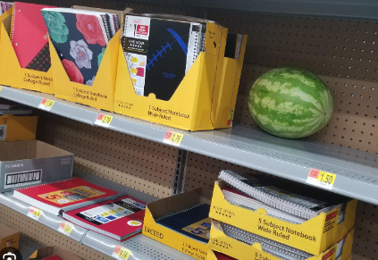
Record Series = Group of Records
Like aisles in a grocery store - arranging records in groups can help us provide better care and access.
Related in a logical way
Document a business process
  Transaction
  Function
  Subject
Share a relationship
Every record within a series is retained for the same amount of time
Access designation & collection purpose statement at the record series level
63G-2-601
63G-2-307
63G-2-103

Slide 7

Identifying Record Series
Bread = 1 series
OR
Wheat bread = 1 series
White bread = 1 series
Rolls = 1 series
Bagels = 1 series
OR
Fresh bread = 1 series
Stale bread = 1 series

Slide 8

Identifying Record Series
Contracts = 1 record series
OR
Simple contracts = 1 record series
Fixed-price contracts = 1 record series
Incentive contracts = 1 record series
OR
Expired contracts = 1 record series
Active contracts = 1 record series

Slide 9
Why Record Series Matter
All Governmental Entities must:
Identify and evaluate record series
Designate classification of each record series
Report designations to State Archives
Without identified record series:
Lack of oversight and organization
Data may be kept too long or too short
Personal data may be misused
Inaccurate privacy notices
Unauthorized secondary use
Increased breach impact
63G-2-307
63A-12-103

Slide 10
Working with DARS
Do you need to create a record series with DARS for every record you create?
Required to:
  Identify, evaluate, and classify/designate every record series and report them to DARS, per 63A-12-103(8); and
  File a statement with DARS explaining the purpose for which each private or controlled record is collected, maintained or used , per 63G-2-601(1).
No automated way to report these things to DARS, and
DARS staff members don’t have the capacity to enter each and every record series for each and every governmental entity in Utah into DARS’ system.
  Multiple options for agencies

Slide 11
Options
Agencies may choose from the following methods:
Working with a DARS RIM specialist, create a data file in DARS' system for every record series, with the required elements specified; or
Create an in-house inventory spreadsheet that lists every record series and share the spreadsheet with DARS.
  AND all record series with private or controlled information or personal data are added/documented in DARS' system; or
Create an in-house inventory spreadsheet that lists every record series, along with the required elements, and share the spreadsheet with DARS.
Inventory Spreadsheet Template
Email recordsmanagement@utah.gov to share the spreadsheet with DARS

Slide 12
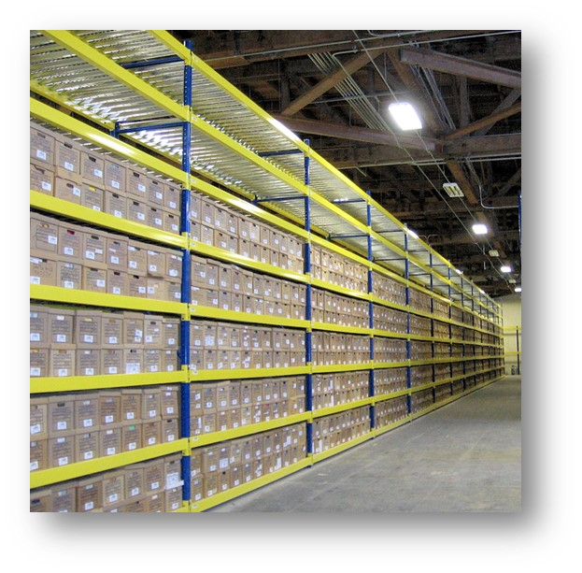
Please note
Record series must be added/documented in DARS’ system if the records:
Retention needs to be approved by the Records Management Committee (RMC),
Are stored at the State Records Center, or
Are being transferred to State Archives
The option you choose must be applied consistently across your entire organization and documented centrally.

Slide 13
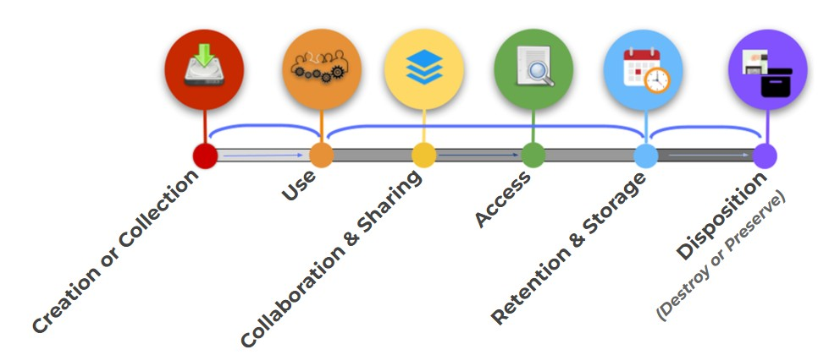
Data & Records Lifecycle
📌 Privacy requirements attach at each lifecycle stage, but retention and disposal are the most common failure points.

Slide 14

Collecting Personal Data
Purpose Matters —Minimize Risk
Collect only what you need
Know why you are collecting it
Document the purpose
  Personal data collection must align to purpose
63G-2-601

Slide 15
Using & Sharing Data
Using and Sharing Records
Sharing includes vendors, contractors and other government agencies
Secondary use increases privacy risk
  Use must align with stated purpose
Processor vs Sub-processor
Tip: Inventory your contracts. Ensure you have MOU’s or DSA’s in place that specify all aspects of ownership and management of the records.
ODP Template
DARS Guideline for Managing Data When Using a Third-Party Vendor

Slide 16
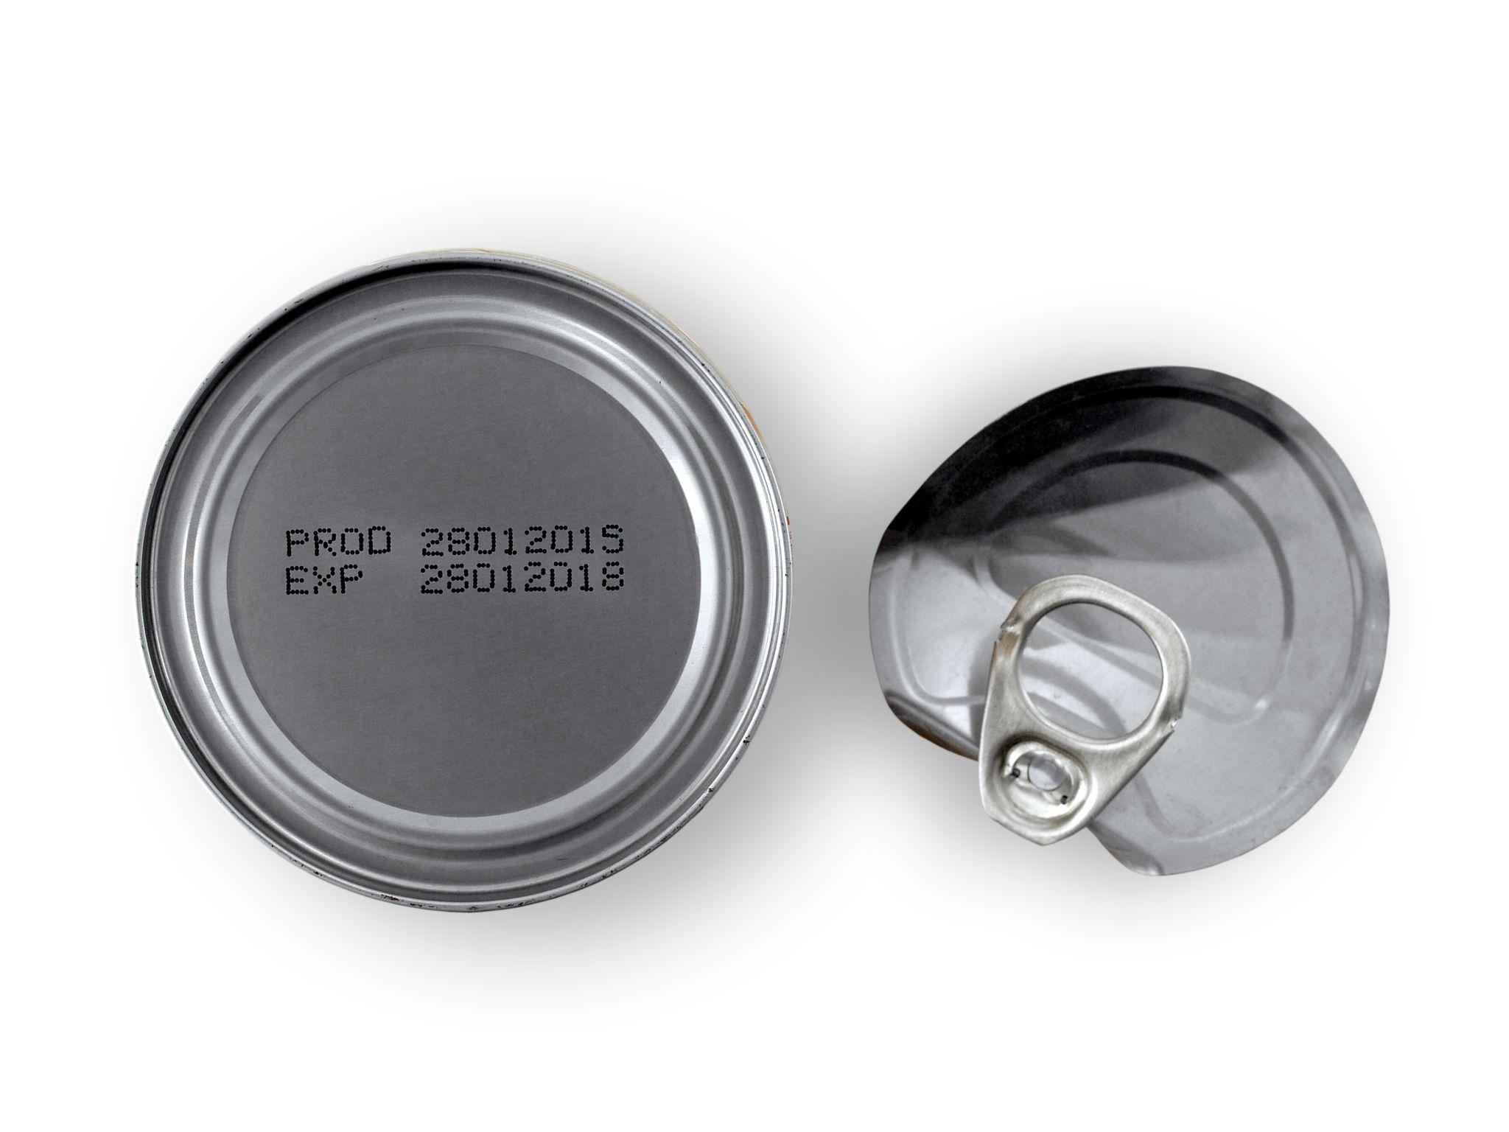
Retention Schedule = Expiration Date
63A-12-112

Slide 17
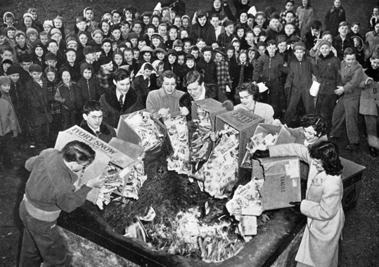
Records are property of the state
Do not intentionally
destroy
mutilate
damage
dispose of
the record copy contrary to a
properly adopted retention schedule!
63A-12-105

Slide 18

Retention & Disposal
Records must follow approved retention schedules. Benefits include:
Increased efficiency
Reduced cost
Increased transparency
Reduced risk to personal data
Provides a safe harbor!
63G-2-604
63A-12-105

Slide 19

Approval Authority for Retention Schedules
Records Management Committee (RMC)

Slide 20
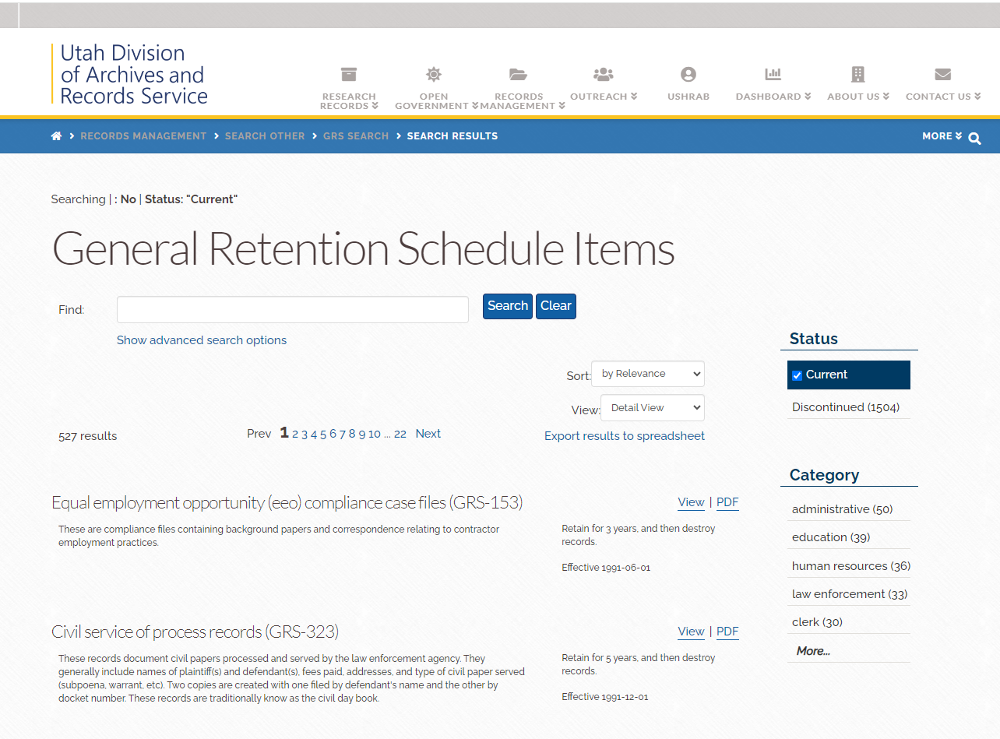

Slide 21
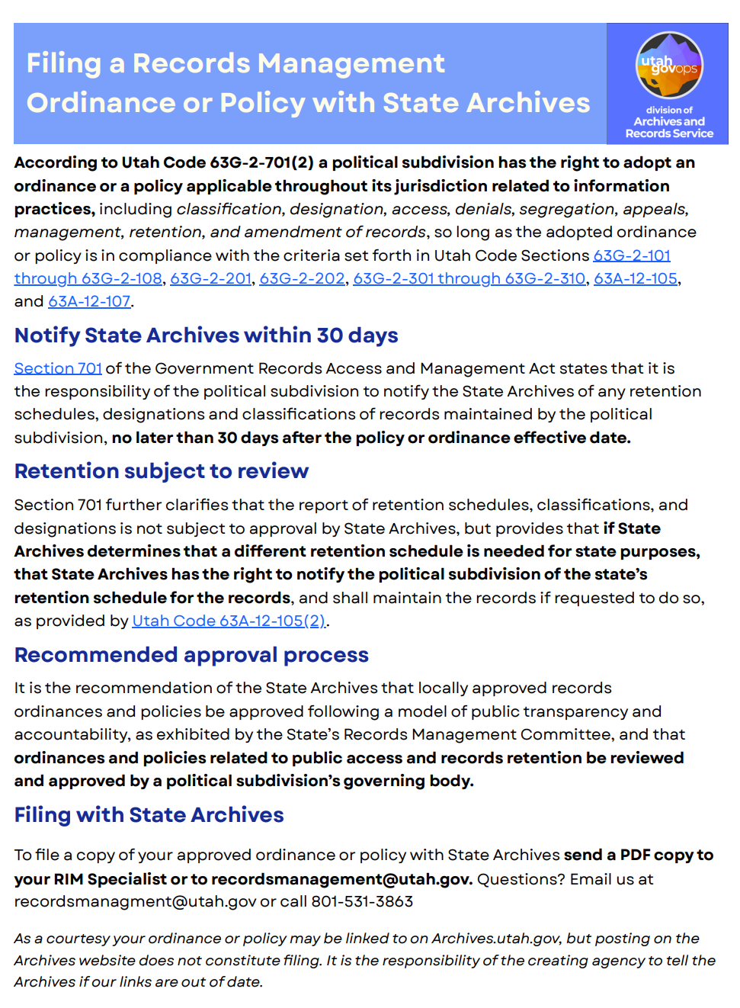
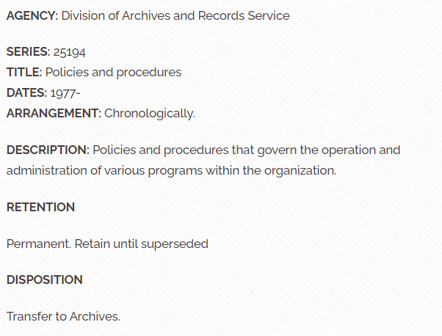
Approval Authority for Retention Schedules

Slide 22
Additional Option for Local Government
Political subdivisions may adopt an ordinance or policy relating to information practices including classification, designation, access, denials, segregation, appeals, management, retention and amendment of records, per 63G-2-701.
Any such policy must be filed with DARS no later than 30 days after the policy effective date, per 63G-2-701(2)(e). (See a complete list of policies filed with DARS.)

Slide 23
Classification Basics
Classification Under GRAMA
Classification governs access
Protects some personal information
Applied when access is requested
May redesignate a record series or reclassify a record, record series, or information within a record at any time.
GRAMA Classification Types
Public
Private
Protected
Controlled
Exempt
63G-2-302-305
63G-2-307

Slide 24
Designation vs. Classification
Series Designation applies to record series
Designation predicts typical classification
Record Classification applies to records or data
Classification applies to specific records
When does Classification go wrong?
Over-restriction reduces transparency
Under-restriction exposes personal data

Slide 25
Where to find Record Series
Sources
DARS website, if you’ve worked with us
Entity-managed inventory
General Retention Schedules (Reflect common record series)
Links
Record Series Lookup by Agency
General Retention Schedule Items
Special Rules for Local Government
May adopt RIM ordinances or policies
Must report them to DARS
Ordinance/Policy lookup
63G-2-701

Slide 26
Things to consider
Where are your records?
HR records
Licensing & permitting
IT systems
Structured vs unstructured data
Offsite storage
What Goes Wrong Most Often
Shadow systems
Untracked spreadsheets & other unstructured data
Vendor-managed data
Over-retention
Decentralized processes & insufficient standardization create inconsistencies

Slide 27

Getting Started Checklist
Identify who is responsible
  Report AROs and CAOs to DARS
Record series inventory complete
Purpose statements documented
Retention schedules approved
Classifications defensible
Next Steps
Review high-risk record series
Validate retention and purpose
Engage Archives or ODP early
63A-12-103

Slide 28
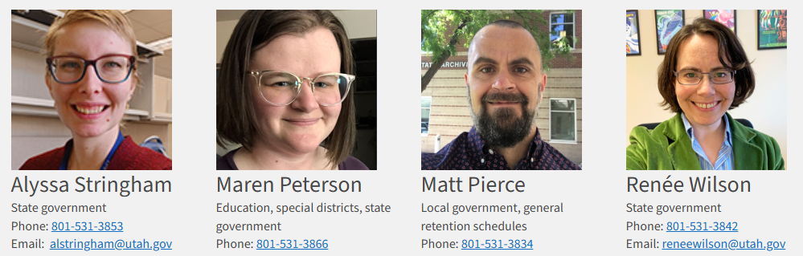
Help & Support
DARS, aka State Archives
Assigned RIM Specialist
ODP Website
Strategic Privacy Plan Guides
Record Series Templates
Retention Schedules
Inventory Template

Slide 29
DARS: recordsmanagement@utah.gov
ODP: officeofdataprivacy@utah.gov

