Slide 1



Records & Info Management
Because nobody likes flat soda…
Kendra Whitaker Yates
kendrayates@utah.gov
385-386-1988
Notes:
Record series and retention schedules are more than a compliance requirement. They are a strategic tool for organizing information, managing risk, improving efficiency, and protecting institutional history. This session will address the relationship between record series and retention schedules, and will take a practical look at how retention schedules are developed, interpreted, and applied in day to day operations. Participants will walk through common challenges, including determining record series, managing mixed formats, utilizing offsite storage, and preparing records for transfer or destruction.
Everybody needs to have a drink in front of them, bcz today we are going to talk about liquid refreshments.

Slide 2
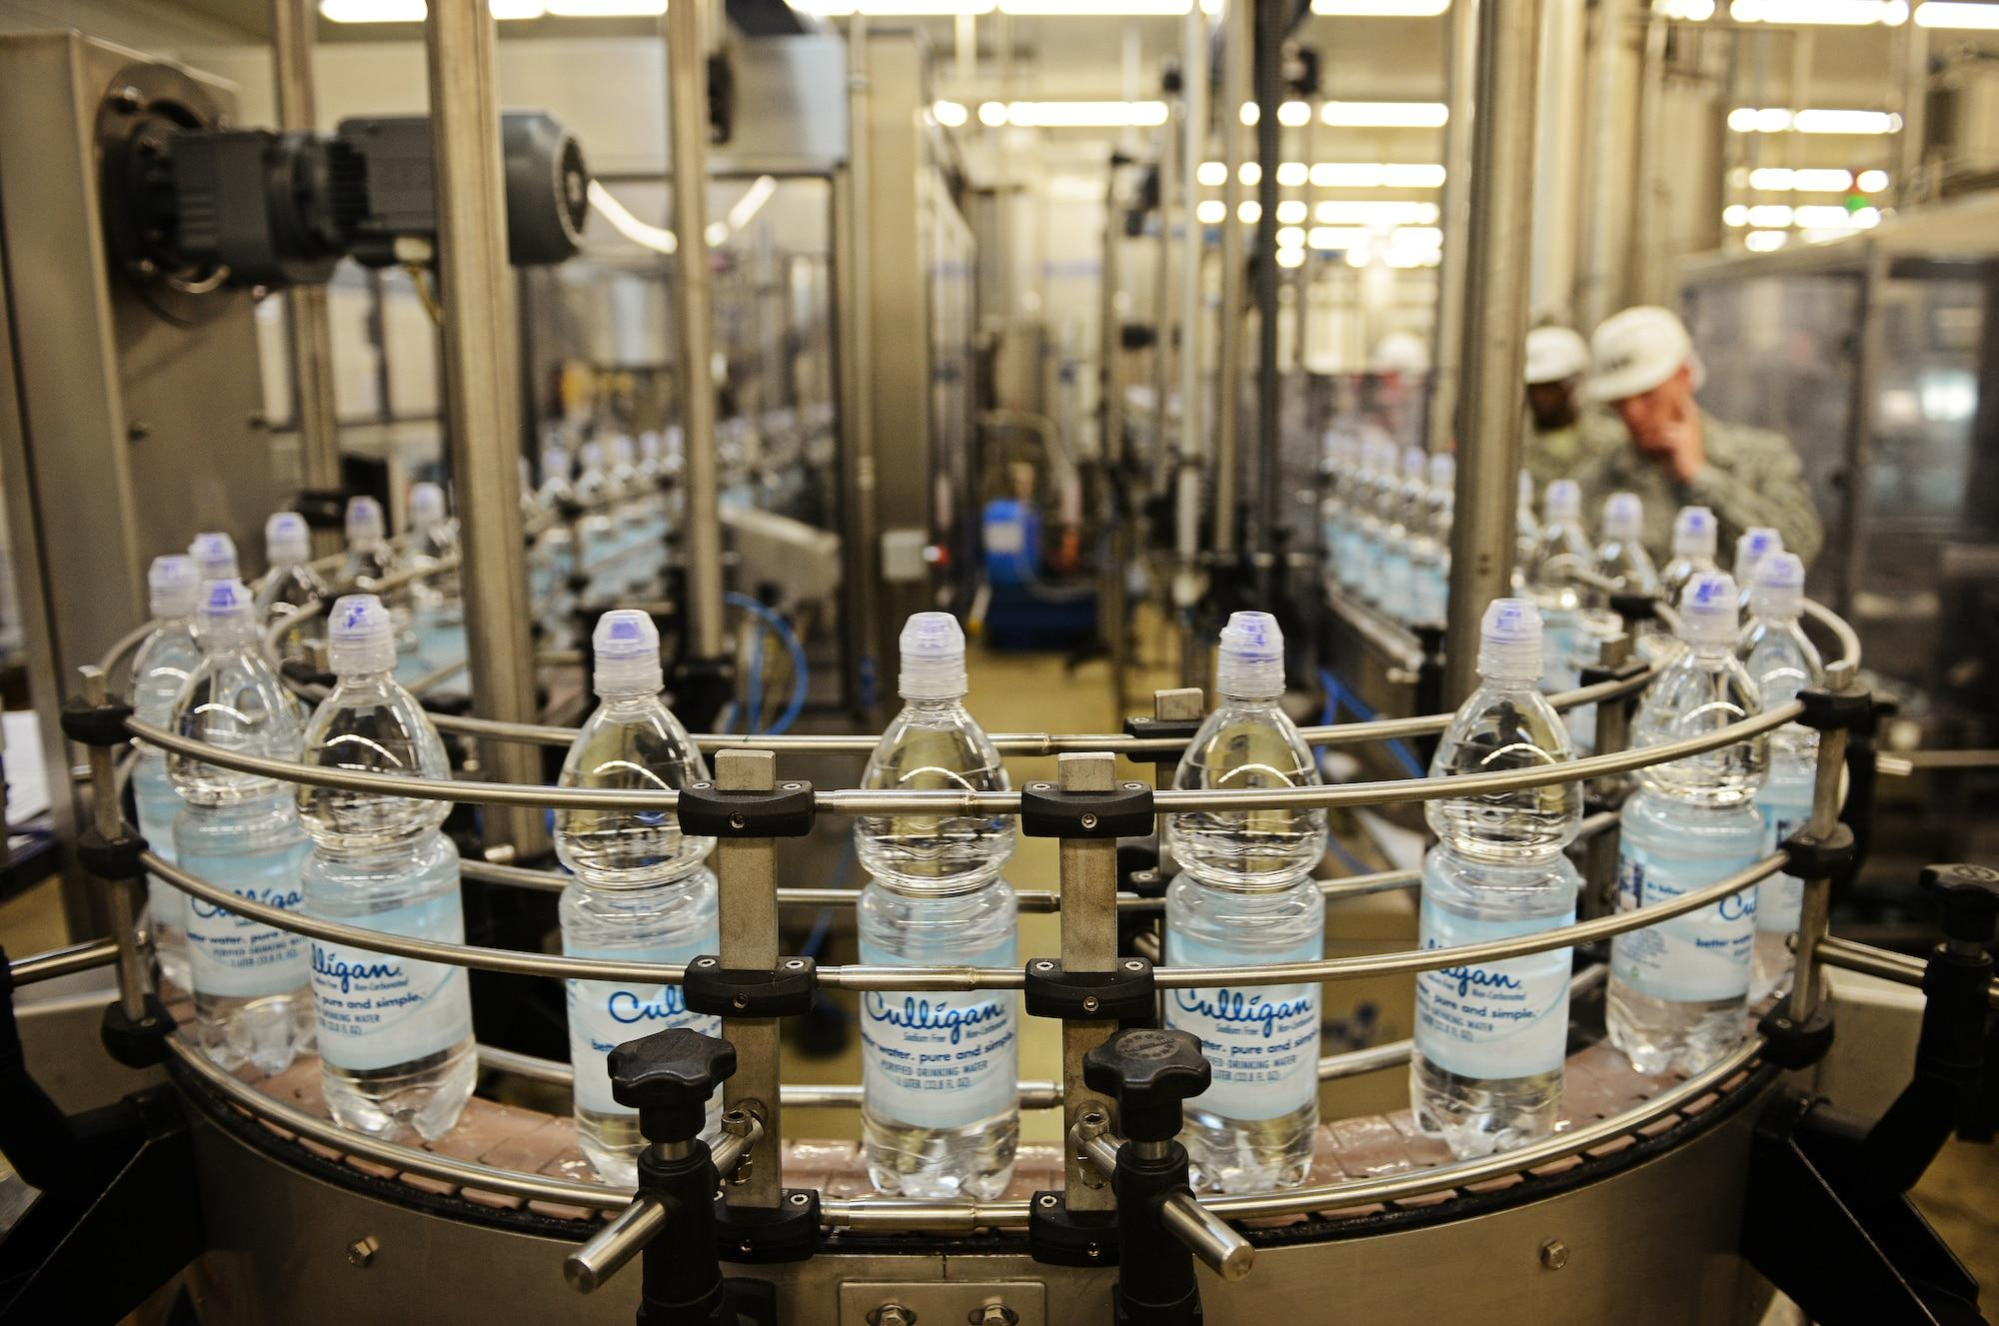
Notes:
Imagine you worked in a drink/liquid refreshment company, your job was expediting finished product and getting it distributed.

Slide 3
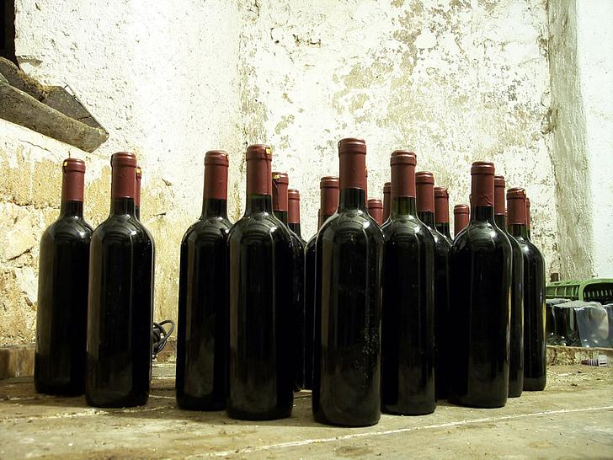
Notes:
What if the bottles had no labels?
And weren’t transparent? Or uniform in shape and size?
How would you know what was in them?
And what to do with them?
Open each and sample the product to identify?
Could switch to clear bottles, but there would still be some guesswork/margin for error
Learn more about processes; is there a specific type created in this specific areas/station?
What information do you need in order to manage these bottles of liquid refreshment?
[wait for them to answer]

Slide 4
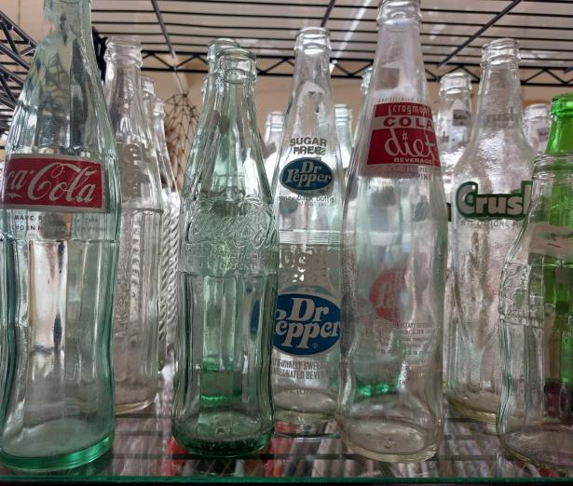
Notes:
What information do you need in order to manage and distribute these bottles of liquid refreshment? [take a look at the can in your hand for ideas]
Is the brand name of the soda it contains enough info?
Description, so you know what to expect (flavor, carbonated or non-carbonated, diet or full sugar, etc.)
Ingredients list: caffeinated or not; alcoholic or not
Nutrition info
Creation info (company, batch number, location)
Distribution info
Sell by date

Slide 5

Efficiency = $$$
Notes:
Over the years, there have been many improvements in the way they process and produce drinks bcz increased efficiency = $$$
Streamline
Specialize
Standardize

Slide 6

Your agency is producing records
Label?
Description?
Creator info?
Ingredients list?
Distribution info?
Sell-by date?
Location?
Notes:
Your agency is producing records the way that company is producing bottles of soda/drink.
When records come “off the line,” do they have a label? Description? Ingredients list? Distribution info? Sell by date? Location they’re heading?

Slide 7
“Records management is the field of management responsible for establishing and implementing policies, systems, and procedures to capture, create, access, distribute, use, store, secure, retrieve records, and ensure proper disposition at the conclusion of organization's records and information lifecycle.”
- ARMA International
Notes:
Records management is the field of management responsible for establishing and implementing policies, systems, and procedures to capture, create, access, distribute, use, store, secure, retrieve records, and ensure proper disposition at the conclusion of organization's records and information lifecycle.
- ARMA International

Slide 8
Learning Objectives
Understanding Record Series
Using Retention Schedules
Making Records Management Plans
What questions do you have?
Notes:
Today we will talk about
Understanding Record Series
Applying Retention Schedules
Making Records Management Plans
But before we get started:
How many people have been to a RIM training before? How many is it their first time?
What questions do you have that you would like answered today? (about RIM)

Slide 9
Understanding Record Series

Slide 10

Record Series = Group of Records
Like aisles in a grocery store - arranging records in groups can help us provide better care and access.
Related in a logical way
Document a business process
Share a relationship
Every record within a series is retained for the same amount of time
Designation, Use Statements, Privacy annotations
Notes:
Record series = group of records related in a logical way: they may document a particular transaction, function, or subject; and should share a relationship based on how or why they are created or how they get used and maintained over time. Any records kept together in an identified records series should be retained for the same amount of time, and destroyed together when that time expires.
Designating GRAMA classification and collection purpose statements are also applied at the record series level.
Like aisles in a grocery store, arranging records in groups can help us provide better care and access.

Slide 11

Identifying Record Series
Drinks = 1 series
OR
Water = 1 series
Soda Pop = 1 series
Sugar-Free Soda = 1 series
Lemonade = 1 series
Hard Lemonade = 1 series
OR
Expired drinks = 1 series
Sellable drinks = 1 series
Notes:
There are many different ways to identify a records series and to group records. Keeping with our analogy of drinks, we could categorize drinks as one series (drinks), or as many series (maybe based on type—water, soda pop, sugar-free soda pop, lemonade, hard lemonade, etc.) OR as two series: one for drinks past their expiration date, and one for drinks that can still be sold (legally).

Slide 12

Identifying Record Series
Contracts = 1 record series
OR
Simple contracts = 1 record series
Fixed-price contracts = 1 record series
Incentive contracts = 1 record series
OR
Expired contracts = 1 record series
Active contracts = 1 record series
Notes:
Let’s apply that concept to a real-world record example of contracts: we might organize contracts as one record series—as long as they all could be deleted or destroyed according to the same rules -- OR you may choose to create multiple series for different kinds of contracts (simple, fixed-price, incentive) OR one for active contracts and one for expired contracts.
Your decision to group records might be based on the volume and variety of contracts that you manage, and the care that they need.
For example: if you don’t have a large variety of contracts you might only want to distinguish between expired and active. Or if you have a large volume of contracts to manage annually you might want to divide them by contract type for ease of use.

Slide 13
Why Record Series Matter
Without identified record series:
Lack of oversight and organization
Data may be kept too long or too short
Personal data may be misused
Unauthorized secondary use
Increased breach impact
Notes:
Why do record series matter?
Without identified record series:
Lack of oversight and organization
Data may be kept too long or too short
Personal data may be misused
Unauthorized secondary use
Increased breach impact

Slide 14
Do you need to create a record series with DARS for every record you create?
Required to:
  Identify, evaluate, and classify/designate every record series and report them to DARS, per 63A-12-103(8); and
  File a statement with DARS explaining the purpose for which each private or controlled record is collected, maintained or used , per 63G-2-601(1).
No automated way to report these things to DARS, and
DARS staff members don’t have the capacity to enter each and every record series for each and every governmental entity in Utah into DARS’ system.
  Multiple options for agencies
Notes:
Sometimes people ask: Do you need to create a record series with DARS for every record you create? (or some version of that question)
Each governmental entity is required to:
identify and classify/designate every record series and report them to DARS, per 63A-12-103(8); and
file a statement with DARS explaining the purpose for which each private or controlled record is collected, maintained or used , per 63G-2-601(1).
There’s no automated way to report these things to DARS, and DARS staff members don’t have the capacity to enter each and every record series for each and every governmental entity in Utah into DARS’ system. Therefore, DARS has provided multiple options for agencies to meet the requirements to report their record series, along with the required information about classification and designation, purpose and use, to DARS.

Slide 15
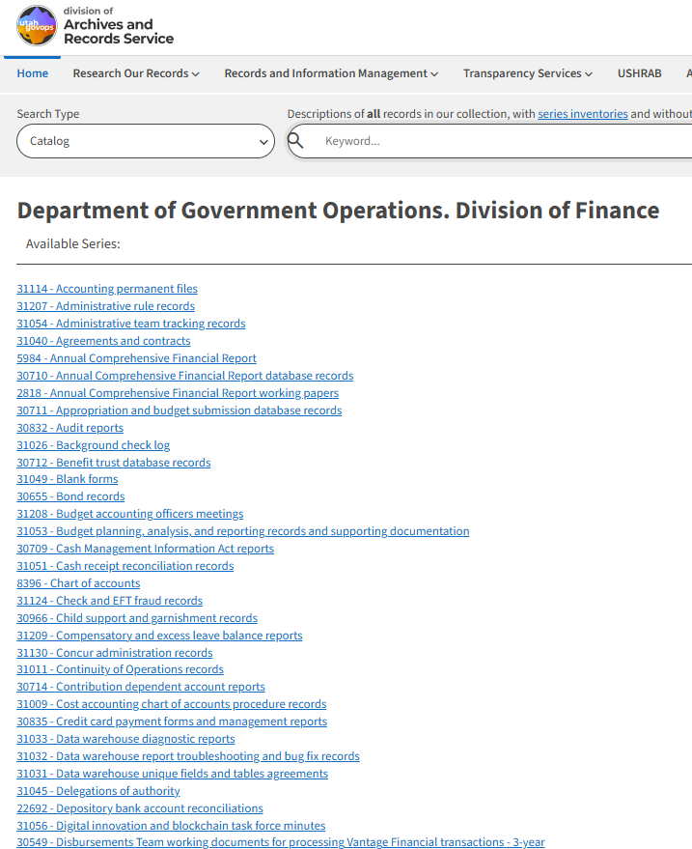
Option
1
Working with a DARS RIM specialist, create a data file in DARS' system for every record series, with the required elements specified
Notes:
Option 1
Working with a DARS RIM specialist, create a data file in DARS' system for every record series, with the required elements specified

Slide 16
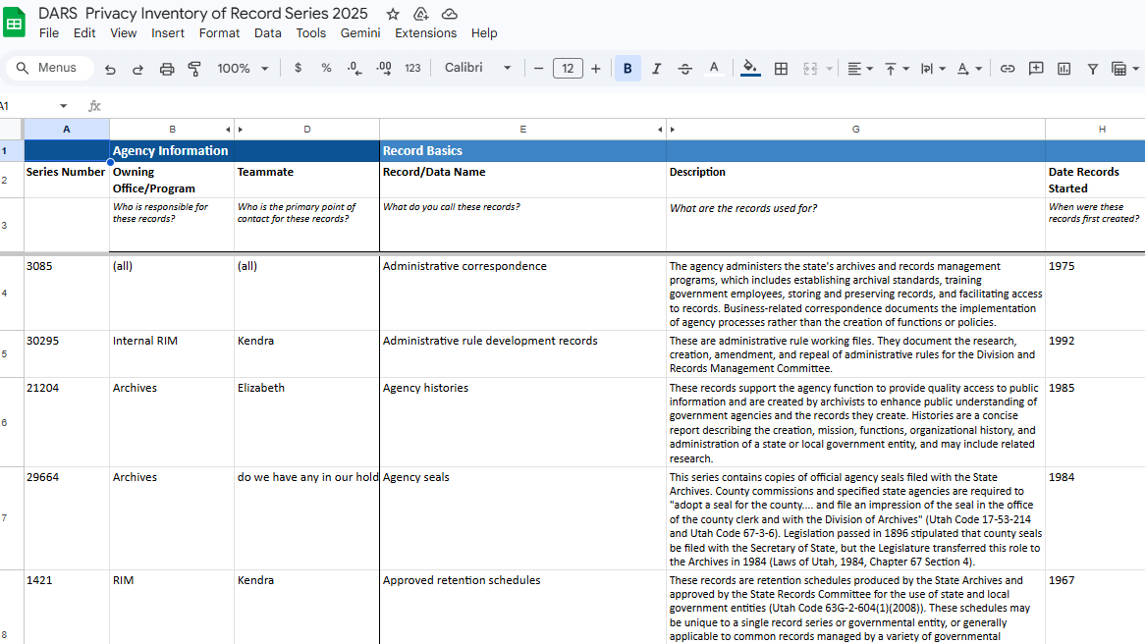
Option
2
Create an in-house inventory spreadsheet that lists every record series, along with the required elements, and share the spreadsheet with DARS.
Inventory Spreadsheet Template
Email recordsmanagement@utah.gov to share the spreadsheet with DARS
Notes:
Option 2
Create an in-house inventory spreadsheet that lists every record series, along with the required elements, and share the spreadsheet with DARS.

Slide 17
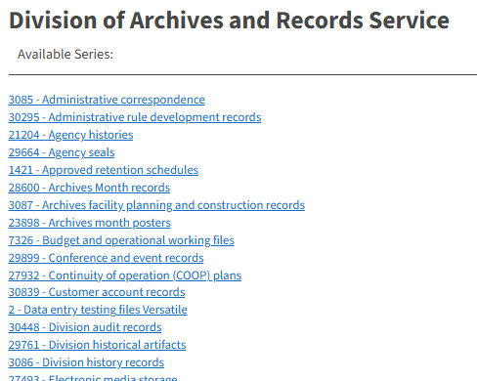
Option
3
Create an in-house inventory spreadsheet that lists every record series and share the spreadsheet with DARS.
AND
Some record series, like those with private or controlled information or personal data, are documented in DARS' system
+
Notes:
Option 3 is a hybrid of options one and two:
create an in-agency inventory spreadsheet that lists every record series and share the spreadsheet with DARS,
AND
document some record series—perhaps those with private or controlled information or personal data—in DARS’ system, along with the required elements.

Slide 18
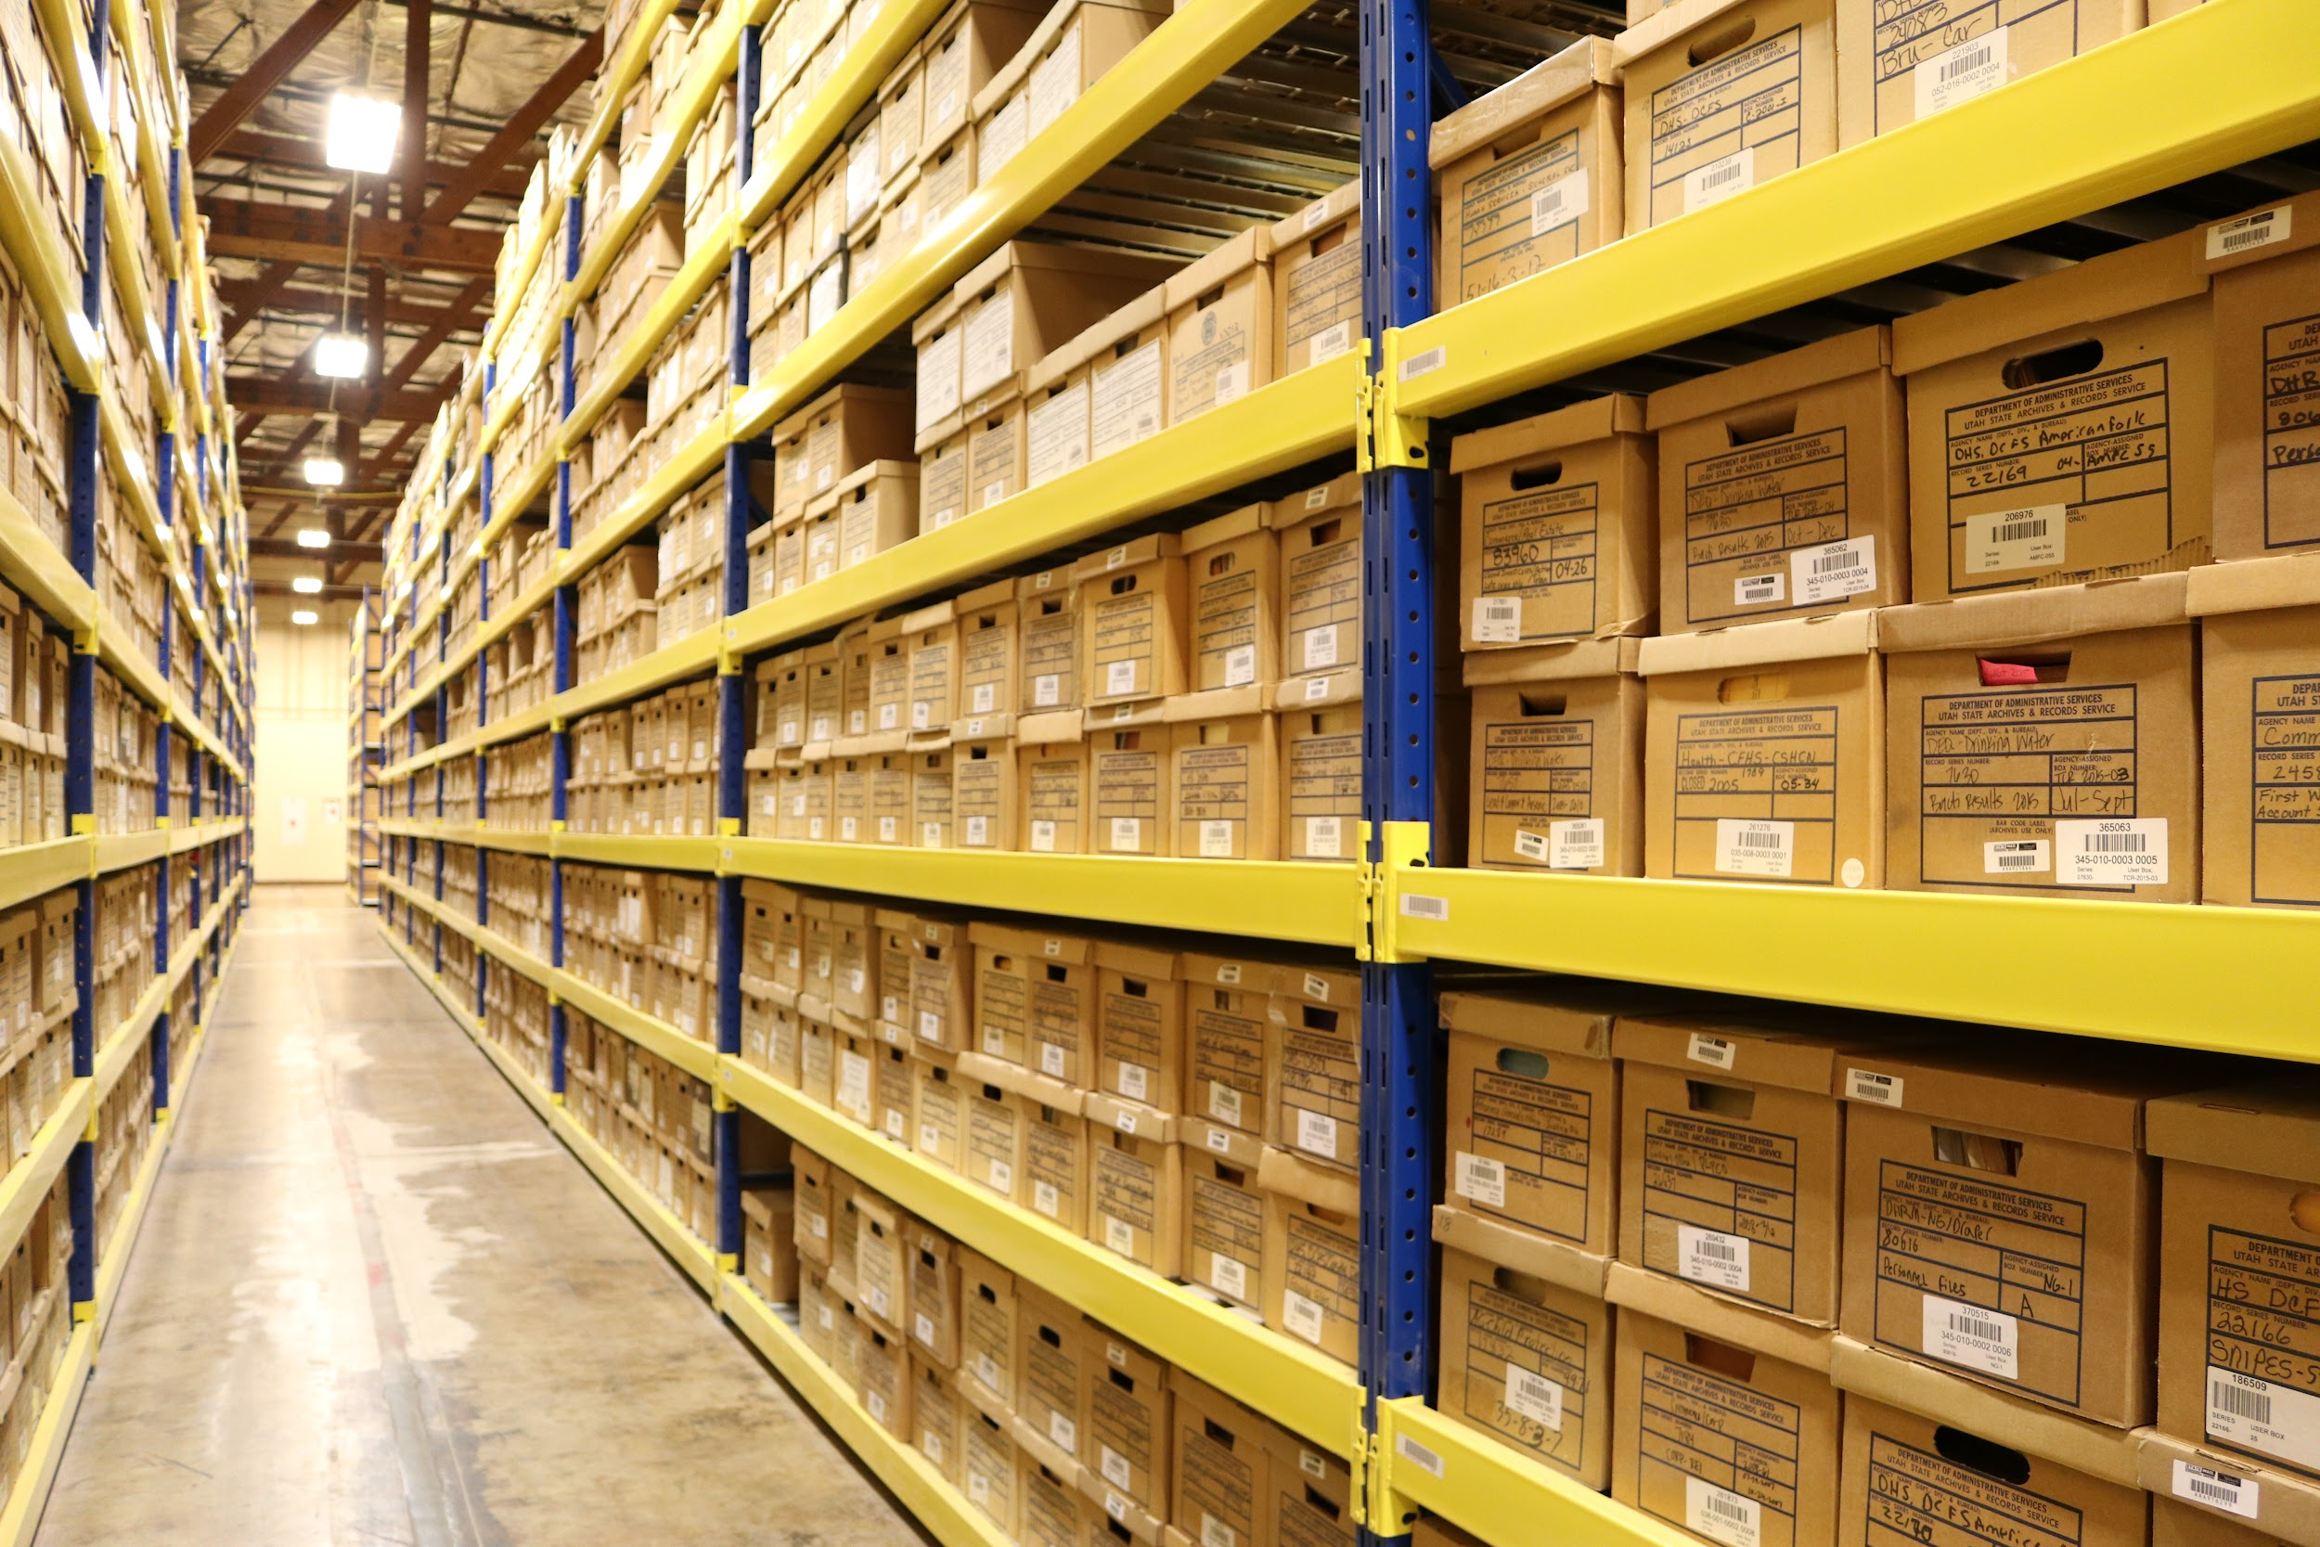
State Records Center, Clearfield
Please Note
Record series must be added/documented in DARS’ system if the records:
Retention needs to be approved by the Records Management Committee (RMC),
Are stored at the State Records Center, or
Are being transferred to State Archives
The option you choose must be applied consistently across your entire organization and documented centrally.
Notes:
Record series must be added/documented in DARS’ system if the records:
Retention needs to be approved by the Records Management Committee (RMC),
Are stored at the State Records Center, or
Are being transferred to State Archives
The bottom line: you need to have a complete list of all of your record series somehow, somewhere. The option you choose should be applied consistently across your entire organization and documented centrally.
If you have questions or would like to discuss options, talk to your RIM Specialist.

Slide 19

Specific type/flavor | Unique ID
Name of Product | Title
Bottling Company: Name & Location | Creating agency
Date bottled | Dates
Product descriptions: flavor, list of ingredients, carbonation, sugar-free, etc. | Description: Process they document, how they’re used, what’s included
Nutrition Facts | Appraisal
Design of container | Media format, Arrangement
Sell-By Date & Recycle Info | Retention & Disposition
Restrictions around access? Caffeine or liquor content | Designation & Classification
Cost | Privacy Annotation
Record Series Profile
Notes:
One thing I want to clarify:
Every agency creates records, and all records are part of a record series, even if it hasn’t been identified or documented officially.
Documenting a record series is like creating labels for a bottle of soda.
Required fields for a record series, whether it’s in the DARS system or not, include:
Unique ID
Title
Creating agency
Dates
Description
Appraisal
Media formats, Arrangement
Retention and Disposition
Designation & Classification
Privacy Annotation

Slide 20
Record Series Retention Schedule
≠
Notes:
Another common misunderstanding I want to clear up: Record series does NOT equal retention schedule. They are not the same thing.
They are related, but not synonymous.

Slide 21
Specific type/flavor | Unique ID
Name of Product | Title
Bottling Company: Name & Location | Creating agency
Date bottled | Dates
Product descriptions: flavor, list of ingredients, carbonation, sugar-free, etc. | Description: Process they document, how they’re used, what’s included
Nutrition Facts | Appraisal
Design of container | Media format, Arrangement
Sell-By Date & Recycle Info | Retention & Disposition
Restrictions around access? Caffeine or liquor content | Designation & Classification
Cost | Privacy Annotation
Record Series Profile
Retention is just one characteristic of a record series
Notes:
Retention is just one characteristic of a record series, one or two pieces of information on the label of your record series, right?
The record series profile does so much more than just tell you how long to keep the records and what to do with it when you’re done with it (aka retention and disposition).
The other elements are equally important for managing the records.

Slide 22
What is a retention schedule?
Notes:
Before we go any further, we should probably talk about what a retention schedule is.

Slide 23
Using Retention Schedules

Slide 24







Records & Information Lifecycle
Use
Access
Retention & Storage
Disposition
(Destroy or Preserve)
Creation or Collection
Collaboration & Sharing
Security & Privacy must be considered throughout all phases of the information lifecycle
Notes:
This is the data and records lifecycle, which data governance professionals use to break down the stages of records management.
First we create or collect records
Second: we use the records for various business processes
Third: We use the records to collaborate, or we share the records with others who have legitimate use for the records, making considerations for the various versions that now might exist
Forth: We organize the data and records in order to provide access—whether that is for business purposes, legal discovery, or GRAMA requests!
Fifth: We plan and manage the storage of the records by identifying how long they need to be kept based on our various needs for the records
Finally, we dispose of the records we no longer need through destruction OR transferring records that have a permanent or historic value to a place where they can be adequately preserved!
Security, Privacy, & Risk Management must be considered throughout all phases of the information lifecycle

Slide 25
Retention Schedule
How long you need to keep something based on your use and/or statutory compliance
What to do with it when that time comes
Aka Disposition authority
Notes:
Retention schedule tells you
How long you need to keep something based on its use to your agency and statutory regulations
What to do with it once you are done with it
Retention schedules are also called disposition authority.

Slide 26
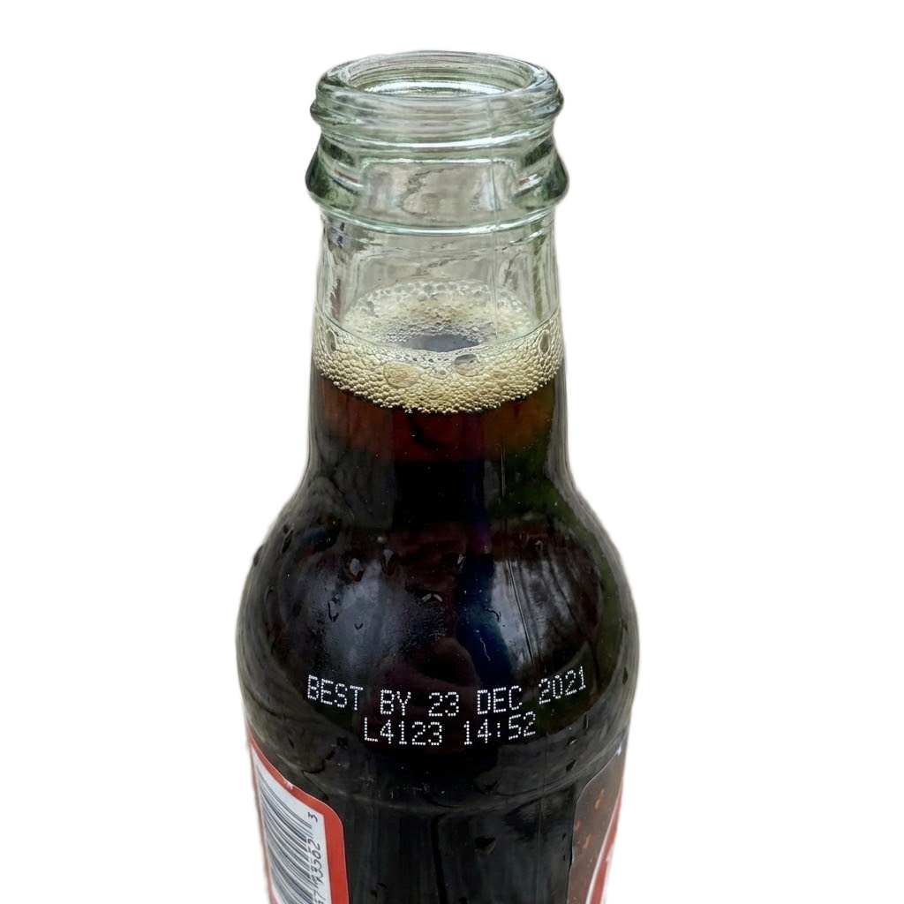
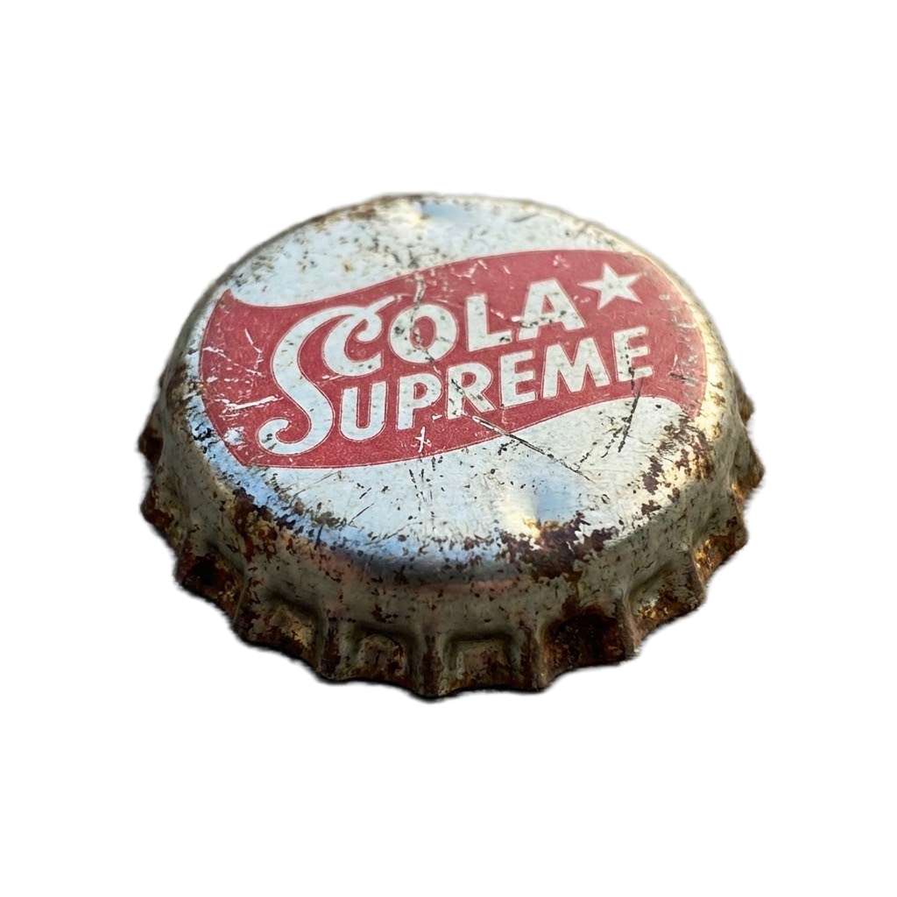
Retention Schedule = Expiration Date
Notes:
In other words, a retention schedule provides us our expiration, or sell-by date. Because no one wants to open a soda and discover it’s lost all its fizz, right?

Slide 27
Developing Retention Schedules:
Records Appraisal Values
Administrative
Fiscal
Legal
Historical
Notes:
The retention schedule is based on the usefulness or value of the record.
The process of figuring out the value of records is called appraisal. Appraisal is often associated with a monetary assessment. But in this case a records appraisal is assessing the usefulness value of the information contained in the records to our business practices and/or statutory requirements.
Records can be valuable in different ways:
They can be administratively valuable for as long as they are needed to carry out the functions of a governmental entity.
They can be fiscally valuable if they are needed to document the expenditure of public funds and to fulfill government financial obligations.
They can be legally valuable if they are needed to provide evidence of the legal rights or obligations of the government or its citizens, or to ensure compliance with laws and regulations.
They can be historically valuable if they contain information that documents the history of government or the community.
Records with historical value become part of the historical record of the state after their administrative, fiscal, and/or legal purposes have been served.

Slide 28



Determining Retention
Purchasing Team
Legal Team
Financial Team
Notes:
Using our earlier example of contract records, here is how this one record type might be appraised differently by the various people involved in its use:
Contract example:
Purchasing Team - For the sake of our example let’s say that our Purchasing Team is in charge of negotiating a contract with a vendor. The team draws up a contract for a needed service, this creating our record. The Purchasing Team has a need to use the record only until the service is provided and then they have little administrative need for the record. (Let’s say it takes one year for our vendor to execute our service)
Legal Team - After creating the contract our Purchasing Team passes the record to the legal team to review it for terms and conditions and to ensure it complies with the law. The legal team wants to keep the contract to ensure that they have it to review in case the contracted service isn’t done correctly and they need to negotiate or sue. Let’s say the statute of limitations is 7 years for this service. So our Legal Team wants the contract around for that entire period of time after the contract expires.
Finance Team - Lastly our contract gets passed along to the Finance Team for review, as evidence of how much to pay the service provider. They want to keep the contract around for 4 years in case they are audited and need to provide proof of why they paid the service provider.
Despite its various uses - we keep the records for 7 years after it expires to meet its longest need. In this case a legal need

Slide 29
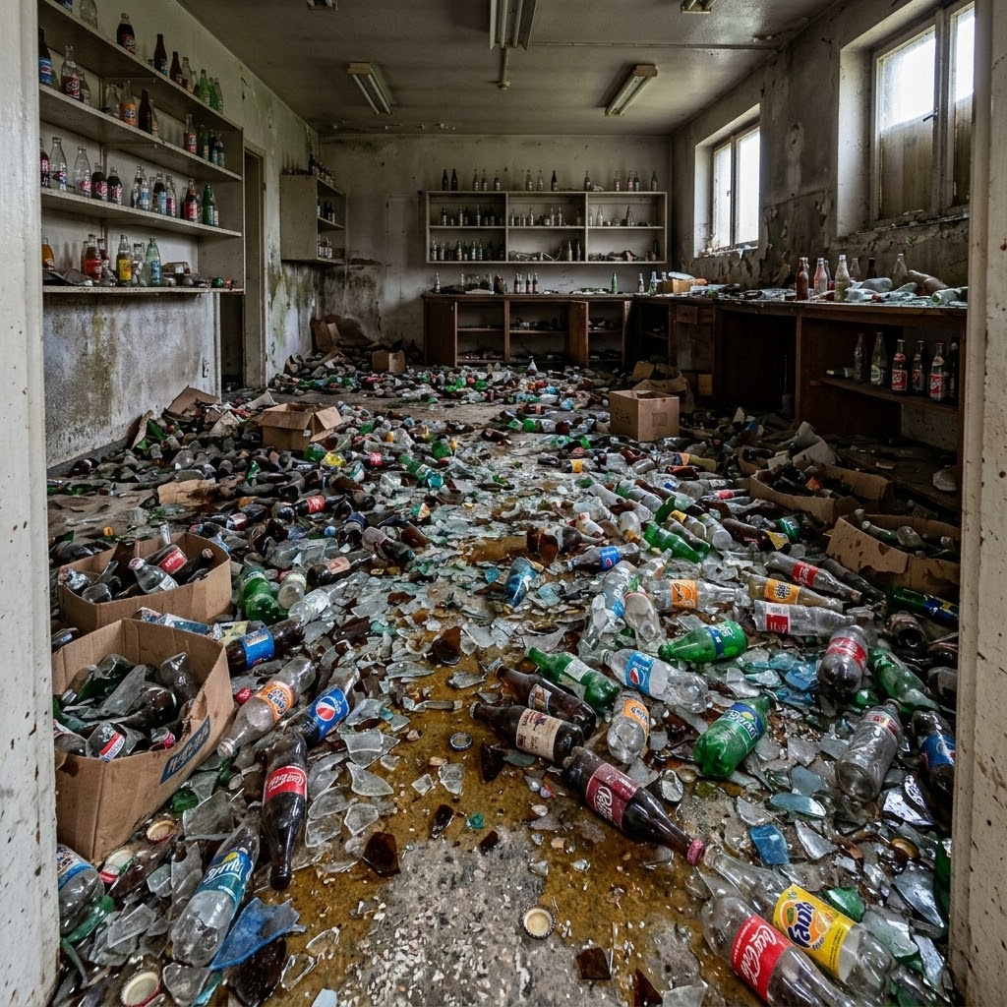
Data Minimization
Utah Code § 63A-19-401
Governmental entities must obtain and process only the minimum amount of personal data reasonably necessary to efficiently achieve a specified purpose.
Notes:
But we want to be careful not to keep things overlong. This is one of the places that RIM and data privacy intersect.
The principle of data minimization is fundamental to data privacy: Governmental entities must obtain and process only the minimum amount of personal data reasonably necessary to efficiently achieve a specified purpose.
Common Example: A state agency collecting detailed personal information (e.g., full Social Security numbers, full medical history, and demographic details) on a simple service form, like registering for a recreational program, where most of that data isn’t needed to provide the service.
A data minimization solution would be to redesign the form using a “minimum necessary” standard: collect only what is directly required (e.g., name, contact info, age range instead of birthdate), make sensitive fields optional or eliminate them entirely, and periodically review forms to remove unused or low-value data fields.

Slide 30
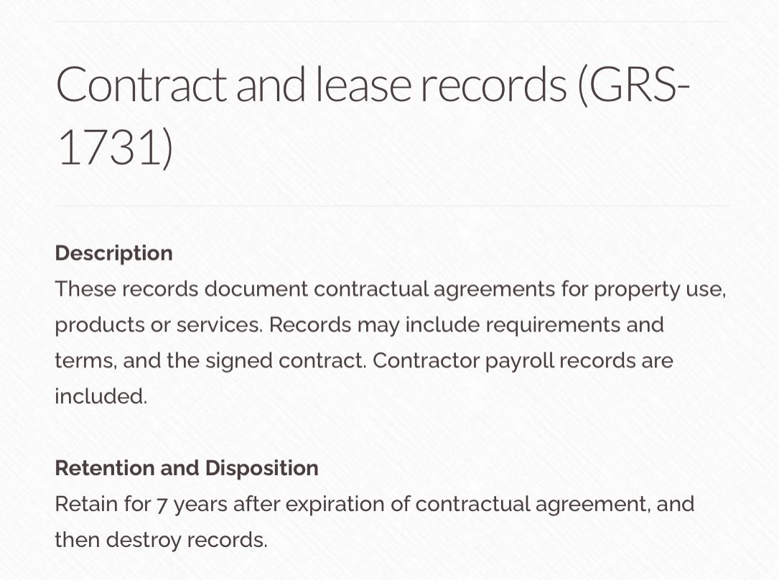
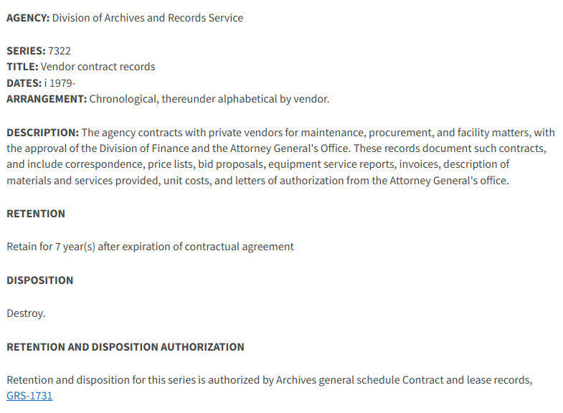
Retention Schedules
Info
Info
General Retention Schedule
Record Series-Specific Retention Schedule
Notes:
After we determine how long to keep a record, we want to write that decision down in an official policy. A collection of these retention rules is called a records retention schedule.
Here are a couple examples of retention schedules for contracts: You can see the retention and disposition noted below, that represents the records-use appraisal we previously discussed.

Slide 31

Approval Authority for Retention Schedules
Records Management Committee (RMC)
Notes:
All government records must have a legally approved retention schedule assigned to them to provide disposition authority. Identifying your governments records series through an inventory process and assigning them an approved retention schedule will ensure you are in compliance with this mandate. The State Archives provides options for finding or getting a legally approved records retention for your records, including:
The Records Management Committee (RMC), which is a public board appointed by the Governor’s office that has the responsibility to “review and approve schedules for the retention and disposal of records” generated by state and local governmental entities.

Slide 32
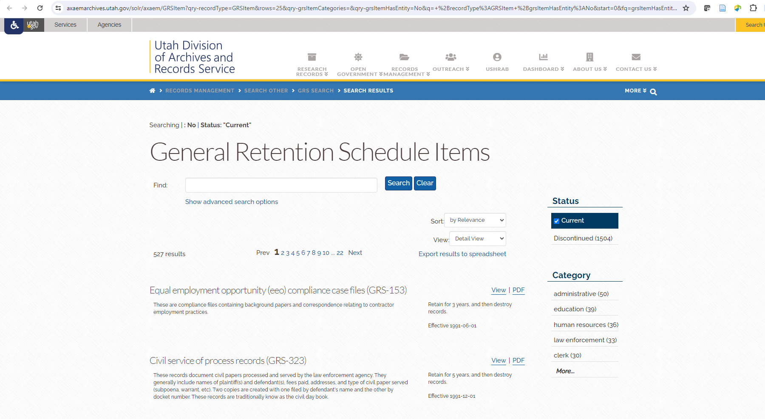
Notes:
The Records Management Committee, or RMC, reviews and approves the general retention schedule the State Archives has the responsibility to keep as outlined in the law. This tool can assist agencies to quickly identify pre-approved disposition authorizations for commonly created government records.
If you have not identified the retention schedules your government records are following, it is assumed that they are subject to the general records retention schedule.

Slide 33
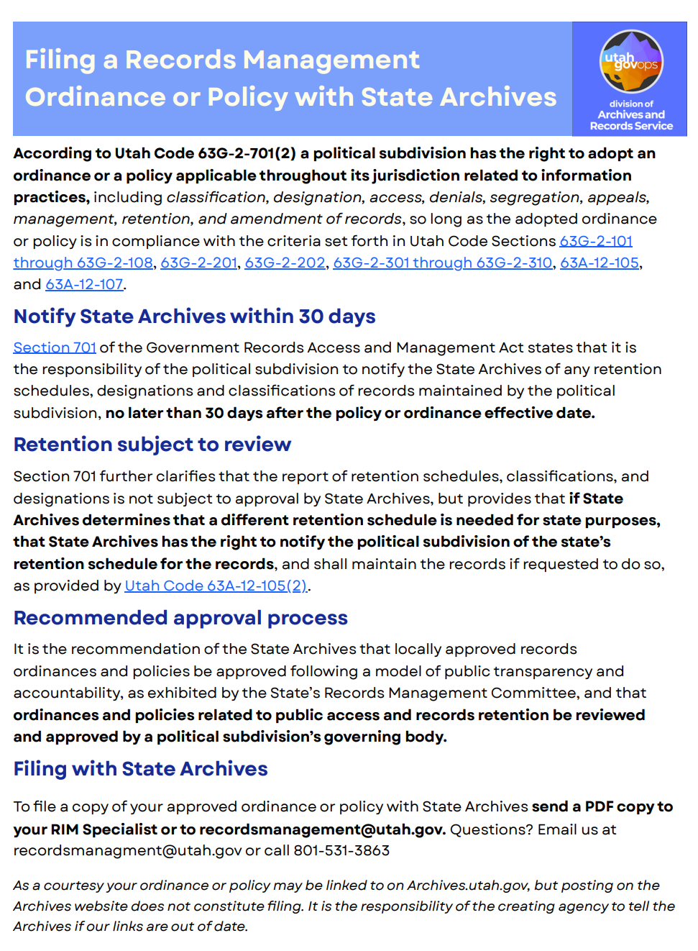
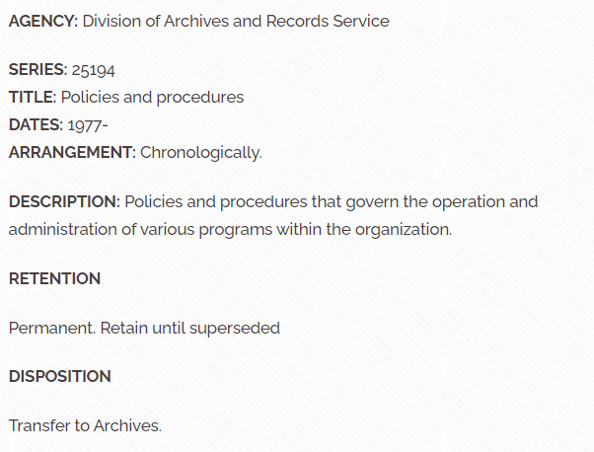
Approval Authority for Retention Schedules
Notes:
If the general records retention schedule doesn’t have a sufficient retention period to suit your disposition needs you have options for creating one that is unique to the records series you have identified. You can create a records-series specific retention schedule approved through the Records Management Committee OR, if you are a political subdivision of the state, you could have your governing body review and approved a records series retention plan for your entity.
If you are interested in learning more about either option a Records and Information Management Specialist would be happy to talk with you about the approval process.

Slide 34
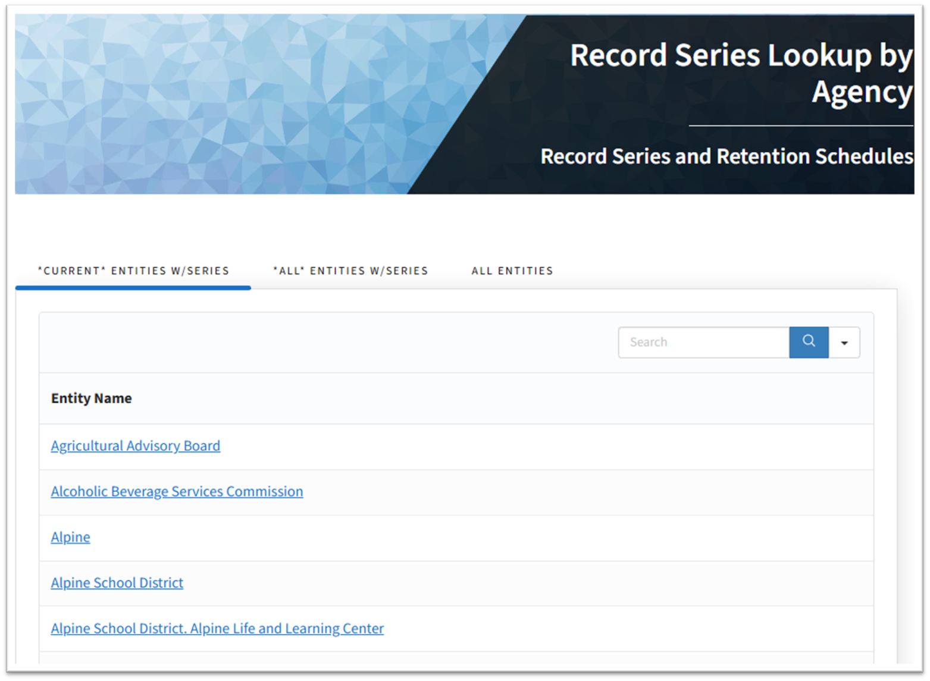
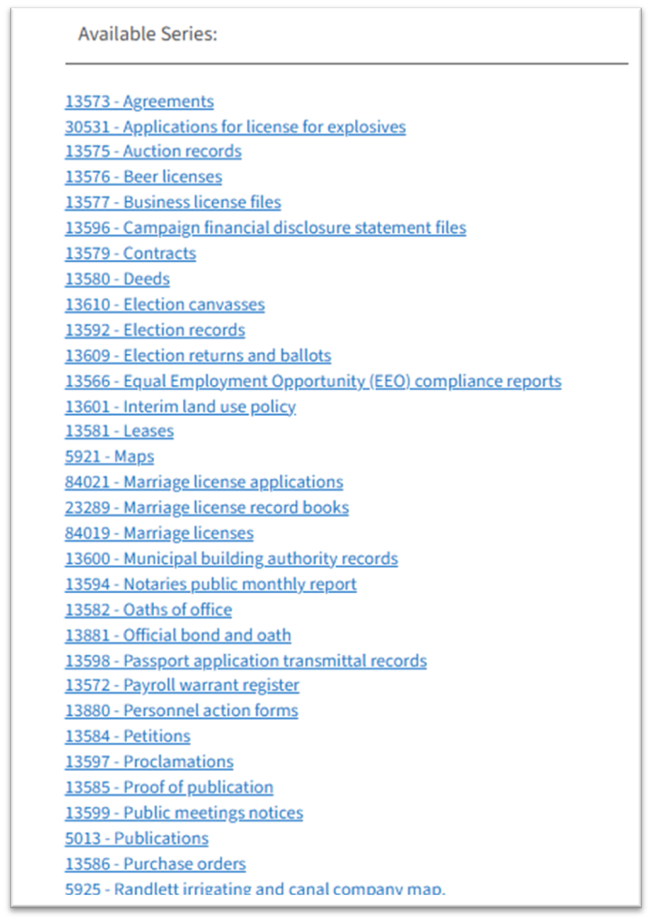
Finding Retention Schedules:
Record series lookup by agency
Notes:
Any questions about that?
Let’s look at how you can find retention schedules for your records.
First, you should look up your agencies record series that have been documented in the DARS system.
You can do this using the Agency series lookup.

Slide 35
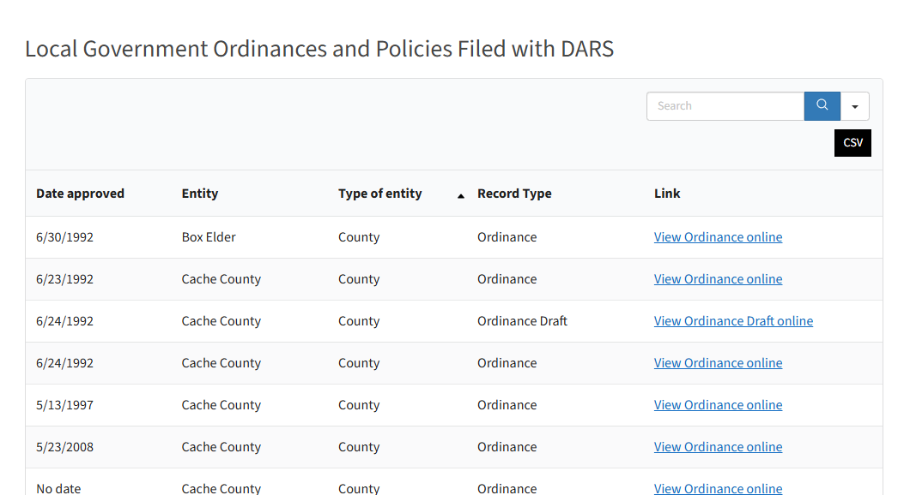
Finding Retention Schedules:
2. Local RIM ordinances & policies
Special Rules for Local Government
May adopt RIM ordinances or policies
Must report them to DARS
Ordinance/Policy lookup
Notes:
If you are a Local governmental entity, you should also look to see what RIM ordinances and policies your entity has officially adopted.
These are supposed to be filed with DARS within 30 days of being approved, though that doesn’t always happen.
You can look them up on our website.

Slide 36
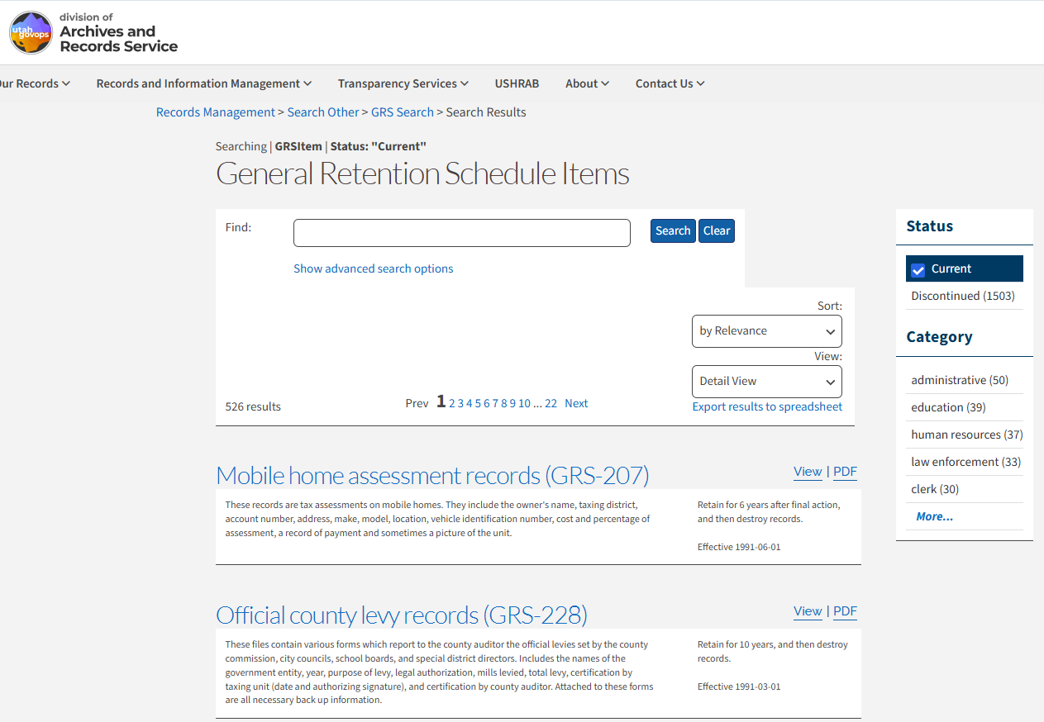
Finding Retention Schedules:
3. General Retention Schedules
GRS Search Interface
Notes:
The third place to look for retention schedules is the general retention schedule, maintained by DARS.
This is what the search interface looks like.

Slide 37
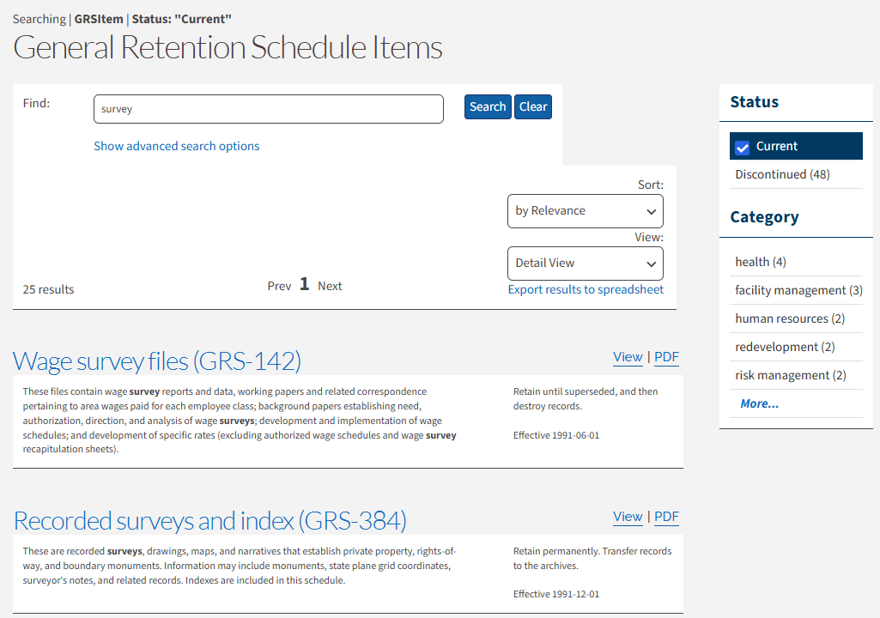
Interpreting Retention Schedules
There is a skill to finding the right GRS for your needs
TIP:
Function→Process→Records
⇵
Records→Process→Function
Search for “survey” returns 25 results, but which is the right one (if any)?
Notes:
There is a skill to finding the right GRS for your needs. Practice and experience go a long way.
But here is a tip that I think will help you:
Think about the process that creates the record that you need to find a retention schedule for.
Think about the reason you do that process, what function it fulfills, or contributes to.
Those processes or functions may be good search terms, and will certainly be useful info to have as you review the search results.
Let’s look at surveys as an example:
A search for survey returns 25 results.
How do I know which is the right GRS, if any? Well, what process was the survey part of? Was I surveying service users to find out how well our staff perform? Was I surveying a community to find out what they thought about the proposal for a new city hall? Was I surveying participants of a research study regarding disease control methods?
What was the function/purpose of the process? Managing personnel? Overseeing construction and development? Managing public health programs?

Slide 38
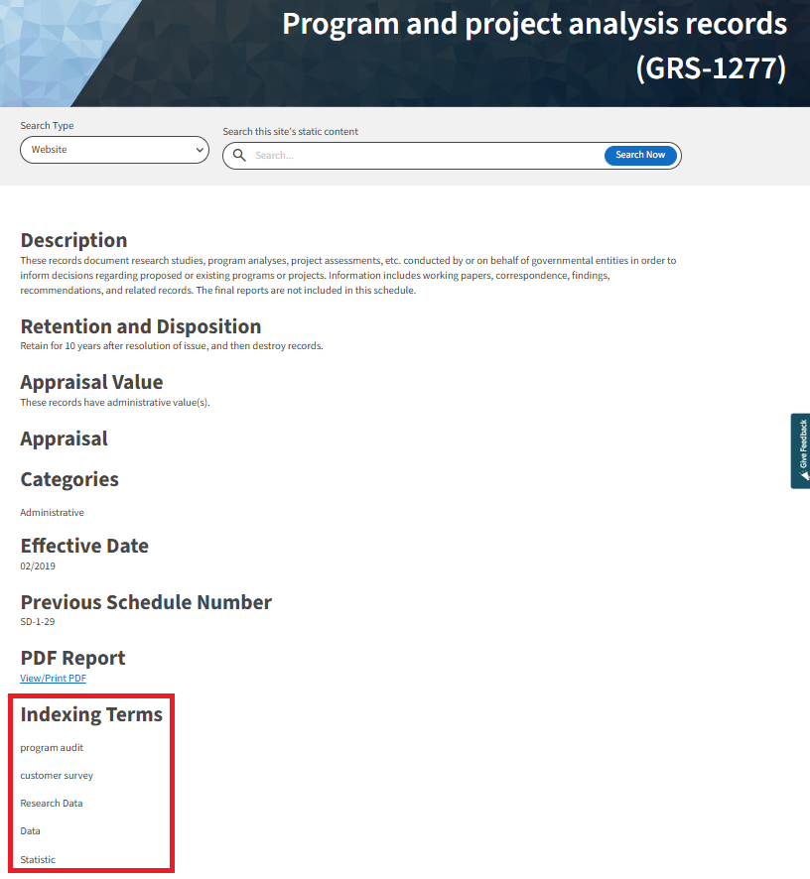
Interpreting General Retention Schedules
Context of the records is important!
They may not be listed by name in the description, but the process they were part of is.
Indexing Terms can be a clue.
Notes:
Let’s say I surveyed the public in my community to find out how well a new community intervention program was functioning, whether it was meeting any of its goals. And now I’m trying to find a retention schedule for those surveys.
This retention schedule for Program and Project Analysis Records doesn’t mention surveys in the description: “These records document research studies, program analyses, project assessments, etc. conducted by or on behalf of governmental entities in order to inform decisions regarding proposed or existing programs or projects. Information includes working papers, correspondence, findings, recommendations, and related records. The final reports are not included in this schedule.”
But the process that the records were part of—analyzing the effectiveness of program—is described here.
The indexing terms also provide a clue for us in this case: customer surveys are listed

Slide 39
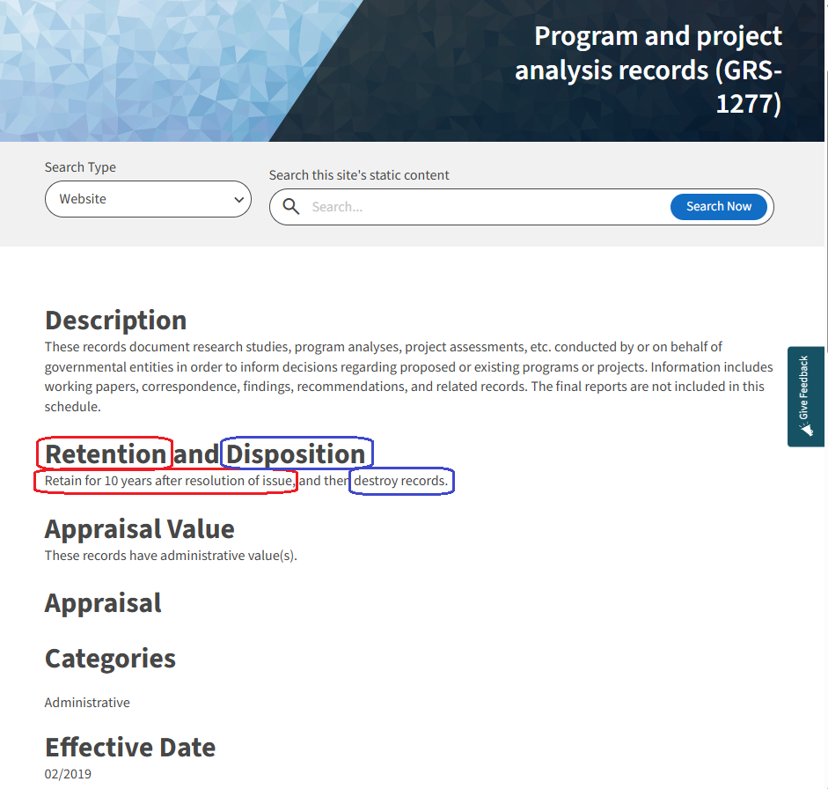
Applying Retention Schedules
Does it meet my agency’s need for the record?
Is it too long or too short?
Notes:
So this GRS looks like a good fit. But I need to look at the retention and disposition and make sure they meet my needs for retaining the record.
Retention = 10 years after resolution of issue
Disposition = destroy
If my agency determined it only needs the records for a very short time and is concerned about the risk of retaining personal data this long, this GRS might not work for us.
If my agency determined there was historical value to these records, this GRS won’t work for us.
In those cases, we could look for another schedule that might apply to the records and meet our needs; if we don’t find it, we’d work with our RIM specialist to create a series-specific retention schedule for the records.

Slide 40

Applying General Retention Schedules
Event triggers
  Clock starts after the event occurs
  May need to be further defined by your agency
Arrangement align with retention rule?
Notes:
One thing to be aware of as you are interpreting and applying retention schedules:
Some of them have Event triggers—these signal the beginning or end of a phase in the lifecycle that is relevant when calculating retention and disposition.
The retention period does not start until after the event happens.
Some of the triggers are vague and need to be defined by the agency: like “Resolution of Issue” Does that mean after the analysis is complete and the final report created? Or after the program is funded again or dissolved? Or…?
Examples of event triggers include: when the case closed, when the student graduates or an employee leaves employment, when a contract expires, a building is demolished, a person is born or dies, a grant is closed out, a construction project is completed, etc.
Another complication:
Does the natural arrangement or organization of the records align with the retention rule, or will the records need to be reorganized in order to purge them at the end of the retention period?
For example: Juvenile Justice offender records need to be kept until the offender is a certain age, so for the purposes of disposing of them correctly, we’d need them organized by birth date. However, while the offenders are in the system (staying in a detention center, etc.) you need to organize the records by the name or ID number of the subject—that’s how they are useful. Their birth date is irrelevant while you are using the records, but it’s the event trigger for disposal. So that needs to be planned around.

Slide 41
Disposition Phase: 2 Options
Destroy
or
Preserve Forever
(transfer to the State Archives)
Notes:
Inevitably at the end of your records retention period you will need to make considerations for what to do with your records (this is the disposition phase)
Records generally have one of two dispositions on their retention schedule:
destroy or “transfer to the State Archives,” where they can be preserved permanently.

Slide 42
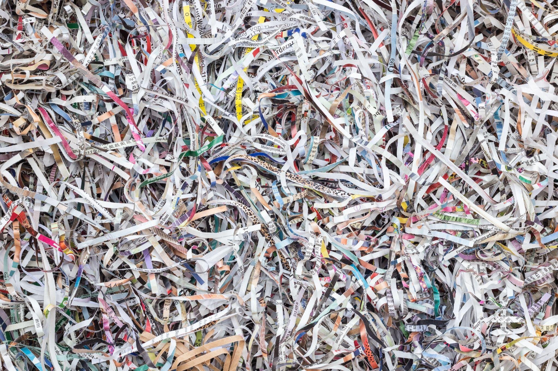

Managing Destruction
Establish a routine
Identify who is responsible for each copy
Destroy thoroughly—cannot be restored or recovered
Document the disposal & disposition authority
DON'T DESTROY RECORDS THAT ARE PART of ONGOING or ANTICIPATED LITIGATION, GRAMA REQUEST or APPEAL, or RECORDS BEING USED IN AN AUDIT
Notes:
Some tips for managing destruction:
Establish a routine for destroying records as part of your normal course of business.
Be clear about who is responsible for the destruction of each copy of the record, and how and when the records will be destroyed.
Destroy records and data thoroughly so that it cannot be pieced back together or recovered, even by a forensic data scientist
Document the disposal of records, citing the retention schedule which authorized disposal, the date, and the names of persons who disposed of the records.
A destruction log can prove invaluable if your records become part of an audit or litigation, but also simplify the process of responding to GRAMA requests by clarifying whether or not you possess the requested record. The log can also prove useful for agency staff looking for a record as well. (Model templates for destruction logs and more are available online)
Just be aware that routine destruction should be delayed if you know that records will be part of ongoing or anticipated litigation, a pending GRAMA request or appeal, or are being used in an audit
Once the litigation, audit, or appeal is resolved, the disposition resumes.

Slide 43
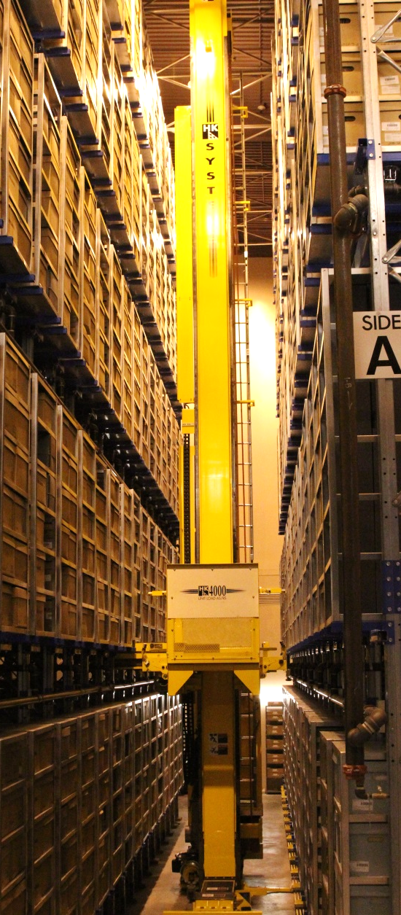
Permanent Records
If a record is appraised as having historical value, it will have a “permanent retention,” meaning it needs to be preserved forever.
Once the administrative, fiscal, and legal use ends, custody can be transferred to the State Archives in SLC, which is responsible for retaining the historical record of the state.
Notes:
If your record has been appraised as having historic value or has a permanent retention, the disposition of your records is “transfer to an archive” (meaning it doesn’t get destroyed after it has satisfied all of its business uses) you will need to make decisions about how you want to archive, and provide perpetual care for that record.
The State Archives can work with government agencies to take on custody of records that have historic value, and take responsibility for their permanent preservation and access. If you decide to keep records of permanent value in your agency, you will need to take additional steps to ensure that they are kept in storage conditions that provide the best chances for the records continued access and survival over-time.

Slide 44
Making Records Management Plans
Notes:
In addition to retention schedules, you need a records management plan for your record series. It’s part of establishing a RIM program.

Slide 45

You need a records management plan for your record series
Inventory
Organization & Location
Media & File formats (environment)
Record copy
Storage & Retrieval
Security
Privacy
Distribution
  Access for staff
  GRAMA Designation & Classification
  Sharing requests
  Discovery
Essential for COOP?
Retention & Disposition
  Transfer
  Destruction
Notes:
Elements of a plan include the things you would hope to see on your drink’s label:
Inventory to identify what it is. During this process:
Identify personal data
Identify private, protected, or controlled information
Describe how the records are organized & indexed
Media & File formats: The environment or system you need to retain it in for the period of time you designated
Document which is the Office of Record, Address backup and convenience copies
Address storage and retrieval at different phases of the lifecycle
Distribution
Access for staff
GRAMA
Sharing requests
Discovery
Security
Privacy
Post privacy notices; write privacy annotations
Identify Essential records—those necessary for resuming business, or Continuation of Operations
Retention & Disposition:
Transfer
Destruction
Security & Privacy must be considered throughout all phases of the information lifecycle

Slide 46
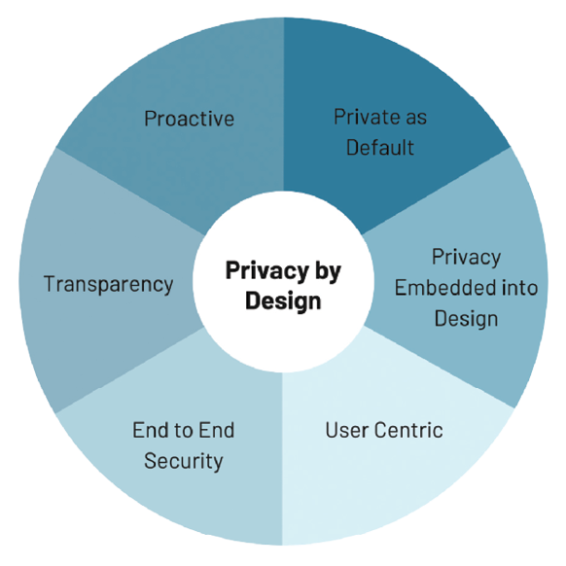
Title
Privacy by Design
Build privacy into systems, processes, and policies from the start.
  Limit data collection
  Protect information by default
  Transparency and accountability throughout the entire lifecycle.
Goal: When changing how data is collected, stored, or used, records officers should be the first call, not the last.
Notes:
Security & Privacy must be considered throughout all phases of the information lifecycle.
Privacy by Design
Privacy by Design means building privacy into systems, processes, and policies from the start.
Rather than adding it later, by limiting data collection, protecting information by default, and ensuring transparency and accountability throughout the entire lifecycle.
Goal: When changing how data is collected, stored, or used, records officers should be the first call, not the last.
Example: During the concept phase, a call is set up with potential vendors, include records officers early so they can address privacy considerations and ask key questions. Use Privacy Impact Assessments and data-sharing templates to guide the discussion.

Slide 47
GRAMA Designation & Classification
Title
Classification governs access
Protects some personal information
Applied when access is requested
May redesignate a record series or reclassify a record, record series, or information within a record at any time.
GRAMA Classification Types
Public
Private
Protected
Controlled
Exempt
Notes:
Classification, as used in GRAMA, is all about determining whether or not to disclose a record to someone.
Protects some personal information and some processes
Applied when access is requested
May redesignate a record series or reclassify a record, record series, or information within a record at any time.
Records can be classified as
Public
Private
Protected
Controlled
Exempt

Slide 48
Designation vs. Classification
Title
Series Designation applies to record series
Designation predicts typical classification
Record Classification applies to records or data
Classification applies to specific records
Notes:
Designation vs. Classification
Series Designation applies to record series
Designation predicts typical classification
Record Classification applies to records or data
Classification applies to specific records
When does Classification go wrong?
Over-restriction reduces transparency
Under-restriction exposes personal data

Slide 49
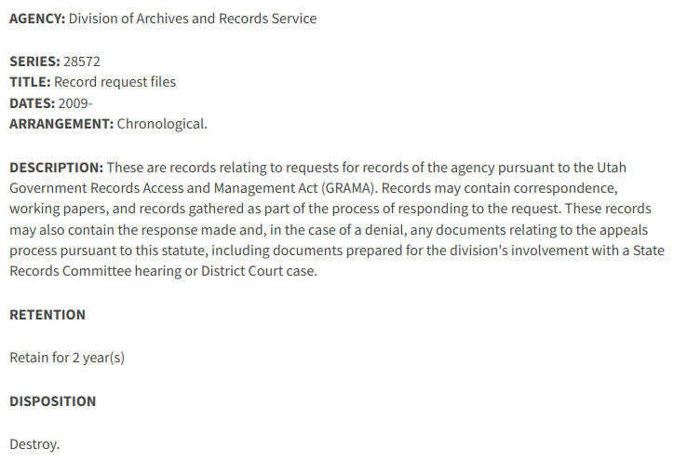
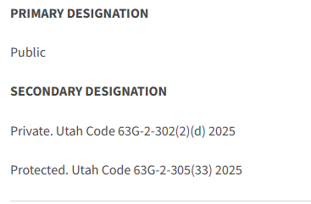
Record Series 28572, Record request files
Designation: Primary = Public; Secondary = Private, Protected

Slide 50
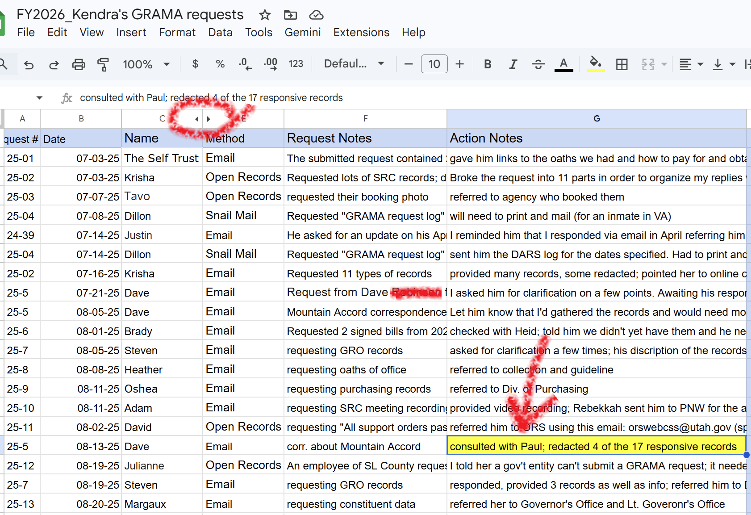
I receive a request for my GRAMA request log, which is part of Record Series 28572, Record request files
Look at the record to classify
Identify what isn’t public
Private per 63G-2-302(2)(d)
Protected per 63G-2-305(17)
Note: it’s different than was designated
Redact it and provide record
Notes:
I review the designation, then look at the record
I see that my log sometimes discloses personal information, particularly if the requester included it in their request (sometimes I copy and paste the wording directly into my log). For instance, someone requested the DCFS file of her son (by name), who was sexually assaulted. Not only is the name of her son personal data, but her name is as well. And in combination with the content of the request, as logged by me, was definitely too much information to share publicly.
I therefore classified some of the information in the record as private, per 63G-2-305(2)(d) (“contains data on individuals the disclosure of which constitutes a clearly unwarranted invasion of personal privacy”)
You can see that I hid the column of last names from my log, to anonymize the requests a bit. But I also had to make sure I didn’t leave last names in there anywhere.
I had to read through all of my notes before I could release the record, to classify the data. In addition to personal data that I felt shouldn’t be public, I also classified some data as protected, as it revealed the content of legal counsel I’d received, which was protected by attorney-client privilege. Now that specific classification subsection had not been included in my designation, but it doesn’t matter for the purposes of classification. I can classify a record or reclassify a record at any time. Maybe I’ll add that subsection to the designation at a later date; for now, I just cite it in my response and redact the offending note.

Slide 51

Data or Record Sharing
Title
Sharing includes vendors, contractors and other government agencies
Secondary use increases privacy risk
  Use must align with stated purpose
Processor vs Sub-processor
Tip: Inventory your contracts.
RESOURCES
Data Sharing Template
Guideline for Managing Data When Using a Third-Party Vendor
Notes:
Sharing Data or Records
Sharing includes vendors, contractors and other government agencies
Secondary use increases privacy risk
Use must align with stated purpose
Processor vs Sub-processor
Tip: Inventory your contracts. Ensure you have MOU’s or DSA’s in place that specify all aspects of ownership and management of the records.
RESOURCES:
ODP Template for data sharing
DARS Guideline for Managing Data When Using a Third-Party Vendor

Slide 52
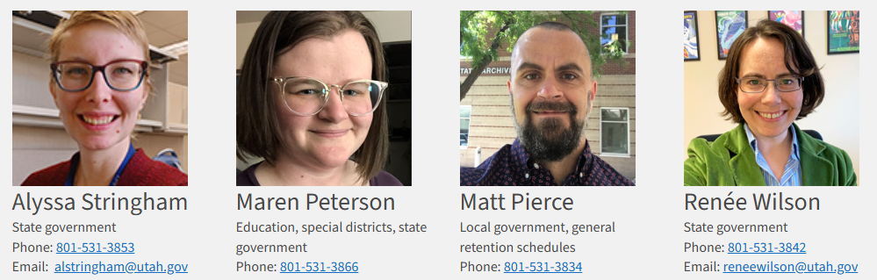
Help & Support
DARS, aka State Archives
Assigned RIM Specialist
ODP Website
Strategic Privacy Plan Guides
Retention Schedules
Inventory Template
RIM 101 recorded training
GRAMA 101 recorded training
Notes:
Speaking of Resources…Help & Support
DARS, aka State Archives
Assigned RIM Specialist
ODP Website
Strategic Privacy Plan Guides
Record Series Templates
Retention Schedules
Inventory Template

Slide 53
Title
Stay Connected
Join the Utah Office of Data Privacy Mailing List
  Receive updates, resources, and upcoming training opportunities.
Share Your Success Stories
  If your team has implemented a strong privacy practice, we’d love to highlight it.

Slide 54


May all your soda be full of bubbles!
DARS: recordsmanagement@utah.gov
ODP: officeofdataprivacy@utah.gov
Notes:
Thank you and May all your soda be full of bubbles!

